Slide 1
AIR QUALITY
2017
HEALTH AND CLIMATE CHANGE TRAINING MODULE SERIES
Minnesota Climate & Health Program | Environmental Impacts Analysis Unit
Notes:
This Air Quality & Health climate change training module is one of six one-hour introductions to the health effects of climate changes in Minnesota. The other training modules are:
Climate Change & Health 101
Agriculture & Food Security
Water Quality & Health
Extreme Heat Events & Health
Well-being & Health
These modules have been designed for public health professionals, as well as others concerned about climate change, to provide a basic level of information about the observed climate changes in Minnesota and their health impacts.
The training modules generally focus on climate adaptation (preparing for and adjusting to new conditions to reduce harm or risk of negative health outcomes), and includes some references to climate mitigation (reducing harmful greenhouse gas emissions) as well.

Slide 2
NOTICE
The Minnesota Department of Health (MDH) developed this presentation based on scientific research published in peer-reviewed journals. References for information can be found in the relevant slides and/or at the end of the presentation.
Notes:
The Minnesota Department of Health (MDH) developed this presentation based on scientific research published in peer-reviewed journals. References for information can be found in the relevant slides and/or at the end of the presentation.

Slide 3
OUTLINE
Introduction to air quality and public health
Climate changes in Minnesota
Climate change and air quality
Strategies: Public health professionals and individuals
Notes:
This module will provide an introduction to air quality and public health, address the observed climate changes in Minnesota, and explain how climate change will affect three major air pollutants linked to negative health impacts: particulate matter, ozone, and allergens. The module will wrap up with some general strategies on how public health agencies and local governments can mitigate or adapt to the changes in climate and air quality, and how individuals can also take actions to address climate change.

Slide 4
Clean air is essential for human health, thriving ecosystems, and a sustainable economy
Notes:
The production and maintenance of clean air is essential for overall human health and well-being, thriving ecosystems, and a sustainable economy.
Image: “Hot air balloon” – Pexels, https://www.pexels.com/photo/reflection-of-green-yellow-and-red-hot-air-balloon-in-lake-147540/

Slide 5
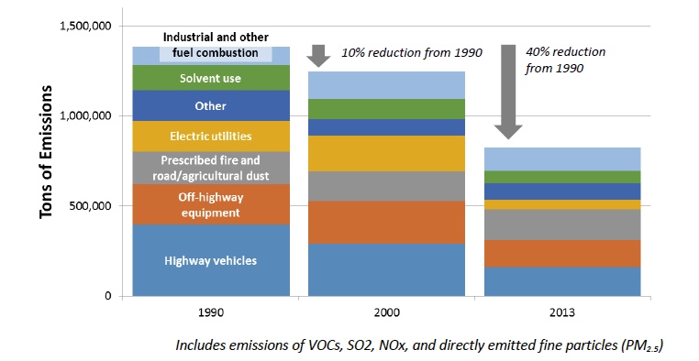
AIR QUALITY AND PUBLIC HEALTH
Trends in Minnesota Air Pollution Emissions by Source Category (1990 – 2013)
Notes:
Overall air quality in Minnesota has improved over the past 20 years, due in part to controls put in place under the Clean Air Act. Annual air pollution emissions in Minnesota have decreased by nearly 40% since 1990. The greatest emission reductions have been achieved by power plants (which are often considered “permitted” sources) with emissions falling by nearly 70% between 1990 and 2013.
Source: MPCA, 2015a

Slide 6
WHERE DOES AIR POLLUTION COME FROM?
On-road vehicles
Cars, trucks
Neighborhood sources
Small businesses, heating, wood smoke
Permitted sources
Power plants, factories
Off-road vehicles and equipment
Construction and agricultural
Notes:
However, air pollution is still a problem. There are four main categories of air pollutants in Minnesota, they include on-road vehicles, off-road vehicles and equipment, neighborhood sources, and permitted sources.
Source: Minnesota Pollution Control Agency, The Air We Breathe, 2017
Images: Minnesota Pollution Control Agency

Slide 7
POLLUTION EMISSIONS IN MINNESOTA
Small and widespread sources are the largest portion of overall air pollution emissions in Minnesota
On-road vehicles 24% Cars, trucks
Neighborhood sources 33% Small businesses, heating, wood smoke
Off-road vehicles and equipment 21% Construction and agricultural
Permitted sources 22% Power plants, factories
Notes:
Small and widespread sources are the largest portion of overall air pollution emissions in Minnesota. These sources include: on-road vehicles like cars, trucks and busses; off-road vehicles like construction and agricultural equipment; and neighborhood sources like small businesses, heating, and wood smoke.
While air quality in Minnesota currently meets federal standards, even low and moderate levels of air pollution can contribute to serious illnesses and early death.
Source: Minnesota Pollution Control Agency, The Air We Breathe, 2017

Slide 8
AIR QUALITY AND PUBLIC HEALTH
Persons affected due to exposure:
Certain occupations
Living adjacent to high traffic corridors
Athletes
Persons affected due to sensitivity:
Pre-existing health conditions
Young children
Elderly
Notes:
The risk to any one individual from air pollution is determined in part on factors related to exposure and sensitivity.
People who can suffer from long term (or chronic) exposures to air pollution include individuals in outdoor occupations such as truck drivers, construction workers, gas station attendants and others who are exposed to vehicle exhaust emissions for extended periods of time, or people who live adjacent to high traffic corridors.
People who can suffer from short term (or acute) exposures to air pollution may also include workers in certain occupations, as well as athletes who breathe faster and take in more air (and therefore more pollutants) during practice or competition, which can pose a health risk on high pollution days.
Examples of people with certain sensitivities to air pollution include:
Persons with existing health conditions such as asthma, diabetes, chronic obstructive pulmonary disease (COPD), allergies or cardiovascular disease. There is evidence to suggest that these conditions are significantly aggravated by exposure to air contaminants.
Young children
Elderly
Source: ALA, 2016
Image: “Cars in congestions” – Pexels, https://www.pexels.com/photo/traffic-cars-street-traffic-jam-7674/

Slide 9
OUTLINE
Introduction to air quality and public health
Climate changes in Minnesota
Climate change and air quality
Strategies: Public health professionals and individuals
Notes:
The next section will describe the observed climate changes in Minnesota.

Slide 10
WEATHER VERSUS CLIMATE
Weather: conditions of the atmosphere over a short period of time
Climate: conditions of the atmosphere over long periods of time
Notes:
Although related, the terms weather and climate are defined differently. Weather generally refers to conditions of the atmosphere over a short period of time (days or weeks), while climate refers to conditions of the atmosphere over long periods of time (30-year standard averaging period) (NASA, 2005).
Therefore, climate change refers to any significant change in the measures of climate lasting for an extended period of several decades (US EPA, 2016a).
Weather has always fascinated Minnesotans, perhaps because we have all kinds of it, but recently climate change has also become a leading topic of concern.
Source: NASA, 2005; US EPA, 2016a
Image source: Lightning bolt and sun – Microsoft Clip Art

Slide 11
DEFINITIONS
CLIMATE ADAPTATION: efforts to anticipate and prepare for the effects of climate change, and thereby to reduce the associated health burden
CLIMATE MITIGATION: efforts to slow, stabilize, or reverse climate change by reducing greenhouse gas emissions
Notes:
Actions to prevent the adverse health effects of climate change can be described as ‘adaptation efforts’ or ‘mitigation efforts.’
Adapting to climate change means anticipating and preparing for the effects of climate change and reducing the associated health burden.
Mitigating climate change means taking on or supporting efforts that slow, stabilize or reverse climate change by reducing greenhouse gas emissions.
Image: Microsoft Clip Art

Slide 12
CLIMATE AND HEALTH ARE LINKED
Notes:
MDH’s MN Climate & Health Program is dedicated to understanding the links between climate changes and adverse health impacts and identifying opportunities for implementing adaptation measures in Minnesota communities.
Recent climate change is resulting in warmer temperatures and changing precipitation. Most climate scientists attribute these changes to burning of fossil fuels, like coal and oil, to produce energy for everyday use. This burning adds heat-trapping gases, such as carbon dioxide, into the air. These gases are called greenhouse gases (NASA, 2016).
As this graphic shows, the rise in greenhouse gases is leading to increases in temperature and changes in precipitation. These changes are causing changes in air quality, weather patterns, water quality and quantity, and ecosystems which, in turn, are leading to more air pollution, extreme heat, floods & drought, and ecosystem threats.
Source: EQB, 2015; MDH, 2015; NASA, 2016

Slide 13
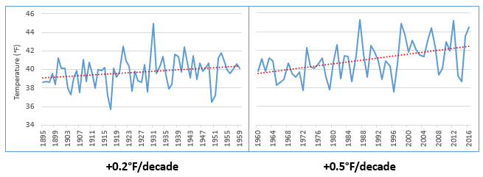
RISING TEMPERATURES
Minnesota Average Annual Temperature, 1895 -2016
Source: NOAA, 2017
Notes:
Minnesota has gotten noticeably warmer, especially over the last few decades. Since the beginning of the data record (1895) through 1959, Minnesota’s annual average temperature increased by nearly 0.2°F per decade, which is equivalent to over 2°F per century. This is shown in the graph to the left. This warming effect has accelerated over the last 50+ years. Data from 1960-2016 show that the recent rate of warming for Minnesota has sped up substantially to over 0.5°F per decade, which is equivalent to 5.0°F per century. This is shown in the graph to the right.
Source: National Oceanic and Atmospheric Administration (NOAA). 2017a. NOAA National Centers for Environmental information, Climate at a Glance: U.S. Time Series, Average Temperature, published February 2017, retrieved on February 9, 2017 from http://www.ncdc.noaa.gov/cag/

Slide 14
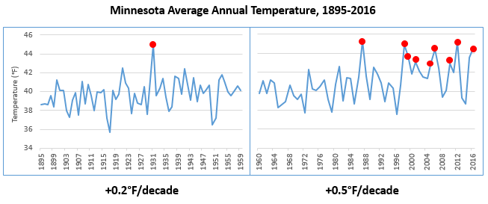
RISING TEMPERATURES
Minnesota Average Annual Temperature, 1895 -2016
Source: NOAA, 2017
Notes:
The increase in temperature trend is driving changes in the environment, affecting ice cover, soil moisture, bird migrations, insect behavior, and forest and plant growth. Based on more than a century of data, 9 of the top 10 warmest years for Minnesota, shown in the slide as the peaks with red points, have occurred just within the last three decades.
Source: National Oceanic and Atmospheric Administration (NOAA). 2017a. NOAA National Centers for Environmental information, Climate at a Glance: U.S. Time Series, Average Temperature, published February 2017, retrieved on February 9, 2017 from http://www.ncdc.noaa.gov/cag/

Slide 15
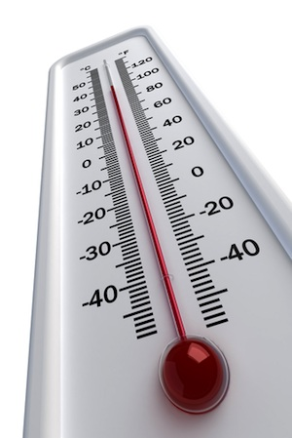
RISING TEMPERATURES
WINTER TEMPREATURES ARE RISING ABOUT TWICE AS FAST AS ANNUAL AVERAGE TEMPERATURES
MINIMUM OR ‘OVERNIGHT LOW’ TEMPERATURES ARE RISING FASTER THAN MAXIMUM OR ‘DAYTIME HIGH’ TEMPERATURES
NORTHERN MINNESOTA IS WARMING FASTER THAN SOUTHERN MINNESOTA
Notes:
Within this overall annual warming pattern, there have been three significant observations in Minnesota.
First, winter temperatures are rising twice as fast as the annual average temperatures. We are now experiencing more warmer winter temps, less snow and more winter rain, and changes in the amount of ice.
Secondly, minimum temperatures, which are the overnight lows, have been rising faster than maximum temperatures, which are the daytime highs. In just the last 30 years, average annual overnight lows have been rising at a rate of 6 degrees Fahrenheit per 100-year period.
And lastly, the northern part of the state is warming faster than the southern part of the state. Over the last 50 years, there has been a distinct spread of warmer overnight lows into the northern part of Minnesota. This is consistent with patterns seen across the Northern Hemisphere, where climate changes are occurring more rapidly at these higher latitudes.
Source: Zandlo, 2008; NOAA, 2017a
Image: Clip Art Images

Slide 16
ENVIRONMENTAL CHANGES
Changing Plant Hardiness Zones
After USDA Plant Hardiness Zone Map, USDA Miscellaneous Publication No. 1475, Issued January 1990.
Arbor Day Foundation Plant Hardness Zone Map published in 2015.
Notes:
The change in temperature is already causing substantial shifts in the environment. Maps of USDA plant hardiness zones show what types of plants will survive well and where. This is the standard by which gardeners and growers determine the plants that are most likely to thrive at a location. Zones are based on the average annual minimum winter temperature over a 30-year period and each zone represents a 10-degree Fahrenheit increment of minimum temperatures (USDA Agricultural Research Service, 2012).
This image from the National Arbor Day Foundation compares two points in recent times. In 1990, Minnesota was predominantly zone 3 in the northern half of the state and zone 4 in the southern half of the state. In 2015, Minnesota was predominantly zone 4 across the majority of the state, with a smaller area of zone 3 in the far northern part of the state and zone 5 emerging in the far southern part of the state.
These shifts may stress native plant species and may make it easier for non-native plants, and the insects and pathogens that rely on them, to move into areas where they previously couldn’t survive.
Source: USDA Agricultural Research Service, 2012
Image source: Plant Hardiness Zones – Arbor Day Foundation, 2015

Slide 17
PRECIPITATION INCREASES
Minnesota Average Annual Precipitation, 1895-2016
-0.2”/decade
+0.5”/decade
Notes:
With a warming atmosphere, more evaporation occurs. Warmer air can also hold more water vapor than cool air. The water holding capacity of air increases by about 7% per 1°C warming.
The graph on this slide shows Minnesota's average annual precipitation from 1895 to 2016. The graph on the left highlights the trend for the early part of the last century, 1895-1959, while the graph on the right highlights the trend for the most recent half century, 1960-2016. For most of the first half of the 20th century, the trend in precipitation was slightly downward, at a loss of 0.2 inches per decade or the equivalent of -2 inches per century. This downward trend was influenced by the Dust Bowl years of the 1930s. However, the rate of precipitation across the state has increased by nearly 0.5 inches per decade or the equivalent of 5 inches per century over the last 50+ years.
Source: Trenberth, 2011; National Oceanic and Atmospheric Administration (NOAA). 2017. NOAA National Centers for Environmental information, Climate at a Glance: U.S. Time Series, Precipitation, published February 2017, retrieved on February 9, 2017 from http://www.ncdc.noaa.gov/cag

Slide 18
PRECIPITATION – MORE EXTREME EVENTS
1860s
1870s
1880s
1900s
1910s
1920s
1930s
1940s
1950s
1960s
1970s
1980s
1990s
2000s
2010s
2020s
1890s
1
1
1
2
3
3
4
7 OF THE 15
MINNESOTA MEGA-RAIN EVENTS HAVE
OCCURRED SINCE 2002
Notes:
Overall our average annual precipitation is slightly increasing and this increase is being driven by heavy precipitation events. This timeline captures the historic mega-rain events in Minnesota that have occurred since 1858. These events constitute a six-inch rainfall that covers more than 1,000 square miles, with the core of the event topping eight inches. 15 mega-rain events have been identified in Minnesota since 1858 and 7 of these events have occurred since 2002.
A recent study of precipitation in Minnesota found that storms with 3+ inches of rainfall has increased 104% in last 50 years.
[Reference] These seven mega-rain events since 2002 include:
June 2002 – where rainfall topped 12 inches over 48 hours in Roseau and Lake of the Woods Counties of Northern MN
September 2004 – with more than 10 inches of rain in a 36-hour period in Faribault and Freeborn Counties of Southern MN
August 2007 – in South East Minnesota, after 15.1 inches of rain fell in 24 hours
September 2010 – in South Central Minnesota, after 9.5 inches of rain fell in one day
June 2012 – in North East Minnesota, after over 10 inches of rain fell over 2 days, causing severe flash flooding and river flooding; the St. Louis River crested at over 16 feet after rising 10 feet in 24 hours
July 2016 – in Central Minnesota, especially Pine County, with a two-day total of 9.3 inches
August 2016 – in Central and South East Minnesota, with rainfall rates of two-three inches per hour.
Source: MDNR, 2016

Slide 19
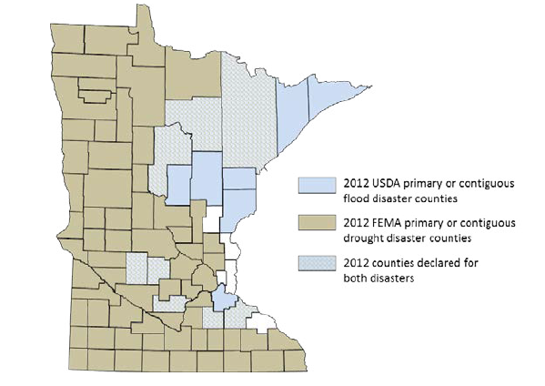
PRECIPITATION CHANGES
Blue counties were declared disaster areas due to flooding.
Brown counties were declared disaster areas due to drought.
Light blue, cross-hatched counties received both designations.
Notes:
However, more moisture in the atmosphere doesn’t necessarily mean a consistent rise in rain and snow. The character of precipitation in Minnesota is changing, increasing the potential for both extreme wet and dry spells. Minnesota is starting to experience increases in localized, heavy precipitation events. Observed trends have the potential to cause both increased flooding and drought, based on the localized nature of storms and their intensity, leaving some areas of the state drenched and other areas without any precipitation. For example, in 2012, 75 counties were declared primary or contiguous disaster areas for drought. However, in that same year 15 counties and three tribal reservations were declared disaster areas for flooding, with eight counties receiving disaster designation for both, underscoring the intensification of precipitation extremes in both directions.
Source: MDH, 2015

Slide 20
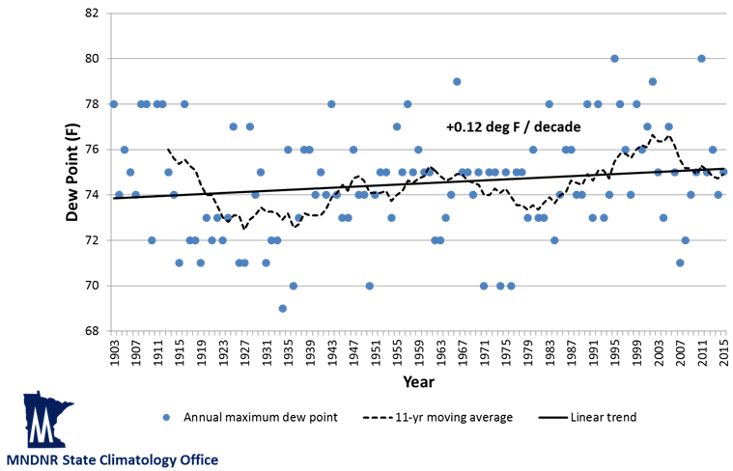
HUMIDITY CHANGES
Highest annual dew points at 6 p.m. CST
Minneapolis – St. Paul, 1903-2015
Notes:
Humidity levels are a function of both temperature and water levels in the atmosphere. Health professionals are particularly interested in humidity, since this affects the skin’s ability to evaporate moisture and cool the body. Dew point is a measure of water vapor in the air. Specifically, the dew point temperature is the temperature to which air must be cooled at constant pressure for it to become fully saturated with water. The higher the dew point is, the more uncomfortable and physically stressed a person feels. This is because people cool themselves by sweating, and if the dew point is high, it becomes more difficult for sweat to evaporate off the skin.
While many measures of dew point and humidity in Minnesota do not yet show evidence of increasing, the most extreme dew point values are becoming more frequent and more extreme over time. Based on historical data, annual maximum dew point temperatures (measured at 6pm CST) are increasing in Minnesota. This trend is modest but significant, about 0.12 degrees per decade. We are also experiencing an increase in the frequency of dew point readings at or above 75°F, a level that is extremely uncomfortable and oppressive. In fact, the frequency of these extreme dew point temperatures is 51% more common in the second half of Minnesota’s weather record (1960-2015) than in the first half (1903-1959).
Source: Trenberth, K.E., 2011; personal communication with Kenny Blumenfeld, Minnesota DNR State Climatology Office on August 9, 2016

Slide 21
OUTLINE
Introduction to air quality and public health
Climate changes in Minnesota
Climate change and air quality
Particulate matter
Ground-level ozone
Allergens
Strategies: Public health professionals and individuals
Notes:
The next section will introduce the relationship between climate change and air quality, and review three major air pollutants that are likely to be affected by climate changes and of concern to public health.

Slide 22
More than 5.5 billion people worldwide die prematurely every year as a result of air pollution
Notes:
Exposure to ambient air pollution is a major risk factor for disease. The Global Burden of Diseases, Injuries, and Risk Factors Study (GBD) is the largest and most comprehensive effort to date to measure epidemiological levels and trends worldwide. According to a recent study by the GBD, more than 5.5 billion people worldwide are dying prematurely every year as a result of air pollution. Climate change is projected to harm human health by increasing exposures to air pollution in many locations.
Source: Melillo, 2014
Image: “Polluted cityscape” – Pexels, https://www.pexels.com/photo/skyline-skyscrapers-city-fog-25610/

Slide 23
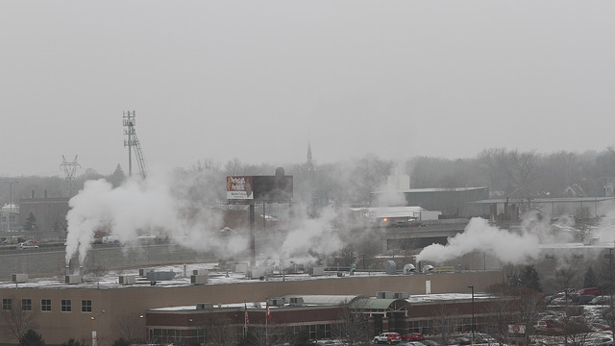
Air pollution contributed to nearly 2,000 deaths, 400 hospitalizations and 600 emergency department visits in the Twin Cities in 2008.
Notes:
A 2015 report by the Minnesota Pollution Control Agency and Minnesota Department of Health (Life and breath: How air pollution affects public health in the Twin Cities), puts the issue in perspective for Minnesota. The report analyzed air quality data from the MPCA and health data from MDH to estimate effects of air pollution on health outcomes for people living in the seven-county Twin Cities metro area. The report estimates that nearly 2,000 deaths, 400 hospitalizations, and 600 emergency room visits were attributable to air pollutant exposure (including fine particulate and ground-level ozone) in the Twin Cities metro area in 2008.
The report used 2008 data because that was the most recent data available which allowed for linking of air pollution levels and health outcomes.
Image: Poor Air Quality in St. Paul, 2014, MPCA (https://www.flickr.com/photos/mpcaphotos/22781822640/in/album-72157660391720208/)

Slide 24
CLIMATE CHANGE AND AIR QUALITY
Climate change may affect exposures to air pollutants and allergens by:
Creating both more windiness and more air stagnation events
Increasing temperatures
Lengthening the growing season
Notes:
Climate change may affect exposure to air pollutants and allergens in a number of ways.
First, changes in the climate may lead to both more windy and more calm days. On the calm days, the still air can be stagnant and pollutants can hang in the air as smog.
Second, with higher temperatures, the demand for more air conditioning can lead to increased pollution because more fossil fuels need to be burned to create more electrical power.
Lastly, climate change is lengthening the growing season, which in turn tends to lengthen the allergy season, increasing allergenicity (or the potency of allergens), and introducing plants with more allergenic pollen

Slide 25
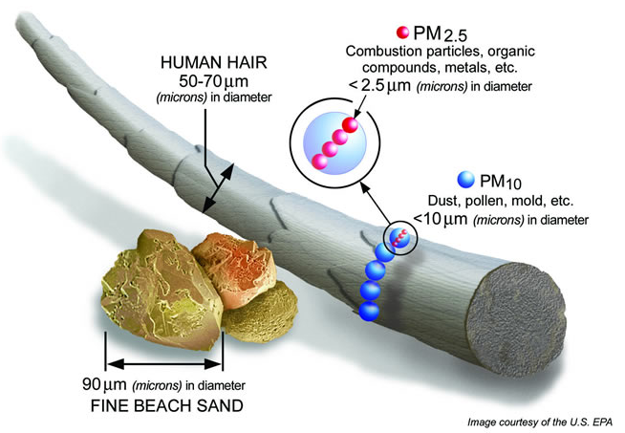
PARTICULATE MATTER
Particulate matter comes in different sizes, from a number of sources:
Dust from construction, mining, and agriculture
Fossil fuel combustion by factories, power plants, and motor vehicles
Wildfires and residential wood burning
Notes:
Particulate matter is a major pollutant for which concentrations are anticipated to be affected by climate change.
Particulate matter comes in different sizes (coarse and fine) from a number of sources including:
Dust and other small particles from construction, mining and agriculture
Fossil fuel combustion by factories, power plants, and diesel- and gasoline-powered motor vehicles
Wildfires and wood burning for home heating
Source: Fuzzi et al., 2015
Image source: U.S. EPA – Available online at: https://www.epa.gov/pm-pollution/particulate-matter-pm-basics

Slide 26
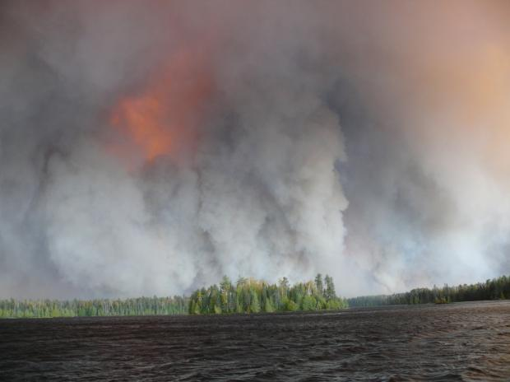
PARTICULATE MATTER
2011 Boundary Waters wildfire burned nearly 145 square miles and cost $21 million
Smoke and ash spread as far as Wisconsin and Michigan
Notes:
Climate change is expected to increase the number and severity of wildfires. Particulate matter from wildfire smoke can often be carried very long distances by the wind, affecting people who live far from the source of this air pollutant.
For example, the 2011 Boundary Waters Canoe Area wildfire in northern Minnesota burned nearly 145 square miles and costs reached $21 million. Smoke and ash spread as far as northeast Wisconsin and Traverse City, Michigan.
As another example, in 2015, air quality in Minnesota was adversely impacted by smoke plumes moving into the state from several hundred fires burning in the western Canadian Rockies. Fine particle levels had reached unhealthy levels triggering an air quality health alert for the entire state of Minnesota, including the Twin Cities area.
Source: Fuzzi et al., 2015; MPCA, 2015b; MPR News, 2011b; U.S. EPA, 2016; USGCRP, 2016
Image: “Pagami Creek Fire, burning near Lake Polly”. 9-12-2011 by Hans Martin, USGS (http://wildfiretoday.com/tag/pagami/)

Slide 27
PARTICULATE MATTER AND HUMAN HEALTH
Potential health effects of particulate matter (PM) exposure:
Impaired respiratory function
Chronic cough
Bronchitis
Chest illness
Chronic obstructive pulmonary disease
Pneumonia
Cardiovascular diseases
Allergies and asthma
Cardiopulmonary diseases
Cancer
Notes:
Exposure to particulate matter (also referenced as “PM”) can have serious health impacts:
Acute exposure to particle pollution not only exacerbates illness in people with respiratory disease but also increases the numbers of hospitalizations and deaths from cardiovascular and respiratory diseases
Long-term effects on health, particularly in the elderly and children, include impaired respiratory function, chronic cough, bronchitis, chest illness, and increased risk for cardiovascular disease, cancer and respiratory diseases such as COPD and pneumonia. PM has also been linked with increased allergic disease and asthma.
Source: Fuzzi et al., 2015
Image: “Listening with Stethoscope,” Pixabay. Available online at: https://pixabay.com/en/investigation-stethoscope-to-listen-2458540/

Slide 28
PARTICULATE MATTER AND HUMAN HEALTH
Who’s most at-risk:
People of all ages who are doing extended or heavy, physical activity like playing sports or working outdoors, especially near high-traffic corridors and/or stationary sources of PM.
People who have asthma or other breathing conditions like chronic obstructive pulmonary disease (COPD).
People who have heart disease or high blood pressure.
Children and older adults.
Notes:
Populations at risk include those who have an increased exposure to particulate air pollution, including people who are doing extended or heavy physical activity (like playing sports or working outdoors), especially near high-traffic corridors and/or stationary sources of air pollution such as factories or power plants.
Some populations are more sensitive to particulate air pollution, including those with asthma and/or other breathing conditions like COPD, those with pre-existing heart disease or high blood pressure, and older adults and children,
Image: “IMG_2580”, https://www.flickr.com/photos/116153846@N06/37252779275/in/photolist-YKTCQk-YuwwM1-8zNey2-YKUepR-9xMiXC-YKU6nD-8zNexc-9xMjkw-9xMiqd-YuwX6m-8zRnr1-9xMjLd-9xMjg5-9xMiSC-Yt4Ec1-YygPGp-YKUEQa-YvEPVU-Yt4DQj-Yt4dMU-Yu4xfQ-YyKU2v-YKTE3R-YLSsTx-7TzZPB-9xJmrR-adhvCb-d8Uzh1-YygHZH-Ywah7L-YLRw7t-jMd9f2-Yxh35M-4LJLY2-61oitC-2bLHK7-YygN6D-YaDSay-XwS2hT-abTJri-XwS3EH-Y8dnRo-8DS7RK-6sSgej-6sUATq-abWzSN-XuSH75-8DS7hM-6jj4XW-6sSzRf

Slide 29
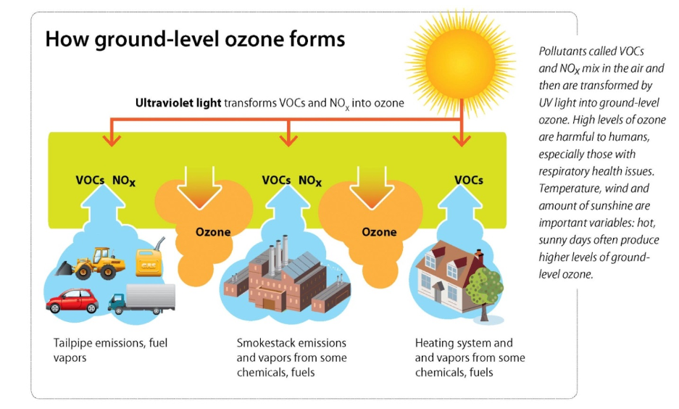
GROUND-LEVEL OZONE
Notes:
Ground-level ozone is another major pollutant for which concentrations are anticipated to be affected by climate change.
Ozone is a gas that occurs both at ground-level and in the Earth’s upper atmosphere. Atmospheric ozone protects life on Earth from the sun’s harmful ultraviolet (UV) rays; however, ground level ozone is harmful to human health and vegetation.
Ground-level ozone is formed by the reaction of volatile organic compounds (VOCs) and nitrogen oxide (NO_{x}) in the presence of sunlight and heat. Having too much ground-level ozone where we live and breathe can be harmful to our health.
Emissions from industrial facilities and electric utilities, motor vehicle exhaust, gasoline vapors, and chemical solvents are some of the major sources of NOx and VOC.
Sources: MPCA, 2015a; Tibbets, 2015
Image source: MPCA

Slide 30
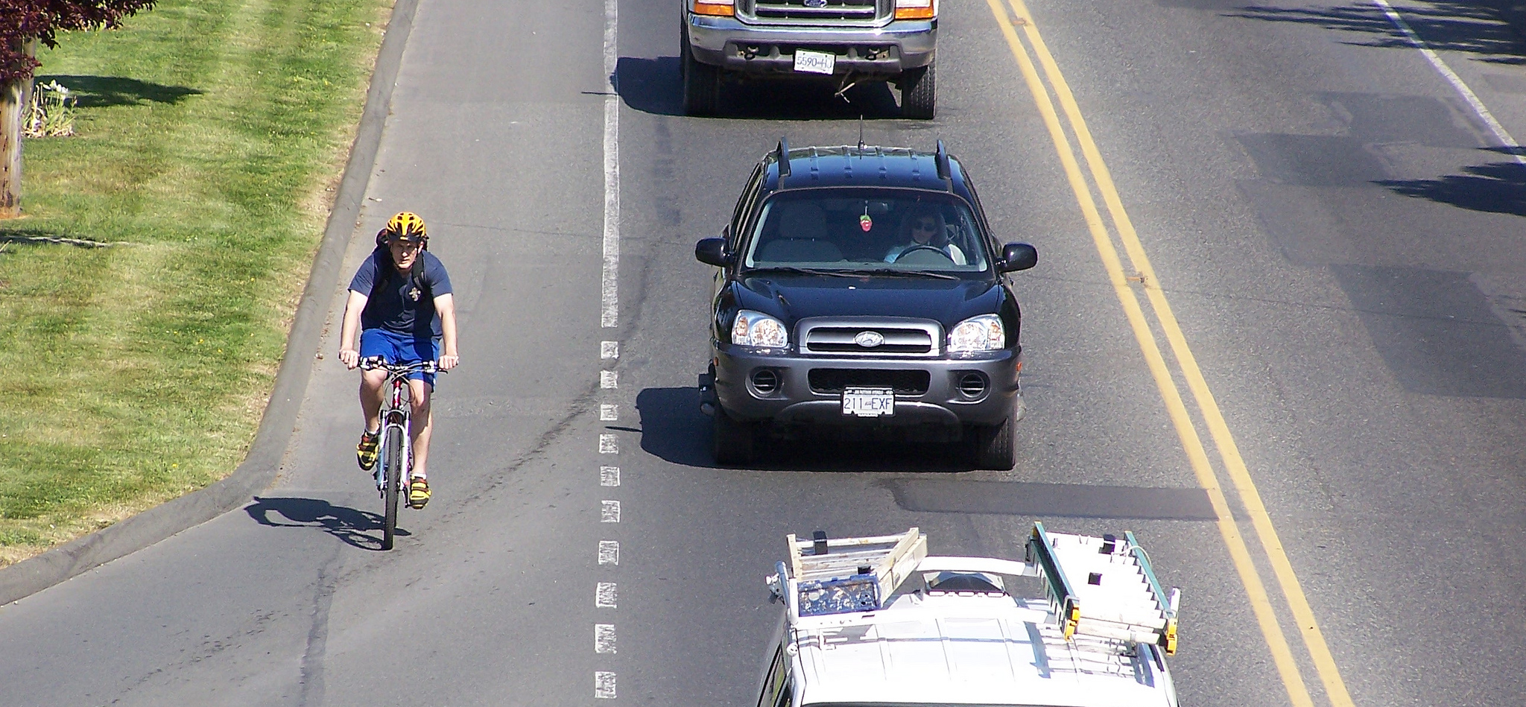
GROUND-LEVEL OZONE AND HUMAN HEALTH
Ground-level ozone exposure is linked to harmful respiratory and cardiopulmonary impacts
Climate change is likely to increase ground-level ozone, especially during the summer and downwind of urban areas
Notes:
The health effects of concern relate primarily to lung inflammation. Unhealthy ozone levels can aggravate pre-existing lung diseases like asthma, emphysema, and COPD. When the air quality is unhealthy, people with these conditions may experience symptoms like difficulty breathing deeply, shortness of breath, wheezing, coughing or fatigue.
People exposed to higher levels of ground-level ozone are at greater risk of dying prematurely or being admitted to the hospital for respiratory problems.
The higher concentrations of ozone due to climate change may result in tens of thousands of additional ozone-related illnesses and premature deaths per year by mid-century in the United States, assuming no change in air quality policies.
Because warm, stagnant air tends to increase the formation of ozone, climate change is likely to increase levels of ground-level ozone in already-polluted areas and increase the number of days with poor air quality.
The effect is strongest during the summer months, downwind of urban areas where ozone pre-cursors are plentiful.
Sources: Tibbetts, 2015; MPCA, 2016; U.S. EPA, 2016; USGCRP, 2016
Image: “Pollution more or less”, by John Luton, https://www.flickr.com/photos/luton/10425823163/in/photolist-gTi4ZM-aL8XN-ayZrTx-aUZfFi-fmR5Tm-bAfqTT-kQ9M68-b7cGjD-7bnbgz-aYyihV-4LLKTM-a7BAv3-9ppsJF-dYuZSU-75D5RG-8c92VS-8Auk7x-2z8Vg4-5n6nuo-4LLKWa-rsxBA2-5bvhUV-dicU9c-2dypAS-Asbs1P-bEuiuh-6ta2P8-6ta47i-9ixFid-pMWZWD-7R2fGZ-f7Wm5j-2Bzt7-2jnQw5-5vFyhx-9teVoL-7R5vTY-8PYswA-noUEcM-3rfBTH-apVsba-kCMEfJ-88XpHk-9psupj-6cG151-p6d4N2-ahVo8o-iso1tx-5kV6mJ-Z39t33

Slide 31
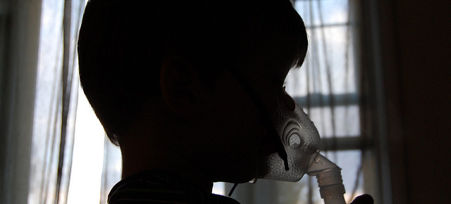
GROUND-LEVEL OZONE AND HUMAN HEALTH
Who’s most at-risk:
People who have asthma or other breathing conditions like chronic obstructive pulmonary disease (COPD), chronic bronchitis, and emphysema.
Children and teenagers.
People of all ages who are doing extended or heavy, physical activity like playing sports or working outdoors.
Some healthy people who are more sensitive to ozone even though they have none of the risk factors.
Notes:
As with particulate matter, there are people who are more likely to be affected when ground-level ozone pollution reaches an unhealthy level. This includes:
People who have asthma or other breathing conditions like chronic obstructive pulmonary disease (COPD), chronic bronchitis, and emphysema.
Children and teenagers.
People of all ages who are doing extended or heavy, physical activity like playing sports or working outdoors.
Some healthy people who are more sensitive to ozone even though they have none of the risk factors. There may be a genetic base for this increased sensitivity.
Image: “Sillouette of Asthma”, KristyFaith https://www.flickr.com/photos/30912734@N04/3631079012/in/photolist-6wSehy-k12yHK-tRnHxG-7HLzTa-abteNg-4vJb76-AHiVtq-BEQnd2-BCwgCJ-eygyy4-66FwpA-qyEsAA-4LgNoi-7Dspf3-8kgTs2-5vMrJi-68q5w1-TQzo-9bmEK8-cCnjkG-5tz14g-m5KpY4-QqWckA-8HcGWn-na51eJ-aMoZfn-JBVDE-eZjr3q-oH4rdU-5Adove-6DpQ5P-7dyPzJ-7cNP1a-8d2oD6-9qMECF-SxsPDb-e2is2q-9x67Q3-99xZRa-su6i2z-2gtk5s-8x6gbV-9x383K-29eQm-G9pNfv-4URrnm-7WSi13-Sbind2-b8HRNi-8F3aBC

Slide 32
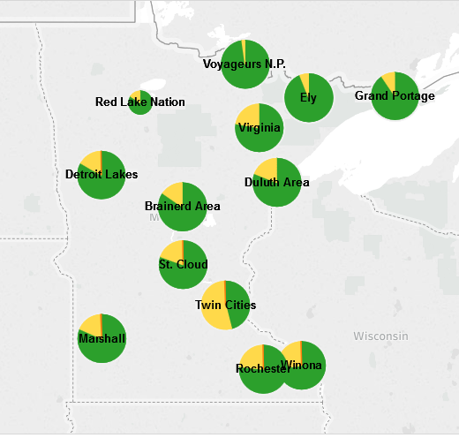
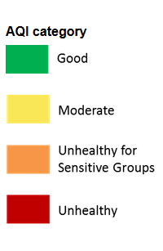
MEASURING AIR QUALITY
Annual Count of Days in each AQI Category - 2014
www.pca.state.mn.us/aqi
Notes:
While it’s true that the majority of days in Minnesota have healthy air quality, those who are sensitive to air pollution know it only takes one day with unhealthy air to feel an impact. Minnesotans need to be prepared for days qualifying as poor air quality index, or AQI, days. The AQI is used to represent real-time air quality conditions and communicate current health risk to the public. The Minnesota Pollution Control Agency measures five air pollutants hourly, including fine particles and ground-level-ozone, and reports the AQI for seventeen areas across Minnesota.
This map shows the annual count of days in each AQI category for each of those areas in 2014. These counts are based on the daily maximum AQI measured from ground-level ozone and fine particle monitors in each area. The size of the pie chart reflects the number of days with available monitoring data.
The number of AQI days in each category varies by region. Typically, areas in the northern half of the state have the highest number of good days. The Twin Cities routinely has the fewest number of good days. This is due, in part, to the density of air pollution sources like cars, trucks, homes, and industry in the metropolitan area.
Minnesotans can download MN Air mobile application or sign-up to receive AQI alerts and forecasts from the MPCA by visiting their website at http://www.pca.state.mn.us/aqi.
Source: MPCA, 2016
Image source: MPCA

Slide 33
ALLERGENS
Allergic diseases have dramatically increased worldwide
More than 50 million Americans suffer from allergies annually
Common allergens that may be affected by climate changes include pollen and mold.
Notes:
Allergens, like pollen and mold, are common air pollutants that are also being affected by climate changes. An allergy is the body’s immune system overreacting to something in the environment that usually causes little or no problems in most people. According to the World Allergy Organization (WAO), the prevalence of allergic diseases, such as asthma and rhinitis, has increased to epidemic proportions worldwide. More than 50 million Americans suffer from allergies each year. Allergy is the sixth leading chronic disease in the U.S. among all ages, collectively costing the health care system approximately 18 billion dollars every year.
In a recent statement the WAO highlights the role of climate change in particular in the dramatic rise of these diseases.
Source: D’Amato et al., 2015; MDH, 2015b
Image: “Ragweed,” https://pixabay.com/en/ragweed-weed-nature-allergy-pollen-219747/

Slide 34
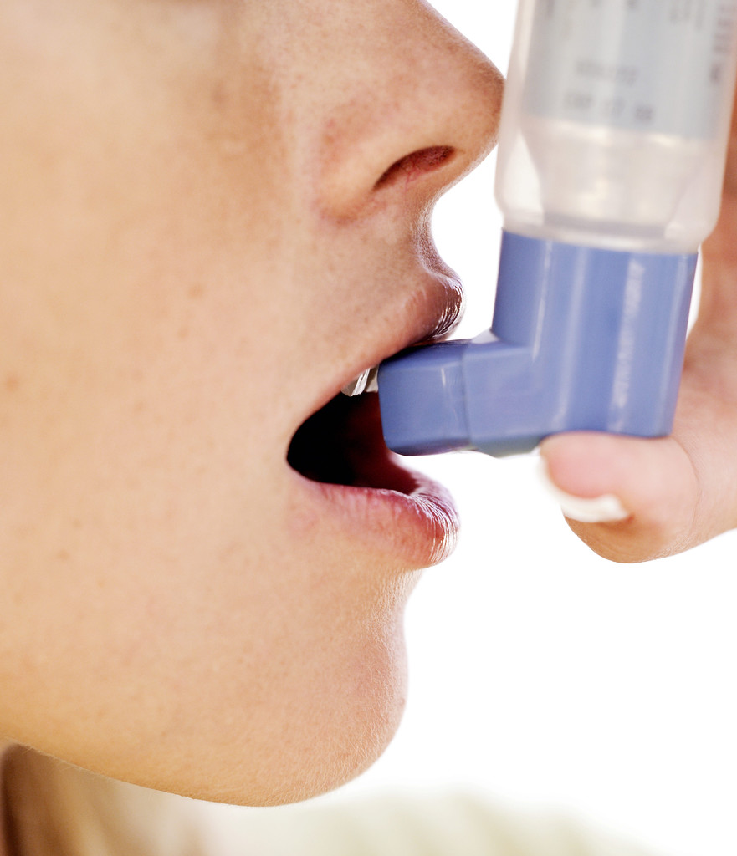
ALLERGENS AND HUMAN HEALTH
Allergens can worsen asthma and other respiratory problems by interacting with other air pollutants.
When ozone levels are high, it takes less ragweed pollen to trigger an asthmatic or allergic response.
Particulate matter can increase allergic response by extending how long the allergens stay in the body.
Notes:
Allergens can affect persons with allergies and asthma
Approximately 10 million Americans have “allergic asthma,” in which their asthma attacks are triggered by a reaction to pollen or other airborne allergens (out of the 24.6 million that have some form of active asthma)
Allergens can interact with air pollution to amplify their individual effects:
When ground-level ozone levels are high, it takes much less ragweed pollen to trigger an asthmatic or allergic response
Particulate matter also increases allergic responses by extending how long the allergens stay in the body
Sources: National Wildlife Federation, 2010; Ziska et al, 2011; American Lung Association, 2016

Slide 35
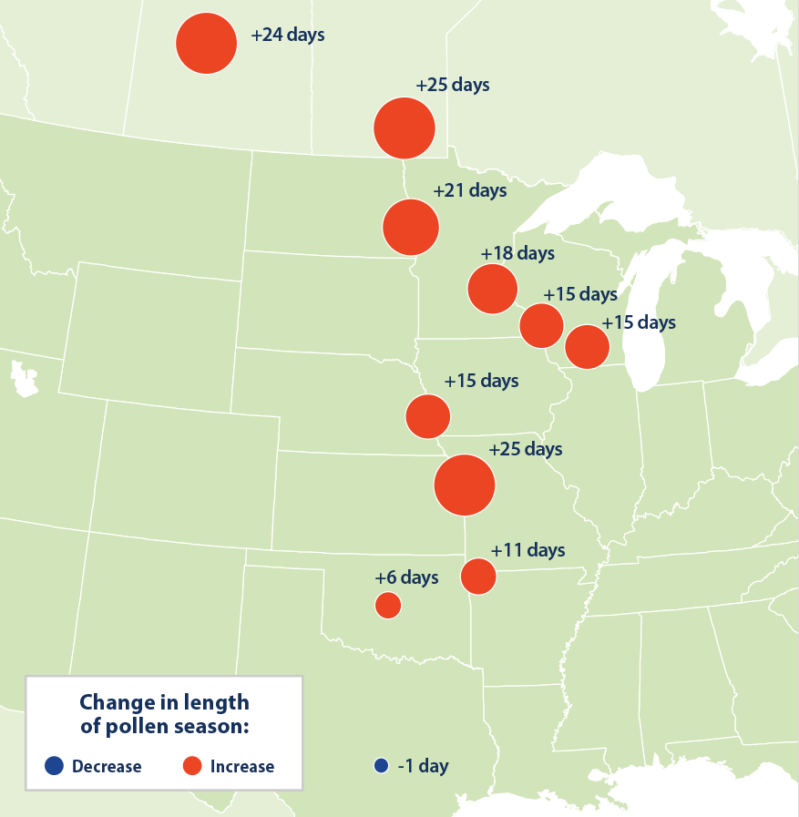
CLIMATE CHANGE AND ALLERGENIC POLLEN
Increased production and potency of pollen
Longer pollen season
Increased proliferation of weedy plant species that produce allergenic pollen
Introduction of new allergen-producing plant species
Change in Ragweed Pollen Season, 1995-2015
Notes:
Climate change is expected to increase pollen production, lengthen the pollen season, and increase the potency of airborne allergens. The warmer temperatures and changes in precipitation cause some plants to grow faster, bloom earlier, and produce more pollen. Additionally, higher levels of carbon dioxide in the atmosphere act as a fertilizer for plant growth. Both increased temperatures and increased carbon dioxide concentrations are expected to increase plant production of pollens, and may also increase fungal growth and spore release.
In addition to increased production of pollen, recent studies also suggest that climate-related temperature changes are expected to increase the potency of airborne allergens. Such changes increase the concentration of pollen in the air, the length of the allergy season and the strength of airborne allergens, and associated increases in allergy symptoms.
This slide shows an example of the change in length of ragweed pollen season, in and around Minnesota, between 1995 and 2015. The larger the orange circles, the more days that are now being experienced from increase in the length of pollen season. In Minnesota, we’ve observed an increase in our ragweed pollen season by 15 days in the southern part of the state, to 19 days in the north.
In addition to the lengthening of our pollen season, climate change will also allow certain allergen-producing plant species to move into new areas. Wind blown dust, carrying pollens and molds from outside of the United States, could expose people to new allergens.
Sources: Bernard et al, 2001; CDC, 2014; US EPA, 2016b; Rogers et al, 2006
Image source: U.S. EPA, August 2016. www.epa.gov/climate-indicators/climate-change-indicators-ragweed-pollen-season

Slide 36
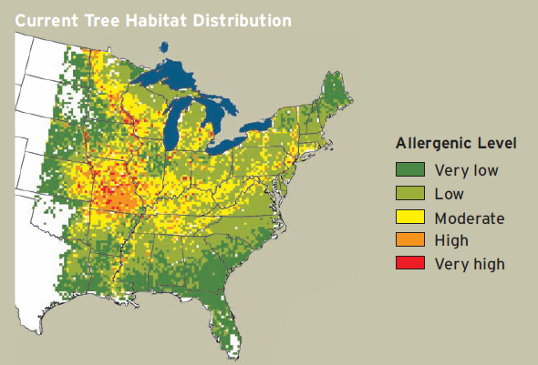
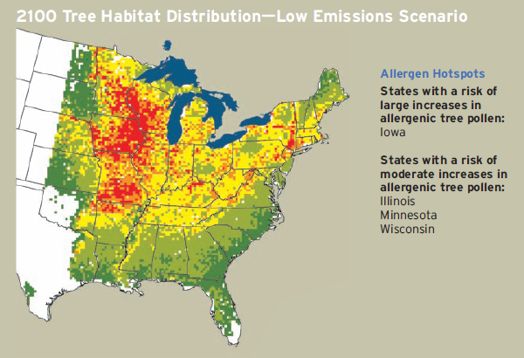
ALLERGENIC TREE POLLEN POTENTIAL
Notes:
For example, climate changes may favor the growth of trees with more allergenic pollen, like certain oak and hickory species, that could expand at the expense of habitat where much less allergenic pine, spruce, and fir trees currently dominate.
These maps show the annual allergenic potential from tree pollen for the current distribution of tree species habitat and for projected distributions of tree species habitat under a low greenhouse gas emissions climate scenario. Minnesota is at moderate to very high risk for increases in allergenic tree pollen, especially in the central and southeastern portions of the state.
Source: National Wildlife Federation, 2010
Image source: National Wildlife Federation

Slide 37
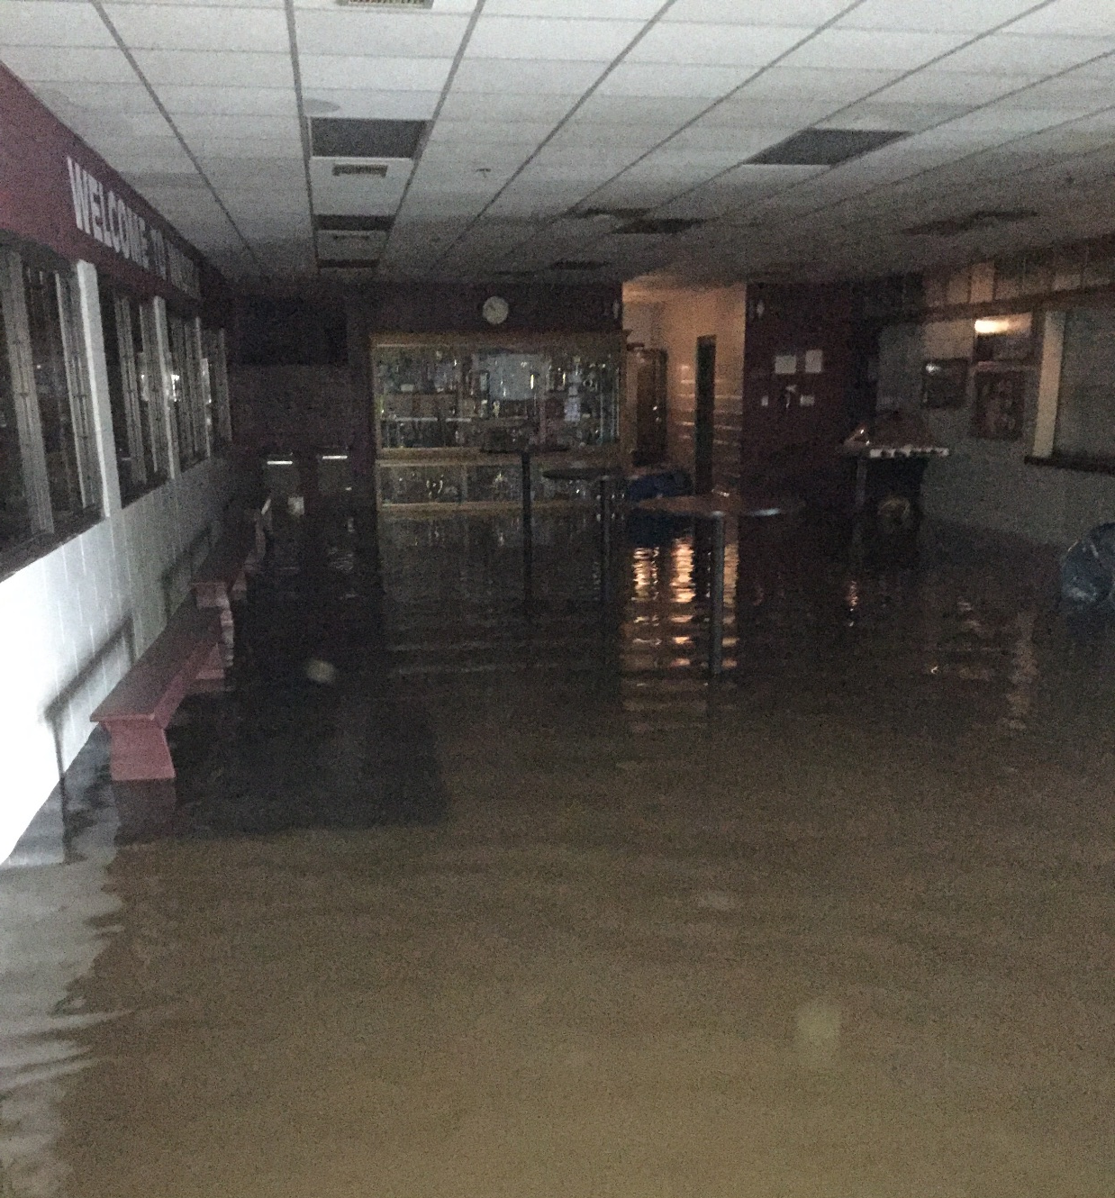
CLIMATE CHANGE AND MOLD
Mold growth is enhanced by:
Precipitation/floods
High temperature or humidity
Increase in plant decay
Improper installation or management of air conditioning
Mold can cause:
Coughing, wheezing
Aggravated respiratory conditions, like asthma
Weakened immune systems
Notes:
Another allergen affected by climate change and of concern for public health is mold. Mold growth is enhanced by moisture; factors that contribute to the prevalence and spread of mold include:
Increase in precipitation/floods
Increase in temperature and/or humidity
Increase in plant growth/plant biomass decay (leaf litter)
Improper installation or management of air conditioning systems
Exposure to mold can cause coughing, wheezing, nasal and throat conditions, and adversely affect persons with asthma or weakened immune systems
Sources: Bernard et al, 2001; National Wildlife Federation, 2010
Image: City of Waseca, 2016. Available at: https://services.arcgis.com/EBcDMSJ0IDOworEe/arcgis/rest/services/Flood2016_StaffPhotos/FeatureServer/0/9/attachments/4

Slide 38
OUTLINE
Introduction to air quality and public health
Climate changes in Minnesota
Climate change and air quality
Strategies: Public health professionals and individuals
Notes:
The next section will address general mitigation strategies for public health agencies and local governments to reduce the negative health impacts of climate changes and air quality.

Slide 39
PUBLIC HEALTH MITIGATION STRATEGIES
Mitigation efforts focus on the reduction of air pollutants.
Work with municipal planning departments to improve/incentivize multimodal transportation
Promote telecommuting policies
Encourage the use of renewable energy sources
Educate about best practices for burning wood
Notes:
Mitigation policies and strategies are aimed at reducing emissions. They are considered an “upstream” approach to eliminating climate change impacts on human health since they reduce the risk at the source by reducing release of greenhouse gases.
Examples of mitigation strategies to reduce air pollution include making smart choices about how to travel and use energy. Everyone has the right to breathe clean air and all of us can do our part to protect our health from air pollution and reduce our contributions to unhealthy air and climate change. For example, as public health professionals we can:
Work with municipal planning departments to improve/incentivize multimodal transportation (walking, biking, transit, etc.) to reduce reliance cars
Promote telecommuting policies to help reduce fuel consumption, air pollution and road congestion
Encourage the use of renewable energy sources by improving the market through group (or government) purchasing power, providing funding for research and development, etc.
Educate about best practices for burning wood and help reduce exposure to harmful wood smoke
Source: USGCRP, 2016
Transportation Image Source: Minnesota Department of Transportation, 2016

Slide 40
PUBLIC HEALTH ADAPTATION STRATEGIES
Adaptation efforts focus on controlling or reducing health impacts of unhealthy air and climate change:
Monitor AQI and be prepared to act
Coordinate outreach and interventions to at-risk populations
Support data collection and monitoring of air contaminants, as well as tracking of diseases such as asthma and allergic disease
Collaborate on policies that prioritize climate-resilient, low-allergenic plants
Notes:
Adaptation policies and strategies are more of a “downstream” approach to reducing health impacts from climate change. They are mainly focused on assisting communities with controlling or reducing their exposures to climate change impacts.
There are several examples of adaptation efforts related to climate change and air pollution.
First, monitor the Air Quality Index, or AQI, and be prepared to act. On unhealthy air quality days, we can be prepared to distribute pre-scripted messaging about protecting health, such as encouraging people with breathing conditions to carry their relief or rescue inhaler, and ways to reduce pollution, such as postponing the use of gasoline powered garden equipment. We can also provide guidance and education on how to locate and interpret daily air quality indices and pollen counts.
Second, improve coordination of health-risk communication strategies and integrate climate change in other efforts (such as emergency preparedness). In doing this work, it’s important to prioritize outreach and interventions to at-risk groups, including people who have asthma or heart disease, children and older adults, and people who are doing extended physical activity outside, like playing sports or working outdoors.
Third, we can support data collection and monitoring of air contaminants, along with related health impact measures such as mortality and morbidity related to air pollution exposures.
Finally, we can work with planning and forestry professionals to prioritize climate-resilient, low-allergenic plants for residential, business, city and county landscaping. There are many species of trees, shrubs, and plants to choose from, but in general we can encourage species that are pollinated by birds and insects, such as apple trees or dogwood shrubs, and utilize species that are pollinated by wind, such as many of the ornamental grasses, sparingly or in strategic locations.

Slide 41
MN Public Health Data Access Portal
health.mn.gov/mndata
Notes:
The Minnesota Public Health Data Access Portal, an online data resource from the MDH Environmental Public Health Tracking Program, is an online resource designed to better equip Minnesota’s communities and public health professionals to explore the relationships between environmental exposures, risk factors, and health effects.
The Portal features information as interactive charts and figures, maps, custom tables, or County profiles across a range of environmental health indicators, including Air Quality and other climate change and health topic areas. We hope you keep this resource in mind as you work to understand air quality and health impacts in your community. You can access the Portal by visiting the link shown at the bottom of this slide or by visiting the MDH website and searching for “Data Access Portal.”

Slide 42
MPCA Environmental Justice Screening Tool
http://arcg.is/nHTyn
Notes:
Another resource to consult when evaluating community-level air and health interventions is the Environmental Justice Screening Tool from the Minnesota Pollution Control Agency. We should all be committed to making sure that unhealthy air doesn’t have a disproportionate impact on any group of people — the principle of environmental justice. This means that all people — regardless of their race, color, national origin, or income — benefit from equal levels of environmental protection and have opportunities to participate in decisions that may impact their environment or health.
Integrating environmental justice into our work begins by assessing where low-income Minnesotans, people of color, and others may be experiencing more harm or may be more susceptible to environmental conditions. To help with this process, the Environmental Justice Screening Tool allows public health staff, environmental agency staff, partners, and community members to identify areas where additional consideration or effort is warranted to evaluate the potential disproportionate negative impacts, consider ways to reduce those impacts, and ensure meaningful community engagement. You can access the tool by clicking on the link on the slide or by visiting the MPCA website and searching for ”environmental justice”.

Slide 43
What can individuals do to address climate change?
Notes:
We as individuals can play many roles in mitigating and adapting to climate change. The next slides list actions each of us can take to make a difference.

Slide 44
Energy
1
Notes:
Energy production is one of the big three contributors to our changing climate because burning oil, coal, and natural gas to generate electric power puts a lot of GHGs into the air.
Image: Windmill – Pexels. Available online at: https://www.pexels.com/photo/road-street-desert-industry-477230/

Slide 45
ENERGY
Individual Action
Use less energy to heat or cool homes
Use energy-efficient appliances and lightbulbs
Reduce, reuse, recycle what we buy and use on a daily basis
Collective Action
Use more renewable energy (solar, wind, and biofuels)
Use less fossil fuel energy (oil, coal, natural gas)
Support policy change for renewable energy
Notes:
As individuals, we can each reduce the amount of GHG emissions we cause in a number of ways like using less energy to heat or cool homes (turning the temp up or down 2 degrees, adding insulation and weather stripping, planting trees for shade); using energy-efficient appliances and light bulbs; and reducing/reusing/recycling what we buy and use on a daily basis.
However, what is really going to make a difference is having all of us rely more on renewable energy sources like solar, wind, and biofuels and less on fossil fuel energy sources like oil, coal, and natural gas. As individuals, we can support public and private sector policy changes that lead to more renewable energy production. A policy example is Minnesota’s Next Generation Energy Act of 2007 that has achievable GHG reduction targets by 2025 and beyond.
Image: Windmill – Pexels. Available online at: https://www.pexels.com/photo/road-street-desert-industry-477230/

Slide 46
Transportation
2
Notes:
Transportation is the second big contributor to our changing climate because burning fuel to power vehicles emits a lot of GHGs into the air.
Image: Person biking – Pexels. Available online at: https://www.pexels.com/photo/person-wearing-black-and-gray-sleeveless-dress-riding-a-step-through-bicycle-521474/

Slide 47
Transportation
Individual Action
Burn less gasoline or diesel fuel
Walk, bike, use transit, carpool, and telecommute when possible
Drive an electric vehicle (powered by wind or solar energy)
Collective Action
Support public and private sector policies
To increase gas and diesel mileage standards
Incentivize the production of electric vehicles
Build more transit options
Notes:
As individuals, we can each reduce the amount of GHG emissions we cause by using transportation choices that burn less gasoline or diesel fuel like walking, biking, using transit, carpooling, and telecommuting when possible. Another option would be to drive an electric vehicle powered by wind or solar energy.
However, what is really going to make a difference is if we all have more transportation options that either burn less or don’t use any gasoline or diesel fuel. As individuals, we can support public and private sector policies like increasing gas and diesel mileage standards, incentivizing the production and purchase of electric vehicles, building more transit options where sufficient population density exists, and having policies that support telecommuting.
Image: Person biking – Pexels. Available online at: https://www.pexels.com/photo/person-wearing-black-and-gray-sleeveless-dress-riding-a-step-through-bicycle-521474/

Slide 48
Agriculture
3
Notes:
Agriculture is the third big contributor to GHG emissions because it takes a lot of energy to produce, process, and transport food.
Image: Food – Pexels. Available online at: https://www.pexels.com/photo/tomatoes-carrots-and-radish-on-the-top-of-the-table-196643/

Slide 49
Agriculture
Individual Action
Buy more locally grown foods
Eat fewer processed foods and less meat
Grow some of our own food
Collective Action
Support policies that incentivize:
Foods produced with fewer chemicals
Food that are less processed
Food that are transported shorter distances
Notes:
As individuals, we can each reduce the amount of GHG emissions we cause by buying more locally grown foods, eating fewer processed foods and less meat, and even growing some of our own food.
However, what is really going to make a difference is if we all have access to foods that are produced, processed, and transported using less energy. As individuals, we can support public and private sector policies that incentivize foods produced with fewer chemicals, foods that are less processed and closer to their natural state, and foods that are transported shorter distances.
Image: Food – Pexels. Available online at: https://www.pexels.com/photo/tomatoes-carrots-and-radish-on-the-top-of-the-table-196643/

Slide 50
SUMMARY
Minnesota’s climate is changing
Increases in temperature
Changes in precipitation
Climate changes will likely increase air pollutants of concern to health:
Particulate matter
Formation of ozone
Pollen and mold
Certain populations are at greater risk from exposure to unhealthy air:
Those with existing respiratory and cardiovascular conditions
Elderly
Children
Public health awareness, education, and coordinated mitigation and adaptation planning with other agencies can reduce the health impacts.
Notes:
In summary, Minnesota’s climate is changing. We are seeing increasing in temperature and changes in levels of precipitation.
These changes will likely increase levels of particulate matter, formation of ground-level ozone, pollen, and mold.
It’s important to remember that certain populations are at greater risk from exposure to air pollutants and allergens. These include those with existing respiratory and cardiovascular conditions, elderly, and children.
Everyone has the right to breathe clean air and all of us can do our part to protect our health from air pollution and reduce our contributions to unhealthy air and climate change.
Public health awareness, education, and coordinated mitigation and adaptation planning with other agencies can reduce the health impacts.

Slide 51
ACKNOWLEDGEMENTS
This work was supported by cooperative agreement 5UE1EH000738 from the Centers for Disease Control and Prevention
Special thanks to the following people for their contributions to the creation of this training module:
Wendy Brunner, Minnesota Department of Health
Hillary Carpenter, Minnesota Department of Health
Anne Claflin, Minnesota Pollution Control Agency
Gregory Pratt, Minnesota Pollution Control Agency
Naomi Shinoda, Minnesota Department of Health

Slide 52
Questions?
Contact Minnesota Climate and Health Program
health.climatechange@state.mn.us
651-201-4898

Slide 53
REFERENCES: 1 of 3
American Lung Association. 2016. State of the Air 2016. Available online: http://www.lung.org/assets/documents/healthy-air/state-of-the-air/sota-2016-full.pdf
Arbor Day Foundation. 2015. Hardiness Zones – Changes from 1990-2015. Available online: https://www.arborday.org/media/map_change.cfm
Bernard SM, Samet JM, Grambsch A, Ebi KL, Romieu I. 2001. The potential impacts of climate variability and change on air pollution-related health effects in the United States. Environmental Health Perspectives Vol 109, Supplement 2, pp 199-209.
Blumenfeld, K. 2016. Minnesota Department of Natural Resources, State Climatology Office; personal communication on August 9, 2016
D’Amato, G., Holgate, S.T., Pawankar, R., Ledford, D.K., Cecchi, L., Al-Ahmad, M., Al-Enezi, F., Al-Muhsen, S., Ansotegui, I., Baena-Cagnani, B., Baker, D.J., Bayram, H., Bergmann, K.C., Boulet, L-P., Buters, J.T.M., D’Amato, M., Dorsano, So. Douwes, J., Finaly, S.E., Garrasi, D., Gomez, M., Haahtela, T., Halwani, R., Jassani, Y., Mahboub, B., Marks, G., Michelozzi, P., Montagni, M., Nunes, C., Jae-Won Oh, J., Popov, T.A., Portnory, J., Ridolo, E., Rosario, N., Rottem, M., Sanchez-Borges, M., Sibanda, E., Sienra-Monge, J.J., Vitale, C., and Annesi-Maesano, I. 2015. Meteorological conditions, climate change, new emerging factors, and asthma and related allergic disorders. A statement of the World Allergy Organization. WAO Journal, 8:25. Available online: http://waojournal.biomedcentral.com/articles/10.1186/s40413-015-0073-0
Dawson, J.P., Bloomer,B.J., Winner, D.A., Weaver, C.P. 2014. Understanding the meteorological drivers of U.S. particulate matter concentrations in a changing climate. Bull Amer Meteor Soc, 95: 521–532.
Ebi, K.L. and McGregor, G. 2008. Climate change, tropospheric ozone and particulate matter, and health impacts. Environ Health Perspect, 116:1449-1455
Environmental Quality Board. 2015. Minnesota and climate change: our tomorrow starts today. Available online: https://www.eqb.state.mn.us/content/climate-change

Slide 54
REFERENCES: 2 of 3
Fuzzi, S., Baltensperger, U., Carslaw, K., Decesari, S., Denier van der Gon, H., Facchini, M.C., Fowler, D., Koren, I., Langford, B., Lohmann, U., Nemitz, E., Pandis, S., Riipinen, I., Rudich, Y., Schaap, M., Slowik, J.G., Spracklen, D. V., Vignati, E., Wild, M., Williams, M., and Gilardoni, S. 2015. Particulate matter, air quality and climate: lessons learned and future needs. Atmospheric Chemistry and Physics 15, 8217-8299, 2015. Available online: http://www.atmos-chem-phys.net/15/8217/2015/acp-15-8217-2015.pdf
Griffin, R. J. 2013. The Sources and Impacts of Tropospheric Particulate Matter. Nature Education Knowledge 4(5):1
Horton, D. E., Skinner, C. B., Singh, D. & Diffenbaugh, N. S. 2014. Occurrence and persistence of future atmospheric stagnation events. Nature Clim. Change. Available online: http://www.nature.com/nclimate/journal/v4/n8/full/nclimate2272.html
Jacob D.J. and Winner, D.A. 2009. Effect of climate change on air quality. Atmospheric Environment, Vol 34, pp. 51-63.
Melillo, J.M. et al. 2014. Climate Change Impacts in the United States: The Third National Climate Assessment. U.S. Global Change Research Program. Available online: http://nca2014.globalchange.gov/report
Minnesota Department of Health (MDH). 2015a. Life and breath: how air pollution affects public health in the Twin Cities. Available online: https://www.pca.state.mn.us/sites/default/files/aq1-61.pdf
Minnesota Department of Health (MDH). 2015b. Minnesota Climate and Health Profile Report. Available online: http://www.health.state.mn.us/divs/climatechange/docs/mnprofile2015.pdf
Minnesota Department of Natural Resources (MDNR), 2016. Historic Mega-Rain Events in Minnesota. Available online: http://www.dnr.state.mn.us/climate/summaries_and_publications/mega_rain_events.html
Minnesota Pollution Control Agency (MPCA). 2015a. Air Quality in Minnesota – 2015 Report to the Legislature. Available online: https://www.pca.state.mn.us/sites/default/files/lraq-1sy15.pdf

Slide 55
REFERENCES: 3 of 3
Minnesota Pollution Control Agency (MPCA). 2015b. Poor air quality in Minnesota due to smoke from Canadian forest fires. Available online: https://www.pca.state.mn.us/news/poor-air-quality-minnesota-due-smoke-canadian-forest-fires
Minnesota Pollution Control Agency (MPCA). 2016. Annual AQI summary reports. Available online: https://www.pca.state.mn.us/annual-aqi-summary-reports
Minnesota Public Radio News. 2011b. Pagami fire smoke visible deep into Wis., Mich. September 13, 2011. Available online: http://minnesota.publicradio.org/display/web/2011/09/13/pagami-fire-smoke-visible-deep-into-wisconsin/
National Aeronautics and Space Administration (NASA). 2005. What’s the Difference Between Weather and Climate? Available online: https://www.nasa.gov/mission_pages/noaa-n/climate/climate_weather.html
National Aeronautics and Space Administration (NASA). 2016. Global Climate Change: Vital Signs of the Planet. Available online: http://climate.nasa.gov/causes
National Oceanic and Atmospheric Administration (NOAA). 2017. NOAA National Centers for Environmental information, Climate at a Glance: U.S. Time Series, Average Temperature, published February 2017. Available online: http://www.ncdc.noaa.gov/cag
National Wildlife Federation. 2010. Extreme Allergies and Global Warming. Available online: www.nwf.org/extremeweather
Tibbetts, J.H. 2015. Air quality and climate change: a delicate balance. Available online: http://ehp.niehs.nih.gov/wp-content/uploads/123/6/ehp.123-A148.alt.pdf
Trenberth, K.E. 2011. Changes in precipitation with climate change. Clim Res 47:123-138. Available online: http://www.int-res.com/articles/cr_oa/c047p123.pdf
Ziska, L., K. Knowlton, C. Rogers, National Allergy Bureau, Aerobiology Research Laboratories, Canada. 2016 update to data originally published in: Ziska, L., K. Knowlton, C. Rogers, D. Dalan, N. Tierney, M. Elder, W. Filley, J. Shropshire, L.B. Ford, C. Hedberg, P. Fleetwood, K.T. Hovanky, T. Kavanaugh, G. Fulford, R.F. Vrtis, J.A. Patz, J. Portnoy, F. Coates, L. Bielory, and D. Frenz. 2011. Recent warming by latitude associated with increased length of ragweed pollen season in central North America. P Natl. Acad. Sci. USA 108:4248–4251.

Slide 56
PHOTO AND IMAGE CREDITS
Slide 4 Hot air balloons – Pexels. Available online at: https://www.pexels.com/photo/reflection-of-green-yellow-and-red-hot-air-balloon-in-lake- 147540/
Slide 5 Trends in Minnesota air pollution emissions by source category – Minnesota Pollution Control Agency
Slide 6 Cars, construction equipment, backyard fire, smokestacks – Minnesota Pollution Control Agency
Slide 8 Cars in traffic – Pexels. Available online at: https://www.pexels.com/photo/traffic-cars-street-traffic-jam-7674/
Slide 10 Lightning bolt and sun – Microsoft Clip Art
Slide 11 Leaves – Microsoft Images
Slide 12 Climate and health graphic – MDH, 2016
Slide 13 Minnesota average annual temperature – NOAA, 2017
Slide 14 Minnesota average annual temperature – NOAA, 2017
Slide 16 Changing plant hardiness zones – Arbor Day Foundation, 2015
Slide 17 Minnesota average annual precipitation graph – MDH
Slide 18 Minnesota mega-rain events graphic – MDH, 2017
Slide 19 Flood and drought map – MDH, 2015
Slide 20 Highest annual dew point graph – MNDNR

Slide 57
PHOTO AND IMAGE CREDITS
Slide 22 Polluted cityscape – Pexels. Available online at: https://www.pexels.com/photo/skyline-skyscrapers-city-fog-25610/
Slide 23 Poor Air Quality in St. Paul – Minnesota Pollution Control Agency, 2014. Available online at: www.flickr.com/photos/mpcaphotos/22781822640/in/album-72157660391720208
Slide 24 Yellow wildflowers – Pexels
Slide 25 Particulate matter – EPA. Available online at: https://www.epa.gov/pm-pollution/particulate-matter-pm-basics
Slide 26 Pagami Creek Fire – Hans Martin, USGS, 2011. Available online at: wildfiretoday.com/tag/pagami/
Slide 27 Listening with stethoscope – Pixabay. Available online at: pixabay.com/en/investigation-stethoscope-to-listen-2458540/
Slide 28 Youth football practice – Flickr. Available online at: www.flickr.com/photos/116153846@N06/37252779275/in/photolist-YKTCQk-YuwwM1-8zNey2-YKUepR-9xMiXC-YKU6nD-8zNexc-9xMjkw-9xMiqd-YuwX6m-8zRnr1-9xMjLd-9xMjg5-9xMiSC-Yt4Ec1-YygPGp-YKUEQa-YvEPVU-Yt4DQj-Yt4dMU-Yu4xfQ-YyKU2v-YKTE3R-YLSsTx-7TzZPB-9xJmrR-adhvCb-d8Uzh1-YygHZH-Ywah7L-YLRw7t-jMd9f2-Yxh35M-4LJLY2-61oitC-2bLHK7-YygN6D-YaDSay-XwS2hT-abTJri-XwS3EH-Y8dnRo-8DS7RK-6sSgej-6sUATq-abWzSN-XuSH75-8DS7hM-6jj4XW-6sSzRf
Slide 29 Ground level ozone graphic – MPCA
Slide 30 Pollution more or less – John Luton, Flicker. Available online at: www.flickr.com/photos/luton/10425823163/in/photolist-gTi4ZM-aL8XN-ayZrTx-aUZfFi-fmR5Tm-bAfqTT-kQ9M68-b7cGjD-7bnbgz-aYyihV-4LLKTM-a7BAv3-9ppsJF-dYuZSU-75D5RG-8c92VS-8Auk7x-2z8Vg4-5n6nuo-4LLKWa-rsxBA2-5bvhUV-dicU9c-2dypAS-Asbs1P-bEuiuh-6ta2P8-6ta47i-9ixFid-pMWZWD-7R2fGZ-f7Wm5j-2Bzt7-2jnQw5-5vFyhx-9teVoL-7R5vTY-8PYswA-noUEcM-3rfBTH-apVsba-kCMEfJ-88XpHk-9psupj-6cG151-p6d4N2-ahVo8o-iso1tx-5kV6mJ-Z39t33

Slide 58
PHOTO AND IMAGE CREDITS
Slide 31 Silhouette of asthma – Kristy Faith, Flicker. Available online at: www.flickr.com/photos/30912734@N04/3631079012/in/photolist-6wSehy-k12yHK-tRnHxG-7HLzTa-abteNg-4vJb76-AHiVtq-BEQnd2-BCwgCJ-eygyy4-66FwpA-qyEsAA-4LgNoi-7Dspf3-8kgTs2-5vMrJi-68q5w1-TQzo-9bmEK8-cCnjkG-5tz14g-m5KpY4-QqWckA-8HcGWn-na51eJ-aMoZfn-JBVDE-eZjr3q-oH4rdU-5Adove-6DpQ5P-7dyPzJ-7cNP1a-8d2oD6-9qMECF-SxsPDb-e2is2q-9x67Q3-99xZRa-su6i2z-2gtk5s-8x6gbV-9x383K-29eQm-G9pNfv-4URrnm-7WSi13-Sbind2-b8HRNi-8F3aBC
Slide 32 Annual count of days in each AQI category – MPCA, 2014
Slide 33 Ragweed – Pixabay. Available online at: https://pixabay.com/en/ragweed-weed-nature-allergy-pollen-219747/
Slide 34 Inhaler – American Lung Association
Slide 35 Ragweed map – U.S. EPA. Available online at: U.S. EPA, August 2016. www.epa.gov/climate-indicators/climate-change-indicators-ragweed-pollen-season
Slide 36 Annual allergenic tree pollen map – U.S. EPA
Slide 37 Flood – City of Waseca, 2016. Available online at: https://services.arcgis.com/EBcDMSJ0IDOworEe/arcgis/rest/services/Flood2016_StaffPhotos/FeatureServer/0/9/attachments/4
Slide 39 Bus – Minnesota Department of Transportation, 2016
Slide 43 Windmill – Pexels. Available online at: https://www.pexels.com/photo/road-street-desert-industry-932/
Slide 45 Bike – Pexels. Available online at: https://www.pexels.com/photo/person-wearing-black-and-gray-sleeveless-dress-riding-a-step-through- bicycle-112588/
Slide 47 Tomatoes, carrots, radish – Pexels. Available online at: www.pexels.com/photo/tomatoes-carrots-and-radish-on-the-top-of-the-table-196643/

