Slide 1
CLIMATE AND HEALTH 101
2017
HEALTH AND CLIMATE CHANGE TRAINING MODULE SERIES
Minnesota Climate & Health Program | Environmental Impacts Analysis Unit
Notes:
This Climate & Health 101 training module is one of six one-hour introductions to the health effects of climate changes in Minnesota. The other training modules are:
Agriculture & Food Security
Air Quality & Health
Extreme Heat Events & Health
Water Quality and Quantity & Health
Well-being & Health
These modules have been designed for public health professionals, as well as others concerned about climate change, to provide a basic level of information about the observed climate changes in Minnesota and their health impacts.
The training modules generally focus on climate adaptation (preparing for and adjusting to new conditions to reduce harm or risk of negative health outcomes), and includes some references to climate mitigation (reducing harmful greenhouse gas emissions) as well.

Slide 2
NOTICE
The Minnesota Department of Health (MDH) developed this presentation based on scientific research published in peer-reviewed journals. References for information can be found in the relevant slides and/or at the end of the presentation.
Notes:
The Minnesota Department of Health (MDH) developed this presentation based on scientific research published in peer-reviewed journals. References for information can be found in the relevant slides and/or at the end of the presentation.

Slide 3
OUTLINE
Climate Change in Minnesota
Health Impacts of Climate Change
Extreme Heat Events
Air Quality: Pollutants and Allergens
Flooding and Drought
Other Impacts
The High Cost of Disasters
Strategies: Public Health Professionals and Individuals
Communicating Climate Change
Notes:
This training module will provide a broad introduction to climate change and public health. It will address the observed climate changes in Minnesota and discuss the health impacts of climate by looking at extreme heat events, air quality, flooding and drought, and other impacts of concern. This module will examine the high cost of natural disasters that could become more severe or frequent with climate change. Examples of strategies for public health professionals and individuals to address climate change are included. The module wraps up with how to communicate about climate change.

Slide 4
WEATHER VERSUS CLIMATE
Weather: conditions of the atmosphere over a short period of time
Climate: conditions of the atmosphere over long periods of time
Notes:
Although related, the terms weather and climate are defined differently. Weather generally refers to conditions of the atmosphere over a short period of time (days or weeks), while climate refers to conditions of the atmosphere over long periods of time (30-year standard averaging period) (NASA, 2005).
Therefore, climate change refers to any significant change in the measures of climate lasting for an extended period of several decades (US EPA, 2016a).
Weather has always fascinated Minnesotans, perhaps because we have all kinds of it, but recently climate change has also become a leading topic of concern.
Source: NASA, 2005; US EPA, 2016a
Image source: Lightning bolt and sun – Microsoft Clip Art

Slide 5
DEFINITIONS
ADAPTATION: efforts to anticipate and prepare for the effects of climate change, and thereby to reduce the associated health burden
MITIGATION: efforts to slow, stabilize, or reverse climate change by reducing greenhouse gas emissions
Notes:
Actions to prevent the adverse health effects of climate change can be described as ‘adaptation efforts’ or ‘mitigation efforts.’
Adapting to climate change means anticipating and preparing for the effects of climate change and reducing the associated health burden.
Mitigating climate change means taking on or supporting efforts that slow, stabilize or reverse climate change by reducing greenhouse gas emissions.
Image: Microsoft Clip Art

Slide 6
OUTLINE
Climate Change in Minnesota
Health Impacts of Climate Change
Extreme Heat Events
Air Quality: Pollutants and Allergens
Flooding and Drought
Other Impacts
The High Cost of Disasters
Strategies: Public Health Professionals and Individuals
Communicating Climate Change
Notes:
This section will discuss the observed climate changes in Minnesota.

Slide 7
CLIMATE AND HEALTH ARE LINKED
Notes:
MDH’s MN Climate & Health Program is dedicated to understanding the links between climate changes and adverse health impacts and identifying opportunities for implementing adaptation measures in Minnesota communities.
Recent climate change is resulting in warmer temperatures and changing precipitation. Most climate scientists attribute these changes to burning of fossil fuels, like coal and oil, to produce energy for everyday use. This burning adds heat-trapping gases, such as carbon dioxide, into the air. These gases are called greenhouse gases (NASA, 2016).
As this graphic shows, the rise in greenhouse gases is leading to increases in temperature and changes in precipitation. These changes are causing changes in air quality, weather patterns, water quality and quantity, and ecosystems which, in turn, are leading to more air pollution, extreme heat, floods & drought, and ecosystem threats.
Source: EQB, 2015; MDH, 2015; NASA, 2016

Slide 8
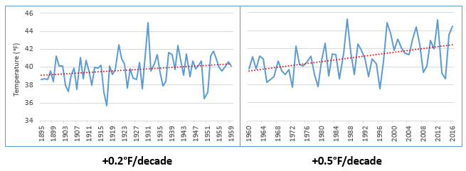
RISING TEMPERATURES
Minnesota Average Annual Temperature, 1895 -2016
Source: NOAA, 2017
Notes:
Minnesota has gotten noticeably warmer, especially over the last few decades. Since the beginning of the data record (1895) through 1959, Minnesota’s annual average temperature increased by nearly 0.2°F per decade, which is equivalent to over 2°F per century. This is shown in the graph to the left. This warming effect has accelerated over the last 50+ years. Data from 1960-2016 show that the recent rate of warming for Minnesota has sped up substantially to over 0.5°F per decade, which is equivalent to 5.0°F per century. This is shown in the graph to the right.
Source: National Oceanic and Atmospheric Administration (NOAA). 2017a. NOAA National Centers for Environmental information, Climate at a Glance: U.S. Time Series, Average Temperature, published February 2017, retrieved on February 9, 2017 from http://www.ncdc.noaa.gov/cag/

Slide 9
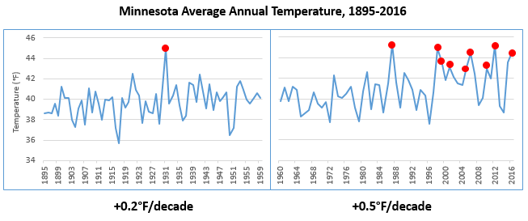
RISING TEMPERATURES
Minnesota Average Annual Temperature, 1895 -2016
Source: NOAA, 2017
Notes:
The increase in temperature trend is driving changes in the environment, affecting ice cover, soil moisture, bird migrations, insect behavior, and forest and plant growth. Some of these changes will impact the health of Minnesotans. For example, finding ways to cope with recent summer heat waves has made climate change less of an abstract concept for many residents, especially those who struggle to acclimate or adjust to these events, and the challenge will likely increase. Based on more than a century of data, 9 of the top 10 warmest years for Minnesota, shown in the slide as the peaks with red points, have occurred just within the last three decades.
Source: National Oceanic and Atmospheric Administration (NOAA). 2017a. NOAA National Centers for Environmental information, Climate at a Glance: U.S. Time Series, Average Temperature, published February 2017, retrieved on February 9, 2017 from http://www.ncdc.noaa.gov/cag/

Slide 10
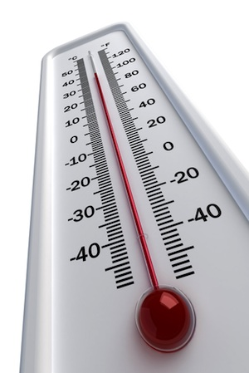
RISING TEMPERATURES
WINTER TEMPREATURES ARE RISING ABOUT TWICE AS FAST AS ANNUAL AVERAGE TEMPERATURES
MINIMUM OR ‘OVERNIGHT LOW’ TEMPERATURES ARE RISING FASTER THAN MAXIMUM OR ‘DAYTIME HIGH’ TEMPERATURES
NORTHERN MINNESOTA IS WARMING FASTER THAN SOUTHERN MINNESOTA
Notes:
Within this overall annual warming pattern, there have been three significant observations in Minnesota.
First, winter temperatures are rising twice as fast as the annual average temperatures. We are now experiencing more warmer winter temps, less snow and more winter rain, and changes in the amount of ice.
Secondly, minimum temperatures, which are the overnight lows, have been rising faster than maximum temperatures, which are the daytime highs. In just the last 30 years, average annual overnight lows have been rising at a rate of 6 degrees Fahrenheit per 100-year period.
And lastly, the northern part of the state is warming faster than the southern part of the state. Over the last 50 years, there has been a distinct spread of warmer overnight lows into the northern part of Minnesota. This is consistent with patterns seen across the Northern Hemisphere, where climate changes are occurring more rapidly at these higher latitudes.
Source: Zandlo, 2008; NOAA, 2017a
Image: Clip Art Images

Slide 11
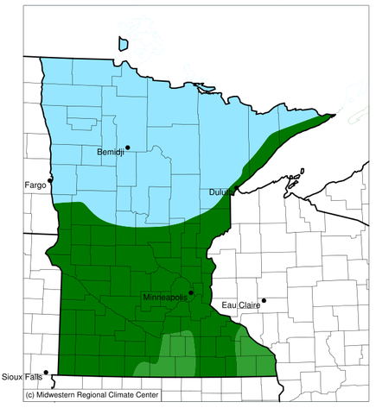
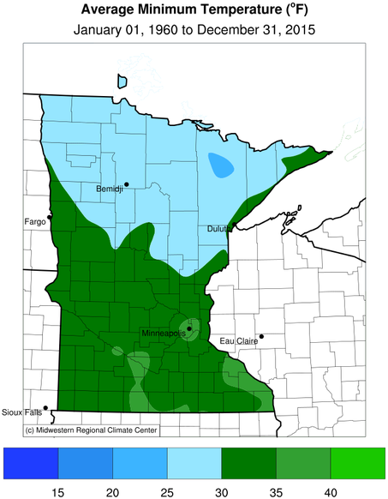
TEMPERATURE INCREASING
Annual Average Minimum Temperature for Minnesota
1900-1959
Source: MDH, 2015
1960-2015
Notes:
In Minnesota, there are distinct daily, seasonal, and regional trends in temperature.
Across the state winter season temperatures have been warming nearly twice as fast as annual average temperatures. The change in Minnesota’s winter daily low temperatures drives the statewide trend in all-season annual temperatures.
Minimum temperatures across all seasons, often referred to as “overnight lows”, have increased at a faster rate than average daily temperatures taken as a whole. Since 1985, average annual overnight lows have been rising at a rate of 6.0°F per century. There is no straightforward answer as to why nighttime lows are warming faster than daytime highs, but one likely factor is an increase in cloudiness that insulates land surface at night combined with reduced snow cover.
Over the last half century there has been a distinct spread of warmer lows into the northern part of Minnesota. Warming rates generally have been higher in northern areas of the state compared to southern areas, which is consistent with patterns seen across the Northern Hemisphere, where climate changes are occurring more rapidly at higher latitudes. However, the Twin Cities area located in the southeastern part of the state is a notable exception. The highest calculated warming trend of recent years is associated with the Twin Cities Metropolitan Area (TCMA). The high rate of warming associated with the TCMA may be a result of the urban heat island effect.
Source: MDH, 2015; Zandlo, 2008
Image source: Annual average minimum temperatures for Minnesota – MDH, 2015

Slide 12
ENVIRONMENTAL CHANGES
Changing Plant Hardiness Zones
After USDA Plant Hardiness Zone Map, USDA Miscellaneous Publication No. 1475, Issued January 1990.
Arbor Day Foundation Plant Hardness Zone Map published in 2015.
Notes:
The change in temperature is already causing substantial shifts in the environment. Maps of USDA plant hardiness zones show what types of plants will survive well and where. This is the standard by which gardeners and growers determine the plants that are most likely to thrive at a location. Zones are based on the average annual minimum winter temperature over a 30-year period and each zone represents a 10-degree Fahrenheit increment of minimum temperatures (USDA Agricultural Research Service, 2012).
This image from the National Arbor Day Foundation compares two points in recent times. In 1990, Minnesota was predominantly zone 3 in the northern half of the state and zone 4 in the southern half of the state. In 2015, Minnesota was predominantly zone 4 across the majority of the state, with a smaller area of zone 3 in the far northern part of the state and zone 5 emerging in the far southern part of the state.
These shifts may stress native plant species and may make it easier for non-native plants, and the insects and pathogens that rely on them, to move into areas where they previously couldn’t survive.
Source: USDA Agricultural Research Service, 2012
Image source: Plant Hardiness Zones – Arbor Day Foundation, 2015

Slide 13
PRECIPITATION INCREASES
Minnesota Average Annual Precipitation, 1895-2016
-0.2”/decade
+0.5”/decade
Notes:
With a warming atmosphere, more evaporation occurs. Warmer air can also hold more water vapor than cool air. The water holding capacity of air increases by about 7% per 1°C warming.
The chart on this slide shows Minnesota's average annual precipitation from 1895 to 2016. The graph on the left highlights the trend for the early part of the last century, 1895-1959, while the graph on the right highlights the trend for the most recent half century, 1960-2016. For most of the first half of the 20th century, the trend in precipitation was slightly downward, at a loss of 0.2 inches per decade or the equivalent of -2 inches per century. This downward trend was influenced by the Dust Bowl years of the 1930s. However, the rate of precipitation across the state has increased by nearly 0.5 inches per decade or the equivalent of 5 inches per century over the last 50+ years.
Source: Trenberth, 2011; National Oceanic and Atmospheric Administration (NOAA). 2017. NOAA National Centers for Environmental information, Climate at a Glance: U.S. Time Series, Precipitation, published February 2017, retrieved on February 9, 2017 from http://www.ncdc.noaa.gov/cag

Slide 14
PRECIPITATION – MORE EXTREME EVENTS
1860s
1870s
1880s
1900s
1910s
1920s
1930s
1940s
1950s
1960s
1970s
1980s
1990s
2000s
2010s
2020s
1890s
1
1
1
2
3
3
4
7 OF THE 15
MINNESOTA MEGA-RAIN EVENTS HAVE
OCCURRED SINCE 2002
Notes:
Overall our average annual precipitation is slightly increasing and this increase is being driven by heavy precipitation events. This timeline captures the historic mega-rain events in Minnesota that have occurred since 1858. These events constitute a six-inch rainfall that covers more than 1,000 square miles, with the core of the event topping eight inches. 15 mega-rain events have been identified in Minnesota since 1858 and 7 of these events have occurred since 2002.
A recent study of precipitation in Minnesota found that storms with 3+ inches of rainfall has increased 104% in last 50 years.
[Reference] These seven mega-rain events since 2002 include:
June 2002 – where rainfall topped 12 inches over 48 hours in Roseau and Lake of the Woods Counties of Northern MN
September 2004 – with more than 10 inches of rain in a 36-hour period in Faribault and Freeborn Counties of Southern MN
August 2007 – in South East Minnesota, after 15.1 inches of rain fell in 24 hours
September 2010 – in South Central Minnesota, after 9.5 inches of rain fell in one day
June 2012 – in North East Minnesota, after over 10 inches of rain fell over 2 days, causing severe flash flooding and river flooding; the St. Louis River crested at over 16 feet after rising 10 feet in 24 hours
July 2016 – in Central Minnesota, especially Pine County, with a two-day total of 9.3 inches
August 2016 – in Central and South East Minnesota, with rainfall rates of two-three inches per hour.
Source: MDNR, 2016

Slide 15
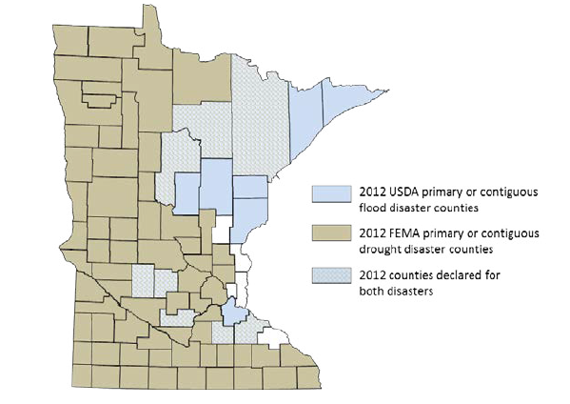
PRECIPITATION CHANGES
Blue counties were declared disaster areas due to flooding.
Brown counties were declared disaster areas due to drought.
Light blue, cross-hatched counties received both designations.
Notes:
However, more moisture in the atmosphere doesn’t necessarily mean a consistent rise in rain and snow. The character of precipitation in Minnesota is changing, increasing the potential for both extreme wet and dry spells. Minnesota is starting to experience increases in localized, heavy precipitation events. Observed trends have the potential to cause both increased flooding and drought, based on the localized nature of storms and their intensity, leaving some areas of the state drenched and other areas without any precipitation. For example, in 2012, 75 counties were declared primary or contiguous disaster areas for drought. However, in that same year 15 counties and three tribal reservations were declared disaster areas for flooding, with eight counties receiving disaster designation for both, underscoring the intensification of precipitation extremes in both directions.
Source: MDH, 2015

Slide 16
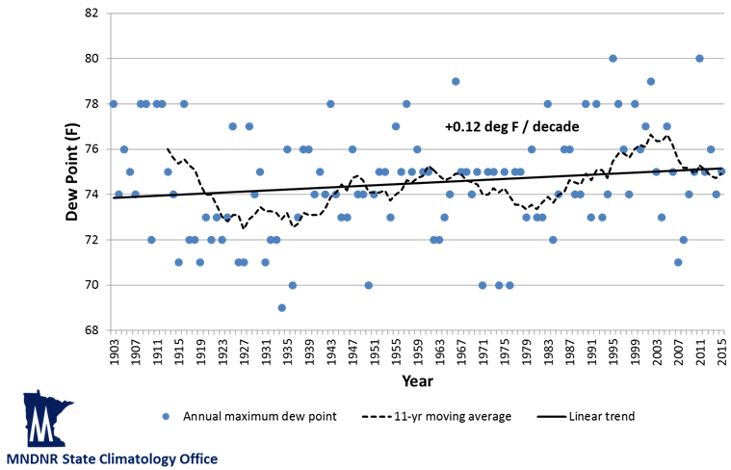
HUMIDITY CHANGES
Highest annual dew points at 6 p.m. CST
Minneapolis – St. Paul, 1903-2015
Notes:
Humidity levels are a function of both temperature and water levels in the atmosphere. Health professionals are particularly interested in humidity, since this affects the skin’s ability to evaporate moisture and cool the body. Dew point is a measure of water vapor in the air. Specifically, the dew point temperature is the temperature to which air must be cooled at constant pressure for it to become fully saturated with water. The higher the dew point is, the more uncomfortable and physically stressed a person feels. This is because people cool themselves by sweating, and if the dew point is high, it becomes more difficult for sweat to evaporate off the skin.
While many measures of dew point and humidity in Minnesota do not yet show evidence of increasing, the most extreme dew point values are becoming more frequent and more extreme over time. Based on historical data, annual maximum dew point temperatures (measured at 6pm CST) are increasing in Minnesota. This trend is modest but significant, about 0.12 degrees per decade. We are also experiencing an increase in the frequency of dew point readings at or above 75°F, a level that is extremely uncomfortable and oppressive. In fact, the frequency of these extreme dew point temperatures is 51% more common in the second half of Minnesota’s weather record (1960-2015) than in the first half (1903-1959).
Source: Trenberth, K.E., 2011; personal communication with Kenny Blumenfeld, Minnesota DNR State Climatology Office on August 9, 2016

Slide 17
OUTLINE
Climate Change in Minnesota
Health Impacts of Climate Change
Extreme Heat Events
Air Quality: Pollutants and Allergens
Flooding and Drought
Other Impacts
The High Cost of Disasters
Strategies: Public Health Professionals and Individuals
Communicating Climate Change
Notes:
This section will focus on the health impacts of climate. First, extreme heat events.

Slide 18
EXTREME HEAT
An extreme heat event is characterized by weather that is substantially hotter and/or more humid for a particular location at a particular time
Notes:
An extreme heat event is characterized by weather that is substantially hotter and/or more humid for a particular location at a particular time.
The definition of extreme heat event varies from place to place and it incorporates variables of temperature, humidity (or dew point), cloud cover, location, and how acclimated the population is to heat.
Sources: Anderson & Bell, 2011; NWS, 2009
Image: Pexels, https://www.pexels.com/photo/close-up-of-lights-251603/

Slide 19
EXTREME HEAT
Heat tetany (hyperventilation)
Heat rash
Heat cramps
Heat exhaustion
Heat edema (swelling)
Heat syncope (fainting)
Heat stroke
Death
Extreme heat events can cause:
Notes:
The human body operates best within a narrow range of core body temperature, around 98.6 °F. When core body temperature rises, the body uses two main physiological mechanisms to cool itself: sweating and increasing blood circulation close to the skin’s surface.
If exposure to heat exceeds the body’s cooling capabilities, a range of heat-related symptoms and conditions can develop. Some of these things are relatively minor and easily treated, such as heat cramps or heat rash. Others are much more serious, including heat exhaustion (profuse sweating, weakness, rapid breathing, dizziness, nausea, muscle cramps, and headaches). If left untreated, heat exhaustion can lead to heat stroke which is a life-threatening medical emergency, occurring when the core body temperature rises to or exceeds 104 °F. High core body temperature can damage vital organs such as the brain, liver, and kidneys. This can result in serious illness, neurological damage, and death.
Heat Illness Definitions:
Heat tetany: These are symptoms of hyperventilation, other respiratory problems and muscular problems like spasms and numbness of muscles that result from short period of intense heat.
Heat rash: These are symptoms of skin irritation resulting from excessive sweating as a result of exposure to extreme heat.
Heat cramps: These are symptoms of excessive muscle spasms that occur with strenuous exercise during periods of extreme wave event.
Heat edema: These are symptoms of swelling in the ankles, feet and hands that occur in persons who are not used to hot climate during heat wave event.
Heat syncope: These are symptoms of dizziness and fainting that occur during heat wave period.
Heat exhaustion: These are symptoms of profuse sweating, weakness, rapid breathing, dizziness, nausea, muscle cramps and headaches that occur during heat wave period.
Heat/sun stroke: This life threatening and usually occurs when the body temperature is greater than 104˚F.
Image: Pexels

Slide 20
EXTREME HEAT
Risk factors:
Lack of air conditioning in home
Low socioeconomic status
Living in urban areas
Living in topmost floor of a dwelling
Living in nursing homes or being bedridden
Living alone or a lack of social or family ties
Prolonged sun exposure
Drinking alcohol
Exercising outside on warm days
Notes:
Factors that increase risk of illness or death due to extreme heat include:
Lack of air conditioning in homes
Low socioeconomic status
Living in urban areas (due to the Urban Heat Island effect)
Living in the topmost floor of a dwelling (The warm air rises and is often trapped on the topmost floor)
Living alone of having a lack of social ties
Prolonged exposure to the sun
Drinking alcohol
Exercising outside on warm days
Image: Fan – Pexels

Slide 21
EXTREME HEAT
Vulnerable populations:
Everyone
Elderly persons 65 years and older, especially those who live alone
Children
Persons with pre-existing disease conditions
Persons taking certain medications
Athletes
Outdoor workers
Homeless
Notes:
Everyone is at risk during an extreme heat event.
Those most vulnerable to extreme heat include:
Elderly, 65 years and older
Children, 5 years and younger
Individuals with pre-existing disease conditions, including cardiovascular, respiratory, endocrine, liver and mental diseases conditions.
Persons taking certain medications such as diuretic, anticholinergics, tranquilizers and psychotropic drugs.
Persons outside during extreme heat events, including athletes and outdoor workers.
Persons who are homeless.
Image: Runner – Pexels, https://www.pexels.com/photo/man-in-white-long-sleeve-shirt-on-track-in-field-126401/

Slide 22
URBAN HEAT ISLANDS
Higher temperatures in urban areas relative to surrounding suburban and rural areas can be caused by:
Reduced vegetation and green space
Heat-absorbing surfaces, such as pavement
Heat-reflecting surfaces, including many building materials
Skyscrapers obstructing free air flow
Notes:
The urban heat island effect is a measurable increase in ambient urban air temperatures resulting primarily from the replacement of vegetation with buildings, roads, and other heat-absorbing infrastructure. The heat island effect can result in significant temperature differences between rural and urban areas.
At night, surfaces that absorbed heat during the day begin to release that heat. This can result in much higher overnight temperatures in urban areas.
Sources: NWS, 2016a; Snyder, 2012
Image: Design for Health, University of Minnesota

Slide 23
OUTLINE
Climate Change in Minnesota
Health Impacts of Climate Change
Extreme Heat Events
Air Quality: Pollutants and Allergens
Flooding and Drought
Other Impacts
The High Cost of Disasters
Strategies: Public Health Professionals and Individuals
Communicating Climate Change
Notes:
This section will examine how climate change affects air quality. Specific pollutants of interest include ground-level ozone, particulate matter, and allergens.

Slide 24
AIR POLLUTANTS AND ALLERGENS
Climate change may affect exposures to air pollutants by:
Creating both more windiness and more air stagnation events
Increasing temperatures
Lengthening the allergy season
Notes:
Climate change may affect exposures to air pollutants by:
Creating both more windiness and more air stagnation events; on calm days with stagnant air, pollutants stick around as smog and create poor air quality
Increased temperatures can
Increase pollution from fossil fuel combustion to meet electricity demand for increased air conditioner use
Increase the emission of pollutants called volatile organic compounds from plants and vegetation that are the raw ingredients for the formation of ozone
Increase generation of ozone: Increased temperature and increased primary pollutants increases ozone generation
Lengthening the allergy season, increasing pollen production, increasing allergenicity (potency of allergens), and introducing plants with more allergenic pollen
Sources: Jacob and Winner, 2009; Bernard et al, 2001; California Department of Public Health, 2008
Image: Flowers – Pexels, https://www.pexels.com/photo/yellow-field-under-blue-sky-69729/

Slide 25
AIR POLLUTANTS AND ALLERGENS: GROUND-LEVEL OZONE
HEALTH IMPACTS
Effects of exposure:
Decreased lung function and development of asthma
Aggravate other conditions, such as asthma, emphysema, and chronic obstructive pulmonary disease (COPD)
POPULATIONS AT RISK
Due to increased exposure:
People who are doing extended or heavy physical activity, especially athletes and outdoor workers
Due to sensitivity:
People who have lung disease
Older adults and children
People who have asthma or other breathing conditions like COPD
Notes:
The health effects of concern relate primarily to lung inflammation. Unhealthy ozone levels can aggravate pre-existing lung diseases like asthma, emphysema, and COPD. When the air quality is unhealthy, people with these conditions may experience symptoms like difficulty breathing deeply, shortness of breath, wheezing, coughing or fatigue.
Exposure of healthy individuals (including children) to relatively low ground-level ozone concentrations can cause harmful respiratory conditions, including lung irritation, difficulty breathing, reduced lung capacity, aggravated asthma, COPD and increased susceptibility to bronchitis.
Some populations are more sensitive to unhealthy ozone levels, including those with pre-existing lung disease, older adults and children, and those with asthma and/or other breathing conditions like COPD.
Sources: Jacob and Winner, 2009; Union of Concerned Scientists, 2011

Slide 26
AIR POLLUTANTS AND ALLERGENS: PARTICULATE MATTER (PM)
HEALTH IMPACTS
Effects of exposure:
Aggravate heart and cardiovascular diseases, as well as lung diseases like asthma and chronic obstructive pulmonary disease (COPD)
When the air quality is unhealthy, people with these conditions may experience symptoms like chest pain, shortness of breath, wheezing, coughing or fatigue
POPULATIONS AT RISK
Due to increased exposure:
People who are doing extended or heavy physical activity (like playing sports or working outdoors), especially near high-traffic corridors and/or stationary sources of PM (such as factories or power plants)
Due to sensitivity:
People who have heart disease or high blood pressure
Older adults and children
People who have asthma or other breathing conditions like COPD
Notes:
Particulate matter (PM) can have serious health impacts; air pollution can aggravate heart and cardiovascular diseases, as well as lung diseases like asthma and chronic obstructive pulmonary disease (COPD). When the air quality is unhealthy, people with these conditions may experience symptoms like chest pain, shortness of breath, wheezing, coughing or fatigue.
Populations at risk include those who have an increased exposure to particulate air pollution, including people who are doing extended or heavy physical activity (like playing sports or working outdoors), especially near high-traffic corridors and/or stationary sources of air pollution such as factories or power plants.
Some populations are more sensitive to particulate air pollution, including those with pre-existing heart disease or high blood pressure, older adults and children, and those with asthma and/or other breathing conditions like COPD.
Sources: Amann et al, 2004; Bernard et al, 2001; Pope et al, 1995; Pope, 2000; Shea et al, 2008; Clean Air Taskforce, 2010

Slide 27
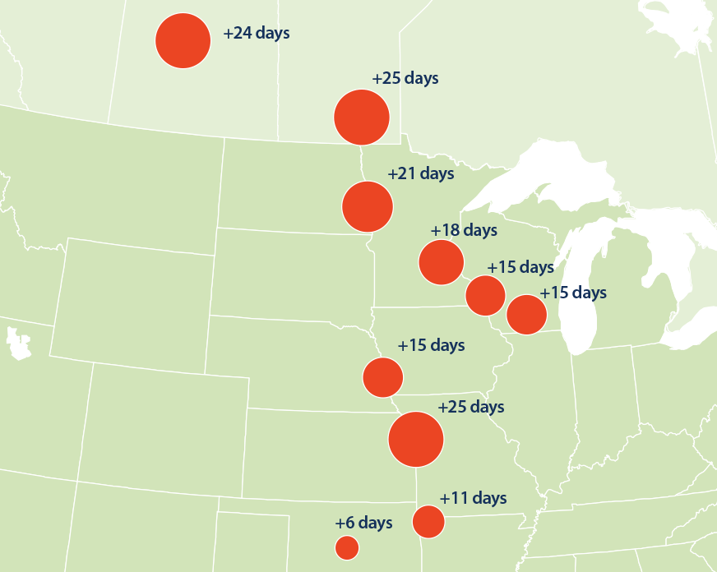
AIR POLLUTANTS AND ALLERGENS: ALLERGENIC POLLEN
Increase in duration of ragweed pollen season, in & around Minnesota.
Source: US EPA
Increased production and potency of pollen
Longer pollen season
Increased proliferation of weedy plant species that produce allergenic pollen
Introduction of new allergen-producing plant species
Notes:
Climate change is expected to increase pollen production, lengthen the pollen season and increase the potency of airborne allergens.
The warmer temperatures and changes in precipitation cause some plants to grow faster, bloom earlier, and produce more pollen. Additionally, higher levels of carbon dioxide (CO2) in the atmosphere act as a fertilizer for plant growth. Both increased temperatures and increased carbon dioxide (CO2) concentrations are expected to increase plant production of pollens, and may also increase fungal growth and spore release.
Temperature changes are expected to alter allergy seasons to begin earlier and last longer.
Recent studies suggest that climate-related temperature changes are expected to increase the potency of airborne allergens. Such changes increase the concentration of pollen in the air, the length of the allergy season and the strength of airborne allergens, and associated increases in allergy symptoms.
Climate change will allow certain allergen-producing plant species to move into new areas. Wind blown dust, carrying pollens and molds from outside of the United States, could expose people to new allergens they had not previously contacted.
Sources: Bernard et al, 2001; CDC, 2014; US EPA, 2016b; Rogers et al, 2006

Slide 28
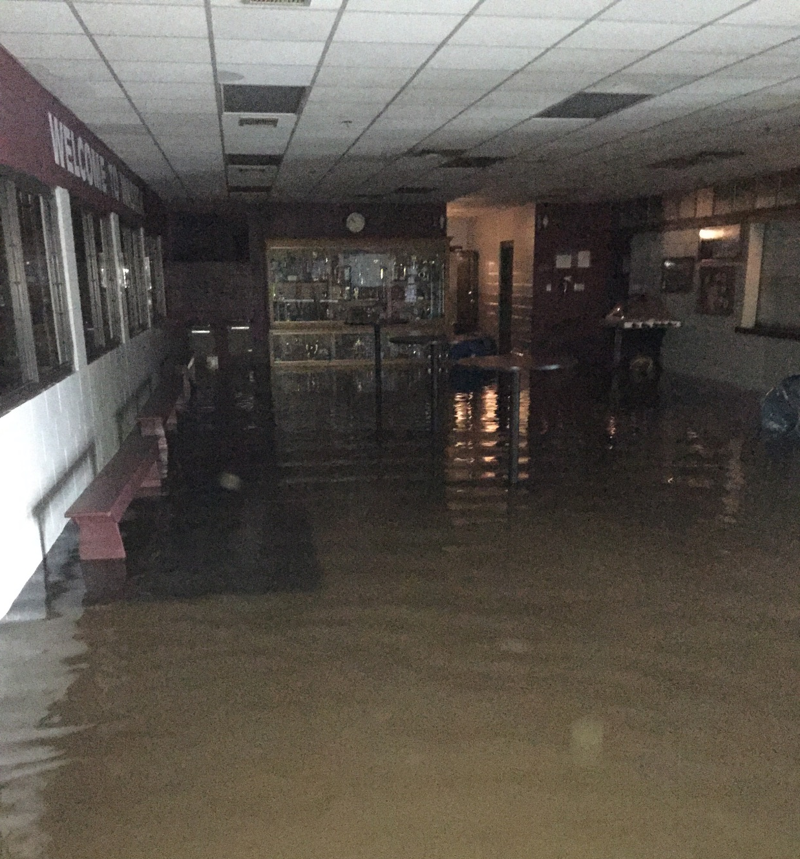
AIR POLLUTANTS AND ALLERGENS: MOLD GROWTH
Mold growth is encouraged by moisture:
Increased precipitation and flooding
Increased humidity
Increase in plant growth and plant biomass decay (leaf litter)
Improper installation or management of air conditioning systems can create conditions ripe for mold
Notes:
Mold growth is enhanced by moisture, and can be the result of:
Increase in precipitation/floods
Increase in temperature and/or humidity
Increase in plant growth/plant biomass decay (leaf litter)
Improper installation or management of air conditioning systems can create conditions ripe for mold
Mold can cause coughing, wheezing, nasal and throat conditions, and adversely affect persons with asthma or weakened immune systems
Sources: Bernard et al, 2001; National Wildlife Federation, 2010
Image: City of Waseca, 2016. Available at: https://services.arcgis.com/EBcDMSJ0IDOworEe/arcgis/rest/services/Flood2016_StaffPhotos/FeatureServer/0/9/attachments/4

Slide 29
OUTLINE
Climate Change in Minnesota
Health Impacts of Climate Change
Extreme Heat Events
Air Quality: Pollutants and Allergens
Flooding and Drought
Other Impacts
The High Cost of Disasters
Strategies: Public Health Professionals and Individuals
Communicating Climate Change
Notes:
This section will look at how increased or more severe flooding and/or drought can affect human health.

Slide 30
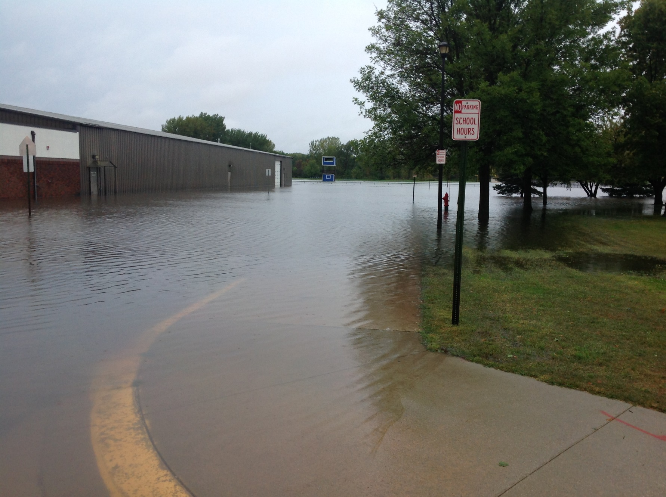
FLOODING
HEALTH IMPACTS
Physical injuries (including drowning)
Allergies (mold)
Food and water-borne illnesses
Food insecurity
Displacement
Mental health issues
Interruption of emergency services
Notes:
Health impacts from flooding can include
physical injuries (including drowning or injuries suffered from structural damage)
allergies (mold)
food and water-borne illnesses, including Salmonellosis, Cryptosporidiosis, and Giardiasis
food insecurity
displacement
mental health issues:
the stress of repairs, dealing with insurance;
feelings of isolation and depression; and
evacuation and loss of possessions undermine an individual’s sense of place, attachment, and self-identity
interruption of emergency services
In Minnesota, 15 people have died in floods between 1993-2016. About 75% of flash-flood deaths occur at night. Half of the victims die in automobiles or other vehicles.
“Be aware of flood hazards no matter where you live, but especially if you live in a low-lying area, near water or downstream from a dam. Even very small streams, gullies, creeks, culverts, dry streambeds, or low-lying ground that appear harmless in dry weather can flood. Every state is at risk from this hazard.” – Federal Emergency Management Agency
Sources: FEMA, 2012; SHELDUS, 2015; WHO, 2010; Ebi et al, 2008; CCSP, 2008; HSEM, 2017
Image: City of Waseca, 2016, available at: https://gis.co.waseca.mn.us/arcgis/rest/services/CountyServices/Flood2016Pics_FeatureService/MapServer/0/4402/attachments/4416

Slide 31
DROUGHT
Changing natural and social factors play a role in how drought affects our society, economy and environment. Factors include:
Timing of drought
Temperature
Population density and growth
Development and implementation of water supply technology
Land use patterns
Notes:
Some areas of the state will experience decreased precipitation. This is a result of localized large storm events, which leave some areas of the state drenched and others without any precipitation. An extended period of below-average precipitation can cause a drought, and it can be worsened by high temperatures or short, intense rainfalls that do not allow rainwater to soak into the ground.
Factors that play a role in how drought affects society, economy, and environment include:
Timing of drought
Temperature
Population density and growth
Development and implementation of water supply technology
Land use patterns
Source: National Drought Mitigation Center, 2011; CDC, US EPA, NOAA, AWWA, 2010
Image: Dry ground – Pexels, https://www.pexels.com/photo/earth-field-desert-dry-96865/

Slide 32
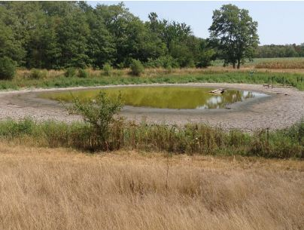
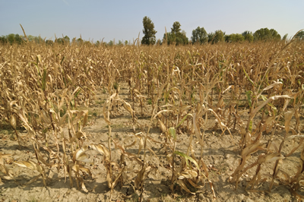
DROUGHT
HEALTH IMPACTS
Reduced lake and wetland levels and stream flows
Potential concentration of pollutants
Decreased water supply for drinking and agriculture
Negative effects on soil moisture and crop progress will impact food security
Increased risk of wildfires
Notes:
Drought and lower water levels are associated with the following public health issues:
Reduced soil moisture reserves, groundwater supplies, lake and wetland levels, and stream flows.
Potential concentration of pollutants. Effects of dry periods on water quality have not been adequately studied, although lower water availability clearly reduces dilution.
Decreasing water supply for drinking water and agriculture
Decreased water supply for agriculture can adversely affect crop progress and soil moisture and therefore food supply
From 1996 to 2011, the U.S. lost $17.2 billion dollars in crop damage due to drought.
Wildfire dangers (e.g. Pagami Creek Fire, Boundary Waters Canoe Area Wilderness– started in August 18th 2011, 92,682 acres): which can cause injuries, impair respiratory function with particles from smoke, property damage, and mental health impacts similar to those from flooding
Sources: MDNR 2000, MDNR 2011a; MDNR 2011b; Kundzewicz et al, 2007; US EPA, 2016c; USDA Forest Service, 2012; NWS, 2016b
Image: Department of Natural Resources, Available online at: http://drought.unl.edu/Portals/0/docs/CentralUSDroughtAssessment2012.pdf
Image: Minnesota Department of Agriculture, Available online at: http://www.mda.state.mn.us/~/media/Images/weather/droughtcorn2.ashx

Slide 33
OUTLINE
Climate Change in Minnesota
Health Impacts of Climate Change
Extreme Heat Events
Air Quality: Pollutants and Allergens
Flooding and Drought
Other Impacts
The High Cost of Disasters
Strategies: Public Health Professionals and Individuals
Communicating Climate Change
Notes:
Climate change can have many impacts to human health. This section will look at two other impacts of public health concern: vectorborne disease and power outage.

Slide 34
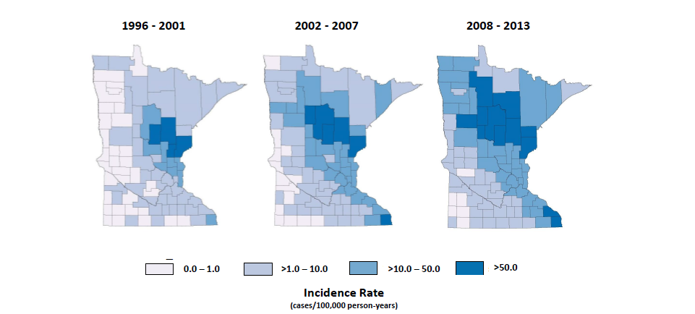
OTHER IMPACTS: VECTORBORNE DISEASE
Distribution of MN Lyme Disease Cases by County of Residence, 1996-2013
Notes:
Climate changes, such as warmer temperatures, increased rainfall, longer warm season, and less severe winters could impact the range and incidence of vectorborne disease. Risk for tickborne disease is also impacted by land use, population density, and human behavior.
For example, blacklegged ticks (“deer ticks”), which carry Lyme disease, are most active on warm, humid days. They are most abundant in wooded or brushy areas that provide food and cover for white-footed mice, deer, and other mammals. If those areas are where many people live, work, or visit for recreation, the risk for tickborne disease can be high.
Within the past 15 years, the incidence of all tick-transmitted diseases has increased substantially. The distribution of the blacklegged tick, the principal vector of these diseases in Minnesota, has expanded beyond its historical range as shown in the three maps on this slide.
The primary tickborne diseases endemic to Minnesota include Lyme disease, human anaplasmosis, and babesiosis. Endemic mosquito-borne diseases include West Nile virus disease, La Crosse encephalitis, Jamestown Canyon virus, and western equine encephalitis.
Source: MDH, 2012. Vector-borne Diseases. Available online: http://www.health.state.mn.us/divs/idepc/dtopics/vectorborne/index.html

Slide 35
OTHER IMPACTS: POWER OUTAGES
Demand for electricity increases in warmer climates for air conditioning
Increased temperatures may reduce power production efficacy in facilities that require water for cooling
Improper generator use during power outages can lead to carbon monoxide poisoning
Brown outs used for load reduction in an emergency may prevent black outs, but can have other impacts
Notes:
Severe storms and flooding can cause power outages through damaged and destroyed infrastructure.
Demand for electricity increases in warmer climates in order to air condition homes and businesses.
An increase of 1.8 °F is expected to increase energy demand 5-20 percent
Increased temperatures may reduce the efficiency of power production in facilities that require water for cooling.
Improper use of generators during power outages can led to carbon monoxide poisoning if generators are operated indoors or close to indoor air intakes. Generators should only be run outdoors.
Brownouts are intentionally reduced voltage in a power supply system used for load reduction in an emergency to prevent black outs, but they can have other impacts.
The health impacts of prolonged power outage may include: foodborne or waterborne illness due to effects on water treatment facilities or lack of refrigeration, hypothermia or hyperthermia, worsened conditions due to inability to contact emergency services, disruption to live-saving medical devices, inability to refrigerate certain medications or vaccines, increased risk of house fire from candle or fireplace use.
Source: US EPA, 2016d
Image: Power tower – Pexels, https://www.pexels.com/photo/sky-sunset-sun-twilight-46169/

Slide 36
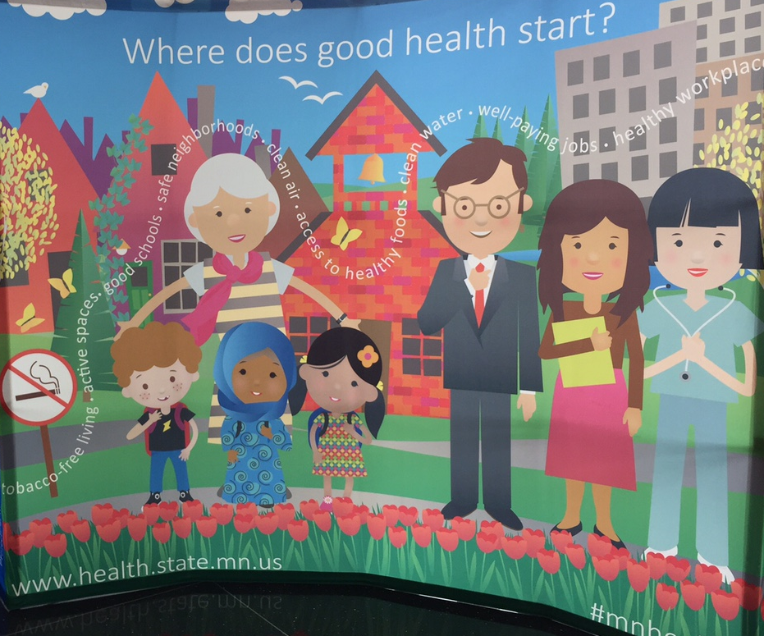
OTHER IMPACTS: HEALTH EQUITY
Climate change is a powerful risk amplifier, particularly in regard to health impacts.
To reduce climate and health inequities, focus on the conditions in which people are born, live, learn, work, and age (social determinants of health) to create communities where everyone has what they need to be healthy.
Notes:
Climate change is the greatest public health challenge of the 21st century, as it threatens the very basics – our air, food, water, shelter and security – that human life depends on. While we will all be impacted by climate change to some extent, we must acknowledge that climate change is a powerful risk amplifier, particularly in regard to health impacts.
Climate change will disproportionately impact many of the communities that already experience health inequities, or systemic difference in health status that are preventable and unfair. Across the U.S. and within Minnesota, inequities in living conditions, wealth, power, and health place low-income communities and some communities of color at greater risk of experiencing the negative health impacts of climate change.
In order to make our communities stronger, more resilient, in the face of climate change, we must focus on reducing health inequities. These health inequities, in large part, persist by nature of the social determinants of health — the conditions in which people are born, live, learn, work, and age. Existing health inequities (and the conditions that contribute to them) provide the context in which people experience the health impacts of climate change. Because of this, climate change is an immense health equity opportunity and we all have a role to play in creating a place where all communities are thriving and all people have what they need to be healthy.
Sources:
Costello A, Abbas M, Allen A, et al. Managing the health effects of climate change: Lancet and University College London Institute for Global Health Commission. Lancet 2009;373(9676):1693–1733. doi:10.1016/S0140-6736(09)60935-1.
Public Health Institute/Center for Climate Change and Health. Climate Change and Healthy Equity, 2016.
Image Credit: Minnesota Department of Health, 2017.

Slide 37
OUTLINE
Climate Change in Minnesota
Health Impacts of Climate Change
Extreme Heat Events
Air Quality: Pollutants and Allergens
Flooding and Drought
Other Impacts
The High Cost of Disasters
Strategies: Public Health Professionals and Individuals
Communicating Climate Change
Notes:
This section will examine the cost of natural disasters, including property and crop damage as well as a case study analysis of the health care costs of climate change.

Slide 38
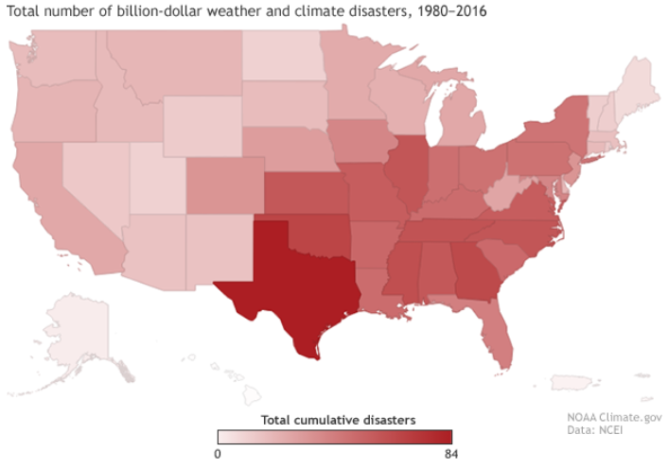
HIGH COST OF DISASTERS
31 Minnesota Events
Notes:
This map shows the number of times each state has been part of a billion-dollar weather or climate disaster of any type from 1980-2016. The darker the red, the greater the number of events the state has experienced.
Between1980 and 2016, the US has sustained 203 weather/climate disasters where overall damages exceeded $1billion.
Two notable disasters were the
1980 Drought/Heat Wave in Central and Eastern US; $48.4 billion in damages to agriculture and related industries, an estimated 10,000 deaths
2005 Hurricane Katrina, $100 billion in damages, over 1200 deaths
Minnesota has been included in multi-state billion dollar disasters including drought and heat waves, floods, severe local storms, winter storms, and wildfires.
Source and image source: NOAA, 2017b

Slide 39
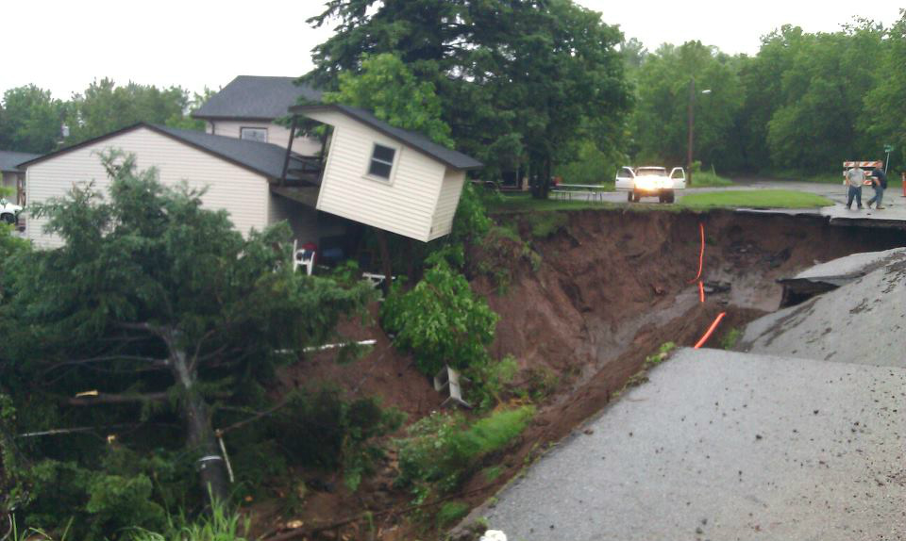
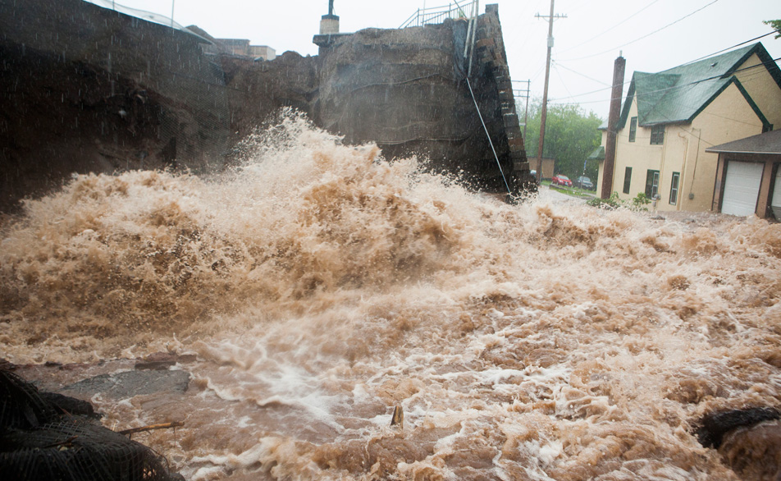
THE HIGH COST OF DISASTERS
2012 Duluth Flood: A 500 Year Storm Event
Total rainfall in excess of 10 inches resulted in severe flash flooding and river flooding
$108 million in damages to infrastructure alone
Damages to roads, bridges, water, and sewer systems, electric utilities, and communications infrastructure
Damage to 1,700 homes and 100 businesses included structural damage, loss of utilities, sewage back up, and the subsequent sustained heat and humidity exacerbated mold growth
Estimated damages for these homes and businesses exceeded $12 million
Notes:
In June 2012, Northeast Minnesota experienced an extreme rain event that caused severe flash flooding and river flooding when the St. Louis River rose over 10 feet in 24 hours, cresting at a record 16.6 feet.
The flooding caused $108 million in damages to infrastructure alone, including:
Roads
Bridges
Water and sewer systems
Electric utilities
Communications infrastructure
Over 1700 homes and 100 businesses were damage or destroyed, including:
Structural damage
Loss of utilities
Sewage back up
Exacerbated mold growth
The estimated damages to these homes and businesses exceeded $12 million.
Source: Governor Dayton, 2012
Photo credits: Rachel Agurkis (top), Derek Montgomery for MPR (bottom)

Slide 40
THE HIGH COST OF DISASTERS
Notes:
This graph shows the cost of property damage (blue) and crop damage (green) in Minnesota between 2000 and 2015 due to severe weather.
There are numerous factors influencing how damage estimates are calculated so we cannot interpret this data as suggesting any sort of trend over time, particularly for such a short time period. But this chart is very useful for communicating the magnitude of damage costs to society from severe weather… as well as the potential savings from effective adaptation strategies.
Source: NOAA, 2016

Slide 41
THE HIGH COST OF DISASTERS
A case study analysis of 6 climate-related disasters estimated the associated health care costs:
US Ozone Air Pollution, 2000-2002
California Heat Wave, 2006
Florida Hurricane Season, 2004
Louisiana West Nile Virus Outbreak, 2002
North Dakota Red River Flooding, 2009
Southern California Wildfires, 2003
The associated health care costs alone topped $14 billion:
1,689 premature deaths
8,992 hospitalizations
21,113 emergency visits
734,398 outpatient visits
Notes:
The health care costs associated with anticipated climate-change related events are projected to be enormous. A case study analysis of 6 disasters showed that the health care costs of those selected disasters alone were over $14 billion.
95 percent of this cost was due the value of lives lost prematurely (1,689 premature deaths). Actual health care costs were over $740 million, reflecting over 760,000 encounters with the health care system, including 734,398 outpatient visits, 21,113 emergency visits, and 8,992 hospitalizations. The analysis did not include the costs of long-term mental health impacts, lost work to an affected individual or lost work or leisure time for a caretaker, which would increase the total health care costs of each disaster.
Source: Knowlton et al., 2011
Image: Pexels, https://www.pexels.com/photo/numbers-money-calculating-calculation-3305/

Slide 42
OUTLINE
Climate Change in Minnesota
Health Impacts of Climate Change
Extreme Heat Events
Air Quality: Pollutants and Allergens
Flooding and Drought
Other Impacts
The High Cost of Disasters
Strategies: Public Health Professionals and Individuals
Communicating Climate Change
Notes:
The next section of the module will cover some examples of strategies for mitigating and adapting to climate change that can be implemented by public health professionals and individuals.

Slide 43
STRATEGIES: PUBLIC HEALTH PROFESSIONALS
MITIGATION
Informing and educating
Mobilizing community partnerships
Developing policies and plans
Enforcing laws and regulations
Researching innovative solutions
Notes:
Public health can play a role in mitigating and adapting to climate change. This slide lists a few examples of how public health can play a role in mitigation. The strategies are based on five of the 10 Essential Public Health Services.
As a reminder, mitigating climate change means taking on or supporting efforts that slow, stabilize or reverse climate change by reducing greenhouse gas emissions.
Examples of public health strategies include:
Informing, educating, and empowering people about health issues, such as:
Educating about the health benefits of active transportation modes like biking, walking, and transit that also reduce greenhouse gas emissions
Mobilizing community partnerships to solve health problems, such as:
Forming a community coalition to review a heat vulnerability map overlaid with an urban forestry or tree canopy map to identify priority areas for greenspace and tree planting
Developing policies and plans that support individual and community health efforts, such as:
Developing plans for a community garden where people can access locally grown foods that reduce food transport and lead to reduced greenhouse gas emissions
Enforcing laws and regulations that protect health and ensure safety, such as:
Enforcing school and public transit bus idling regulations that reduce exhaust fumes, which also reduce greenhouse gas emissions
Researching innovative solutions to health problems, such as:
Conducting a pilot-study of climate change mitigation strategies identified and implemented by a community that is trying to reduce the health impacts of climate change on a specific vulnerable population
Source: Council of State and Territorial Epidemiologists (CSTE), 2013. Developing Climate Change Environmental Public Health Indicators: Guidance for Local Health Departments. CSTE State Environmental Health Indicators Collaborative Climate Change Subcommittee, September 2013.
Image source: Pexels

Slide 44
STRATEGIES: PUBLIC HEALTH PROFESSIONALS
ADAPTATION
Monitor health status
Diagnose and investigate community health problems
Link people to environmental health services
Assure competent workforce
Evaluate effectiveness, accessibility, and quality of health services
Notes:
Public health can also play a role in adapting to climate change by understanding how climate change affects human health and which populations in your community are most likely to be affected by climate change.
As a reminder, adapting to climate change means anticipating and preparing for the effects of climate change and reducing the associated health burden. Examples of public health strategies include:
Monitoring health status to address community health problems, such as:
Tracking community health status impacted by climate change events such as extreme heat and poor air quality
Diagnosing and investigating community health problems and health hazards, such as:
Conducting vulnerability assessments to identify potential exposure to flooding
Linking people to needed environmental health services, such as:
Maintaining robust all-hazards plans that include planning for and responding to severe storms, extreme heat, and power loss
Assuring competent public and personal health care workforce, such as:
Providing training to health professionals on adaptation strategies that reduce the health impacts from climate change
Evaluating effectiveness, accessibility, and quality of personal and population-based health services, such as:
Evaluating access to affordable air filtration systems for people with asthma and other respiratory conditions vulnerable to poor air quality
Source: Council of State and Territorial Epidemiologists (CSTE), 2013. Developing Climate Change Environmental Public Health Indicators: Guidance for Local Health Departments. CSTE State Environmental Health Indicators Collaborative Climate Change Subcommittee, September 2013.
Image Credit: Pexels, https://static.pexels.com/photos/40120/pexels-photo-40120.jpeg

Slide 45
What can individuals do to address climate change?
Notes:
We as individuals can play many roles in mitigating and adapting to climate change. The next slides list actions each of us can take to make a difference.

Slide 46
Energy
1
Notes:
Energy production is one of the big three contributors to our changing climate because burning oil, coal, and natural gas to generate electric power puts a lot of GHGs into the air.
Image: Windmill – Pexels. Available online at: https://www.pexels.com/photo/road-street-desert-industry-477230/

Slide 47
Energy: Individual Action and Collective Action
INDIVIDUAL ACTION
Use less energy to heat or cool homes
Use energy-efficient appliances and lightbulbs
Reduce, reuse, recycle what we buy and use on a daily basis
COLLECTIVE ACTION
Use more renewable energy (solar, wind, and biofuels)
Use less fossil fuel energy (oil, coal, natural gas)
Support policy change for renewable energy
Notes:
As individuals, we can each reduce the amount of GHG emissions we cause in a number of ways like using less energy to heat or cool homes (turning the temp up or down 2 degrees, adding insulation and weather stripping, planting trees for shade); using energy-efficient appliances and light bulbs; and reducing/reusing/recycling what we buy and use on a daily basis.
However, what is really going to make a difference is having all of us rely more on renewable energy sources like solar, wind, and biofuels and less on fossil fuel energy sources like oil, coal, and natural gas. As individuals, we can support public and private sector policy changes that lead to more renewable energy production. A policy example is Minnesota’s Next Generation Energy Act of 2007 that has achievable GHG reduction targets by 2025 and beyond.
Image: Windmill – Pexels. Available online at: https://www.pexels.com/photo/road-street-desert-industry-477230/

Slide 48
Transportation
2
Notes:
Transportation is the second big contributor to our changing climate because burning fuel to power vehicles emits a lot of GHGs into the air.
Image: Person biking – Pexels. Available online at: https://www.pexels.com/photo/person-wearing-black-and-gray-sleeveless-dress-riding-a-step-through-bicycle-521474/

Slide 49
Transportation: Individual Action and Collective Action
INDIVIDUAL ACTION
Burn less gasoline or diesel fuel
Walk, bike, use transit, carpool, and telecommute when possible
Drive an electric vehicle (powered by wind or solar energy)
COLLECTIVE ACTION
Support public and private sector policies
To increase gas and diesel mileage standards
Incentivize the production of electric vehicles
Build more transit options
Notes:
As individuals, we can each reduce the amount of GHG emissions we cause by using transportation choices that burn less gasoline or diesel fuel like walking, biking, using transit, carpooling, and telecommuting when possible. Another option would be to drive an electric vehicle powered by wind or solar energy.
However, what is really going to make a difference is if we all have more transportation options that either burn less or don’t use any gasoline or diesel fuel. As individuals, we can support public and private sector policies like increasing gas and diesel mileage standards, incentivizing the production and purchase of electric vehicles, building more transit options where sufficient population density exists, and having policies that support telecommuting.
Image: Person biking – Pexels. Available online at: https://www.pexels.com/photo/person-wearing-black-and-gray-sleeveless-dress-riding-a-step-through-bicycle-521474/

Slide 50
Agriculture
3
Notes:
Agriculture is the third big contributor to GHG emissions because it takes a lot of energy to produce, process, and transport food.
Image: Food – Pexels. Available online at: https://www.pexels.com/photo/tomatoes-carrots-and-radish-on-the-top-of-the-table-196643/

Slide 51
Agriculture: Individual Action and Collective Action
INDIVIDUAL ACTION
Buy more locally grown foods
Eat fewer processed foods and less meat
Grow some of our own food
COLLECTIVE ACTION
Support policies that incentivize:
Foods produced with fewer chemicals
Food that are less processed
Food that are transported shorter distances
Notes:
As individuals, we can each reduce the amount of GHG emissions we cause by buying more locally grown foods, eating fewer processed foods and less meat, and even growing some of our own food.
However, what is really going to make a difference is if we all have access to foods that are produced, processed, and transported using less energy. As individuals, we can support public and private sector policies that incentivize foods produced with fewer chemicals, foods that are less processed and closer to their natural state, and foods that are transported shorter distances.
Image: Food – Pexels. Available online at: https://www.pexels.com/photo/tomatoes-carrots-and-radish-on-the-top-of-the-table-196643/

Slide 52
OUTLINE
Climate Change in Minnesota
Health Impacts of Climate Change
Extreme Heat Events
Air Quality: Pollutants and Allergens
Flooding and Drought
Other Impacts
The High Cost of Disasters
Strategies: Public Health Professionals and Individuals
Communicating Climate Change
Notes:
The final section of the module will cover how to communicate about climate change to staff and the community.

Slide 53
COMMUNICATING CLIMATE CHANGE
The Yale Project on Climate Change Communication identified six distinct American audiences, each of which responds to the issue of climate change in markedly different ways.
Alarmed
Concerned
Cautious
Disengaged
Doubtful
Dismissive
28%
27%
17%
7%
11%
10%
Highest belief in climate change
Most concerned
Most motivated
Lowest belief in climate change
Least concerned
Least motivated
Notes:
One of the greatest challenges to addressing the health impacts of climate change is communicating about climate change. Climate change can be a highly political topic that was long framed as an environmental issue rather than a human health issue.
Further, public opinion about climate change is fluid and changes because it reflects social, economic, and environmental factors in the communities that surround us.
The Six Americas, a Yale Project on Climate Change Communication started in 2007 to understand how Americans thought about and understood climate change. The information in this and subsequent slides is from their March 2016 data.
The Six Americas are arranged on a spectrum of concern and issue engagement from Alarmed (those with the highest concern about climate change and who are most supportive of individual and political action to mitigate the threat) to Dismissive (who are equally convinced that climate change is not occurring and no action is needed). You can see the proportion of the population in each of the Six Americas and their position on the spectrum on this slide. Specific details about each category are given in the next 2 slides.
Source: Leiserowitz et al., 2015

Slide 54
COMMUNICATING CLIMATE CHANGE
Alarmed
Concerned
Cautious
Disengaged
Doubtful
Dismissive
28%
27%
17%
7%
11%
10%
Completely convinced that climate change is real
Believe that people are already being harmed by climate change
Supportive of personal and policy action
Believe that climate change is real
Feel that dangerous impacts of climate change will be seen in 10 years
Supportive of personal and policy action
Unsure whether climate change is occurring
Believe the impacts of climate change will be seen in 25 years
Do not believe personal actions or the actions of a single nation will make any difference
Notes:
Alarmed:
Completely convinced that climate change is real
Believe that people are already being harmed by climate change
Supportive of personal and policy action
Concerned:
Believe that climate change is real
Feel that dangerous impacts of climate change will be seen in 10 years
Supportive of personal and policy action
Cautious:
Unsure whether climate change is occurring
Believe the impacts of climate change will be seen in 25 years
Do not believe personal actions or the actions of a single nation will make any difference
Source: Leiserowitz et al., 2015

Slide 55
COMMUNICATING CLIMATE CHANGE
Alarmed
Concerned
Cautious
Disengaged
Doubtful
Dismissive
28%
27%
17%
7%
11%
10%
Less convinced that climate change is happening
Believe that impacts of climate change will be felt in 50 years
Do not feel that immediate action is needed
Unconcerned about whether or not climate change is occurring
Believe the impacts of climate change will be felt in 100 years
Do not feel that immediate action is needed
The only segment that is completely unconcerned about climate change because they do not believe it is happening
Notes:
Disengaged:
Less convinced that climate change is happening
Believe that impacts of climate change will be felt in 50 years
Do not feel that immediate action is needed
Doubtful:
Unconcerned about whether or not climate change is occurring
Believe the impacts of climate change will be felt in 100 years
Do not feel that immediate action is needed
Dismissive:
The only segment that is completely unconcerned about climate change because they do not believe it is happening
Source: Leiserowitz et al., 2015

Slide 56
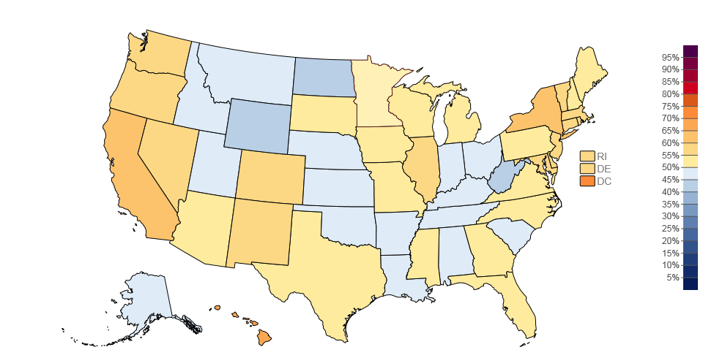
CLIMATE CHANGE AWARENESS
Percent of adults who are worried about climate change (2014)
Minnesotans: 52%
Americans: 52%
Notes:
Americans are generally unaware of the current and potential health consequences of climate change. According to a recent Public Perceptions Report from the Yale Project on Climate Change, few Americans only 1 in 4 (27%) could name at least one health problem related to climate change and 10% answered *incorrectly* that there are no health problems associated with climate change.
There also seems to be a disconnect between recognizing the impacts of climate change with a personal realm of influence. In a similar study, also conducted by the Yale Project on Climate Change, 52% of Americans (nation-wide) cited that they’re worried about climate change (this percentage holds the same for Minnesotans).
Note: Public opinion estimates are produced using a statistical model based on national survey data gathered between 2008 and 2014 by the Yale Project on Climate Change Communication and the George Mason Center for Climate Change Communication.
Source: Leiserowitz et al., 2014; Howe et al., 2015
Image: Yale, http://climatecommunication.yale.edu/visualizations-data/ycom/

Slide 57
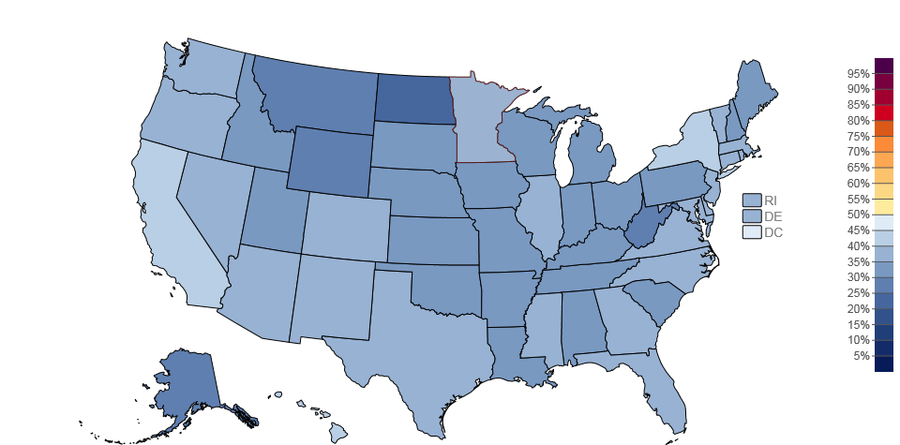
CLIMATE CHANGE AWARENESS
Percent of adults who think climate change will harm them personally (2014)
Minnesotans: 32%
Americans: 34%
Notes:
Yet only 34% of Americans, and similarly 32% of Minnesotans, think climate change will harm them personally. This limited awareness and sense of urgency strongly indicates the need for more public education about the current and future impacts of climate change on human health.
Note: Public opinion estimates are produced using a statistical model based on national survey data gathered between 2008 and 2014 by the Yale Project on Climate Change Communication and the George Mason Center for Climate Change Communication.
Source: Howe et al., 2015

Slide 58
COMMUNICATING CLIMATE CHANGE
Most Americans think of climate change in geographically and temporally distant terms
Few Americans, without prompting, report that climate change has any connection to human health
Notes:
Most Americans think of climate change in geographically and temporally distant terms– that it is most likely to affect plants and animals and/or future generations and least likely to affect our community or ourselves.
61% believe climate change will harm plants and animals
61% believe climate change will harm future generations
53% believe climate change will harm people in developing countries
39% believe climate change will harm people in their community
32% believe climate change will harm themselves
Few Americans, without prompting, report that climate change has any connection to human health. With education, however, they are easily able to understand the relationship.
Source: Maibach et al., 2011

Slide 59
COMMUNICATING CLIMATE CHANGE
COMMUNICATION STRATEGIES
Put people first and connect on common values
Make the data real
Frame climate change as a human health issue and emphasize health solutions
Notes:
Communication strategies for talking about climate change and health:
Put people first and connect on common values
Move from people to climate, not the other way around
Do your homework – understand your audience’s concerns and values, then find ways to connect to these shared values (community, choice/freedom, health, family) to build a relationship and motivate action
Make the data real
Use visual language - let the audience see themselves in the solution
Localize climate change impacts - use tangible examples from your audience’s your region, state, or city as often as possible
Frame climate change as a human health issue and emphasize health solutions - the “win-win”
Many people perceive it as environment only; human health is a broadly shared value and may be more likely to engage
People respond best to positive information
People responded best to co-benefits messaging because recommended behaviors were seen as benefiting themselves individually as well as impacting climate change (walkable communities, bike sharing, buying local foods).
Regardless of which communications strategies you employ, you likely won’t be able to convince everyone that climate change is happening or that it is a human health issue.
Source: ecoAmerica, 2016; Maibach et al., 2011
Images:
Man - https://www.pexels.com/photo/man-young-happy-smiling-91227/
Data - https://www.pexels.com/photo/blue-and-yellow-graph-on-stock-market-monitor-159888/
Holding Hands - https://www.pexels.com/photo/action-adult-affection-eldery-339620/

Slide 60
SUMMARY
Minnesota’s climate is changing:
Increases in temperature
Increases in extreme precipitations events
Climate changes can lead to a variety of events with serious health impacts
Extreme heat and air pollution
Flooding and drought
Other impacts
Public health mitigation, adaptation, and communication strategies can reduce the health impacts of climate change
Notes:
Communication strategies for talking about climate change and health:
Put people first and connect on common values
Move from people to climate, not the other way around
Do your homework – understand your audience’s concerns and values, then find ways to connect to these shared values (community, choice/freedom, health, family) to build a relationship and motivate action
Make the data real
Use visual language - let the audience see themselves in the solution
Localize climate change impacts - use tangible examples from your audience’s your region, state, or city as often as possible
Frame climate change as a human health issue and emphasize health solutions - the “win-win”
Many people perceive it as environment only; human health is a broadly shared value and may be more likely to engage
People respond best to positive information
People responded best to co-benefits messaging because recommended behaviors were seen as benefiting themselves individually as well as impacting climate change (walkable communities, bike sharing, buying local foods).
Regardless of which communications strategies you employ, you likely won’t be able to convince everyone that climate change is happening or that it is a human health issue.
Source: ecoAmerica, 2016; Maibach et al., 2011

Slide 61
ACKNOWLEDGEMENTS
This work was supported by cooperative agreement 5UE1EH000738 from the Centers for Disease Control and Prevention

Slide 62
Questions?
Contact Minnesota Climate and Health Program
health.climatechange@state.mn.us
651-201-4898

Slide 63
REFERENCES: 1 of 7
Amann, Swart, Raes, Tuinstra. 2004. A good climate for clean air: linkages between climate change and air pollution. Climatic Change 66: 263–269.
Anderson GB and Bell ML. 2011. “Heat waves in the United States: Mortality risk during heat waves and effect modification by heat wave characteristics in 43 US communities,” Environmental Health Perspectives, 119(2), 210.
Arbor Day Foundation. 2015. Hardiness Zones – Changes from 1990-2015. Available online: https://www.arborday.org/media/map_change.cfm
Arbor Day Foundation, 2017. Everyone Can Plant a Tree & Help Fight Climate Change, https://www.arborday.org/trees/climatechange/plantatree.cfm
Bernard SM, Samet JM, Grambsch A, Ebi KL, Romieu I. 2001. The potential impacts of climate variability and change on air pollution-related health effects in the United States. Environmental Health Perspectives Vol 109, Supplement 2, pp 199-209.
Blumenfeld, K. 2016. Minnesota Department of Natural Resources, State Climatology Office; personal communication on August 9, 2016.
California Department of Public Health. 2008. Public Health Climate Change Adaptation Strategy for California. Available online: http://www.climatechange.ca.gov/adaptation/public_health.html
Centers for Disease Control and Prevention (CDC). 2014. Allergens. Available online: https://www.cdc.gov/climateandhealth/effects/allergen.htm
Centers for Disease Control and Prevention, US Environmental Protection Agency, National Oceanic and Atmospheric Agency, and America Water Works Association (CDC, US EPA, NOAA, AWWA). 2010. "When Every Drop Counts: Protecting Public Health During Drought Conditions-- A Guide for Public Health Professionals." Atlanta, US Department of Health and Human Services.
Clean Air Taskforce. 2010. The Toll from Coal: An Updated Assessment of Death and Disease from America’s Dirtiest Energy Source. Available online: http://www.catf.us/resources/publications/files/The_Toll_from_Coal.pdf

Slide 64
REFERENCES: 2 of 7
Climate Change Science Program (CCSP). 2008. Analyses of the effects of global change on human health and welfare and human systems. A Report by the U.S. Climate Change Science Program and the Subcommittee on Global Change Research. [Gamble JL (editor), Ebi KL, Sussman FG, Wilbanks TJ, (authors)]. U.S. Environmental Protection Agency, Washington, DC, USA.
Costello A, Abbas M, Allen A, et al. Managing the health effects of climate change: Lancet and University College London Institute for Global Health Commission. Lancet 2009;373(9676):1693–1733. doi:10.1016/S0140-6736(09)60935-1.
Do It Green Minnesota. 2017a. Eating Low: Back to Basics. Available online: https://doitgreen.org/topics/food/eating-low-back-basics
Do It Green Minnesota, 2017b. The Connection Between Recycling and Global Warming, https://doitgreen.org/topics/climate-change/connection-between-recycling-and-global-warming
Do It Green Minnesota, 2017c. Rainwater as a Resource, https://doitgreen.org/topics/do-it-yourself/rainwater-resource
Do It Green Minnesota, 2017d. Achieving a Sustainable Lawn, https://doitgreen.org/topics/gardening/achieving-sustainable-lawn
Ebi KL, Balbus J, Kinney PL, Lipp E, Mills D, O’Neill MS, and Wilson M. 2008. Effects of global change on human health. In: Analyses of the Effects of Global Change on Human Health and Welfare and Human Systems [Gamble JL (editor), Ebi KL, Sussman FG, and Wilbanks TJ (authors)]. Synthesis and Assessment Product 4.6. U.S. Environmental Protection Agency, Washington, DC, pp. 39-87.
ecoAmerica: 2016. Let’s Talk Health and Climate: Communication Guidance for Health Professionals, Climate for Health, Washington, D.C.
Environmental Quality Board. 2015. Minnesota and climate change: our tomorrow starts today. Available online: https://www.eqb.state.mn.us/content/climate-change
Federal Emergency Management Agency (FEMA). 2012. Floods. Available online: http://www.ready.gov/floods
Frumkin H, Hess J, Luber G, Malilay J, and McGeehin M. 2008. Framing Public Health Matters, Climate Change: the Public Health Response. American Journal of Public Health, March 2008, Vol. 98, No. 3, pp 435-445.
Governor Dayton, M. 2012. Individual Assistance request to President Barak Obama. July 19, 2012.
Homeland Security and Emergency Management (HSEM). 2017. Flooding, Flash Floods. HSEM, Minnesota Department of Public Safety. Available online: https://dps.mn.gov/divisions/hsem/weather-awareness-preparedness/Pages/severe-weather-flooding.aspx

Slide 65
REFERENCES: 3 of 7
Howe P, Mildenberger M, Marlon J, and Leiserowitz A. 2015. “Yale Climate Opinion Maps – United States.” Yale Program on Climate Change Communication. Available online: http://climatecommunication.yale.edu/visualizations-data/ycom
Jacob DJ and Winner DA. 2009. Effect of climate change on air quality. Atmospheric Environment, Vol 34, pp. 51-63.
Kessler R. 2011. Stormwater Strategies: Cities prepare aging infrastructure for climate change. Environmental Health Perspectives. Vol 119, Num 12.
Knowlton K, Rotkin-Ellman M, Geballe L, Max W, Solomon GM. 2011. “Six Climate Change-Related Events in The United States Accounted for About $14 Billion in Lost Lives and Health Costs.” Health Affairs, Vol 30, No. 11, pp. 2167-76.
Kundzewicz ZW, Mata LJ, Arnell NW, Döll P, Kabat P, Jiménez B, Miller KA, Oki T, Sen Z and Shiklomanov IA. 2007. Freshwater resources and their management. Climate Change 2007: Impacts, Adaptation and Vulnerability. Contribution of Working Group II to the Fourth Assessment Report of the Intergovernmental Panel on Climate Change, [Parry ML, Canziani OF, Palutikof JP, van der Linden PJ, and Hanson CE(eds.)]. Cambridge University Press, Cambridge, UK, and New York, pp. 617-652.
Leiserowitz A, Maibach E, Roser-Renouf C, Smith N. 2015. “Global Warming’s Six America’s.” Yale University and George Mason University. New Haven, CT: Yale Project on Climate Change Communication. Available online: http://www.c2es.org/docUploads/SixAmericas.pdf
Leiserowitz A, Maibach E, Roser-Renouf C, Feinberg G, Rosenthal S, and Marlon J. 2014. “Public Perceptions of the Health Consequences of Global Warming: October 2014.” Yale University and George Mason University. New Haven, CT: Yale Project on Climate Change Communication. Available online: http://climatecommunication.yale.edu/wp-content/uploads/2014/12/Global-Warming-Public-Health-October_2014_FINAL-1.pdf
Low Carbon Food Print Shopping Guide, 2017. Minnesota/Midwest; www.doitgreen.org
Maibach E, Nisbet M, and Weather M. 2011. “Conveying the Human Implications of Climate Change: A Climate Change Communication Primer for Public Health Professionals.” Fairfax, VA: George Mason University Center for Climate Change Communication.

Slide 66
REFERENCES: 4 of 7
Minnesota Department of Health (MDH). 2012. Vector-borne Diseases. Available online: http://www.health.state.mn.us/divs/idepc/dtopics/vectorborne/index.html
Minnesota Department of Health (MDH). 2015. Minnesota Climate and Health Profile Report. Available online: http://www.health.state.mn.us/divs/climatechange/docs/mnprofile2015.pdf
Minnesota Department of Natural Resources (MDNR). 2000. Minnesota’s Water Supply: Natural Conditions and Human Impacts. Available online: http://files.dnr.state.mn.us/publications/waters/mn_water_supply.pdf
Minnesota Department of Natural Resources (MDNR). 2011a. Drought. Available online: http://www.dnr.state.mn.us/climate/drought/index.html
Minnesota Department of Natural Resources (MDNR). 2011b. Lake Level Minnesota. Available online: http://www.dnr.state.mn.us/climate/waterlevels/lakes/index.html
Minnesota Department of Natural Resources (MDNR), 2016. Historic Mega-Rain Events in Minnesota. Available online: http://www.dnr.state.mn.us/climate/summaries_and_publications/mega_rain_events.html
Minnesota Pollution Control Agency (MPCA). 2011. Floods: Minimizing Pollution and Health Risks. Available online: https://www.pca.state.mn.us/waste/floods-minimizing-pollution-and-health-risks
MPR News, 2012. Is cooling the house heating up the planet? August 27, 2012; http://www.mprnews.org/story/2012/08/25/regional/air-conditioning-global-warming
National Aeronautics and Space Administration (NASA). 2005. What’s the Difference Between Weather and Climate? Available online: https://www.nasa.gov/mission_pages/noaa-n/climate/climate_weather.html

Slide 67
REFERENCES: 5 of 7
National Aeronautics and Space Administration (NASA). 2016. Global Climate Change: Vital Signs of the Planet. Available online: http://climate.nasa.gov/causes
National Drought Mitigation Center. 2011. Drought-Ready Communities: A Guide to Community Drought Preparedness. Available online: http://www.drought.unl.edu/portals/0/docs/DRC_Guide.pdf
National Oceanic and Atmospheric Administration (NOAA). 2016. Office of Climate, Water, and Weather Services. Available online: http://www.weather.gov/organization/afs
National Oceanic and Atmospheric Administration (NOAA). 2017a. National Centers for Environmental Information, Climate at a Glance: U.S. Time Series, Average Temperature, February 2017. Available online: http://www.ncdc.noaa.gov/cag/
National Oceanic and Atmospheric Administration (NOAA). 2017b. 2016: A historic year for billion-dollar weather and climate disasters in U.S. Available online: https://www.climate.gov/news-features/blogs/beyond-data/2016-historic-year-billion-dollar-weather-and-climate-disasters-us
National Oceanic and Atmospheric Administration/National Climate Data Center (NOAA/NCDC). 2016. National Centers for Environmental Information, Climate at a Glance: U.S. Time Series, July 2016. Available online: http://www.ncdc.noaa.gov/cag
National Weather Service (NWS). 2009. Heat. National Oceanic and Atmospheric Administration’s National Weather Service. Available online: http://nws.noaa.gov/glossary/index.php?letter=h
National Weather Service (NWS). 2016a. Heat Island Effect. National Oceanic and Atmospheric Administration’s National Weather Service. Available online: http://www.epa.gov/heatisld/resources/glossary.htm#u
National Weather Service (NWS). 2016b. Natural Hazard Statistics. Available online: http://www.nws.noaa.gov/om/hazstats.shtml
National Wildlife Federation. 2010. Extreme Allergies and Global Warming. Available online: www.nwf.org/extremeweather
Pope CA, Thun MJ, Namboodiri MM, Dockery DW, Evans JS, Speizer FE, Heath CW. 1995. Particulate air pollution as a predictor of mortality in a prospective study of U.S. adults. Am. J. Respir. Crit. Care Med. vol. 151 no. 3 669-674.

Slide 68
REFERENCES: 6 of 7
Public Health Institute/Center for Climate Change and Health. Climate Change and Healthy Equity, 2016.
Rogers CA, Wayne PM, Macklin EA, et al. 2006. Interaction of the onset of spring and elevated atmospheric CO₂ on ragweed pollen production. Environmental Health Perspectives 114: 865-869.
Shea K et al. 2008. Climate change and allergic disease. American Academy of Allergy, Asthma & Immunology. Doi:10.1016/j.jaci.2008.06.032
Snyder P. 2012. “Islands in the Sun,” presented January 19, 2012. University of Minnesota Department of Soil, Water, and Climate.
Spatial Hazard Events and Losses Database for the United States (SHELDUS). 2015. Available online: http://webra.cas.sc.edu/hvri/products/sheldus.aspx
Trenberth, K.E. 2011. Changes in precipitation with climate change. Available online: http://www.int-res.com/articles/cr_oa/c047p123.pdf
Union of Concerned Scientists. 2011. Climate Change and Your Health: Rising Temperatures, Worsening Ozone Pollution. Available online: www.ucsusa.org/climateandozonepollution
United States Department of Agriculture (USDA) Agricultural Research Service. 2012. USDA Plant Hardiness Zone Map. Available online: http://planthardiness.ars.usda.gov
United States Department of Agriculture (USDA) Forest Service. 2012. Forest Service Releases Pagami Creek Wildfire Management Reviews. Available online: https://www.fs.usda.gov/detail/superior/news-events/?cid=STELPRDB5374762
United States Environmental Protection Agency (US EPA). 2016a. Climate Change: Basic Information. Available online: https://www3.epa.gov/climatechange/basics

Slide 69
REFERENCES: 7 of 7
United States Environmental Protection Agency (US EPA). 2016b. Climate Change Indicators in the United States. Available online: https://www.epa.gov/climate-indicators
United States Environmental Protection Agency (US EPA). 2016c. Climate Impacts on Agriculture and Food Supply. Available online: https://www.epa.gov/climate-impacts/climate-impacts-agriculture-and-food-supply
United States Environmental Protection Agency (US EPA). 2016d. Climate Impacts on Energy. Available online: https://www.epa.gov/climate-impacts/climate-impacts-energy
United States Environmental Protection Agency (US EPA). 2016e. Climate Change, What You Can Do: At Home, https://www.epa.gov/climatechange/what-you-can-do-home
What’s Your Impact, 2017. http://whatsyourimpact.org/fight-climate-change/drive-less
World Health Organization (WHO). 2010. Climate change and health. Fact sheet N°266. Available online: http://www.who.int/mediacentre/factsheets/fs266/en/
Xcel Energy, 2017. Renewable Energy Options – Residential, https://www.xcelenergy.com/programs_and_rebates/residential_programs_and_rebates/renewable_energy_options_residential
Zandlo, Jim. 2008. Observing the climate. Minnesota State Climatology Office. Available online: http://climate.umn.edu/climateChange/climateChangeObservedNu.htm

Slide 70
PHOTO AND IMAGE CREDITS
Slide 4 Lightening bold and sun – Microsoft Clip Art
Slide 5 Leaves – Microsoft Clip Art
Slide 7 Climate and health graphic – MDH, 2016. Available online at: http://www.health.state.mn.us/divs/climatechange/climate101.html
Slide 8 Minnesota average annual temperature – NOAA, 2017. Available online at: http://www.ncdc.noaa.gov/cag/
Slide 9 Minnesota average annual temperature – NOAA, 2017: Available online at: http://www.ncdc.noaa.gov/cag/
Slide 10 Thermometer – Microsoft Clip Art
Slide 11 Annual average minimum temperature – MDH, 2015
Slide 12 Change in plant hardiness zones – Arbor Day Foundation, 2015
Slide 13 Minnesota average annual precipitation – NOA, 2017
Slide 14 Minnesota mega-rain events timeline – MDH, 2017
Slide 15 Flood and drought map – MDH, 2015
Slide 16 Highest annual dew points – MNDNR
Slide 18 Lights – Pexels. Available online at: https://www.pexels.com/photo/close-up-of-lights-251603/
Slide 19 Sweat – Pexels
Slide 20 Fan – Pexels
Slide 21 Runner – Pexels. Available online at: https://www.pexels.com/photo/man-in-white-long-sleeve-shirt-on-track-in-field-126401/
Slide 22 Design for Health, University of Minnesota
Slide 24 Flowers – Pexels. Available online at: https://www.pexels.com/photo/yellow-field-under-blue-sky-69729/
Slide 27 Ragweed pollen season map – U.S. EPA
Slide 28 2016 flood event – City of Waseca. Available online at: https://services.arcgis.com/EBcDMSJ0IDOworEe/arcgis/rest/services/Flood2016_StaffPhotos/FeatureServer/0/9/attachments/4
Slide 30 2016 flood event – City of Waseca. Available online at:
https://gis.co.waseca.mn.us/arcgis/rest/services/CountyServices/Flood2016Pics_FeatureService/MapServer/0/4402/attachments/4416
Slide 31 Dry ground – Pexels. Available online at: https://www.pexels.com/photo/earth-field-desert-dry-96865/
Slide 32 Drought – Department of Natural Resources. Available online at: http://drought.unl.edu/Portals/0/docs/CentralUSDroughtAssessment2012.pdf
Slide 32 Drought – Minnesota Department of Agriculture. Available online at: http://www.mda.state.mn.us/~/media/Images/weather/droughtcorn2.ashx
Slide 34 Distribution of MN Lyme Disease Cases by County of Residence – MDH, Available online at: http://www.health.state.mn.us/divs/idepc/dtopics/vectorborne/index.html

Slide 71
PHOTO AND IMAGE CREDITS
Slide 35 Power tower – Pexels. Available online at: https://www.pexels.com/photo/sky-sunset-sun-twilight-46169/
Slide 36 What creates health — Minnesota Department of Health, 2017
Slide 38 Total number of billion dollar weather and climate disasters – NOAA, 2017
Slide 37 Earthquake – Rachel Agurkis
Slide 37 Flood – Derek Montgomery for MPR
Slide 40 Minnesota severe weather damages – NOAA
Slide 39 Deaths and injuries caused by severe weather – NOAA
Slide 41 Money – Pexels. Available online at: https://www.pexels.com/photo/numbers-money-calculating-calculation-3305/
Slide 43 Bikes – Pexels. Available online at: https://www.pexels.com/photo/bike-bicycles-order-pattern-48707/
Slide 44 Professionals Working — Pexels, Available online at: Pexels, https://static.pexels.com/photos/40120/pexels-photo-40120.jpeg
Slide 44 Bikes – Pexels. Available online at: https://www.pexels.com/photo/bike-bicycles-order-pattern-48707/
Slide 46 Windmill – Pexels. Available online at: https://www.pexels.com/photo/road-street-desert-industry-477230/
Slide 47 Windmill – Pexels. Available online at: https://www.pexels.com/photo/road-street-desert-industry-477230/
Slide 48 Person biking – Pexels. Available online at: https://www.pexels.com/photo/person-wearing-black-and-gray-sleeveless-dress-riding-a-step- through-bicycle-521474/
Slide 49 Person biking – Pexels. Available online at: https://www.pexels.com/photo/person-wearing-black-and-gray-sleeveless-dress-riding-a-step- through-bicycle-521474/
Slide 50 Food – Pexels. Available online at: https://www.pexels.com/photo/tomatoes-carrots-and-radish-on-the-top-of-the-table-196643/
Slide 51 Food – Pexels. Available online at: https://www.pexels.com/photo/tomatoes-carrots-and-radish-on-the-top-of-the-table-196643/
Slide 56 Percent of adults who are worries about climate change – Yale, Available online: http://climatecommunication.yale.edu/visualizations- data/ycom/
Slide 57 Percent of adults who think climate change will harm them personally – Yale, Available online: http://climatecommunication.yale.edu/visualizations-data/ycom/
Slide 59 Man – Pexels. Available online at: https://www.pexels.com/photo/man-young-happy-smiling-91227/
Slide 59 Data – Pexels. Available online at: https://www.pexels.com/photo/blue-and-yellow-graph-on-stock-market-monitor-159888/
Slide 59 Holding hands – Pexels. Available online at: https://www.pexels.com/photo/action-adult-affection-eldery-339620/

