Slide 1
Wellbeing
2017
HEALTH AND CLIMATE CHANGE TRAINING MODULE SERIES
Minnesota Climate & Health Program | Environmental Impacts Analysis Unit
Notes:
This Wellbeing & Health climate change training module is one of six one-hour introductions to the health effects of climate changes in Minnesota. The other training modules are:
Climate Change & Health 101
Agriculture & Food Security
Air Quality & Health
Extreme Heat Events & Health
Water Quality and Quantity & Health
These modules have been designed for public health professionals, as well as others concerned about climate change, to provide a basic level of information about the observed climate changes in Minnesota and their health impacts.
The training modules generally focus on climate adaptation (preparing for and adjusting to new conditions to reduce harm or risk of negative health outcomes), and includes some references to climate mitigation (reducing harmful greenhouse gas emissions) as well.

Slide 2
NOTICE
The Minnesota Department of Health (MDH) developed this presentation based on scientific research published in peer-reviewed journals. References for information can be found in the relevant slides and/or at the end of the presentation.
Notes:
The Minnesota Department of Health (MDH) developed this presentation based on scientific research published in peer-reviewed journals. References for information can be found in the relevant slides and/or at the end of the presentation.

Slide 3
OUTLINE
Climate change in Minnesota
The climate change and wellbeing connection
Meaningful action steps
Resources, data, and citations
Notes:
The focus of today’s presentation is on wellbeing and climate change. While the physical impacts of climate change, such as damage to city infrastructure or disruption in food production, are relatively easy to grasp, the impacts of climate change go well beyond the physical structures and systems around us. Climate change is also significantly impacting human wellbeing, a more intangible and hard to measure consequence that is just recently receiving focused attention from researchers, policymakers, health professionals, and the like.
The content in today’s presentation explores climate change through the lens of wellbeing, starting with an overview of the climate changes we’re seeing in Minnesota, how climate change and wellbeing are connected, steps that you can walk away with to make a positive impact, and a list of helpful resources to support your efforts moving forward.

Slide 4
WEATHER VERSUS CLIMATE
Weather: conditions of the atmosphere over a short period of time
Climate: conditions of the atmosphere over long periods of time
Notes:
Although related, the terms weather and climate are defined differently. Weather generally refers to conditions of the atmosphere over a short period of time (days or weeks), while climate refers to conditions of the atmosphere over long periods of time (30-year standard averaging period) (NASA, 2005).
Therefore, climate change refers to any significant change in the measures of climate lasting for an extended period of several decades (US EPA, 2016a).
Weather has always fascinated Minnesotans, perhaps because we have all kinds of it, but recently climate change has also become a leading topic of concern.
Source: NASA, 2005; US EPA, 2016a
Image source: Lightning bolt and sun – Microsoft Clip Art

Slide 5
DEFINITIONS
CLIMATE ADAPTATION: efforts to anticipate and prepare for the effects of climate change, and thereby to reduce the associated health burden
CLIMATE MITIGATION: efforts to slow, stabilize, or reverse climate change by reducing greenhouse gas emissions
Notes:
Actions to prevent the adverse health effects of climate change can be described as ‘adaptation efforts’ or ‘mitigation efforts.’
Adapting to climate change means anticipating and preparing for the effects of climate change and reducing the associated health burden.
Mitigating climate change means taking on or supporting efforts that slow, stabilize or reverse climate change by reducing greenhouse gas emissions.
Image: Microsoft Clip Art

Slide 6
CLIMATE CHANGE REALITIES
Notes:
So what’s happening with the climate in Minnesota? Recent climate change is resulting in warmer temperatures and changing precipitation. Most climate scientists attribute these changes to burning of fossil fuels, like coal and oil, that we use to produce energy for everyday use. This burning adds heat-trapping gases, such as carbon dioxide, into the air. These gases are called greenhouse gases.
As this graphic shows, the rise in greenhouse gases is leading to increases in temperature and changes in precipitation. Minnesota is experiencing both of these climate changes.
Source: EQB, 2015; MDH, 2015; NASA, 2016

Slide 7
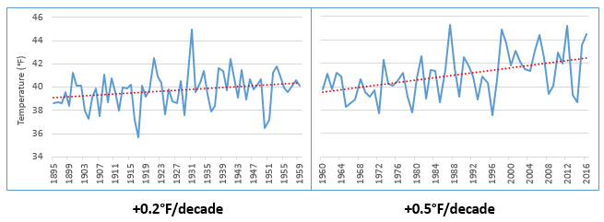
RISING TEMPERATURES
Minnesota Average Annual Temperature, 1895 -2016
Source: NOAA, 2017
Notes:
One of the main effects of Minnesota’s changing climate is that average temperatures are rising. Minnesota has gotten noticeably warmer, especially over the last few decades. This slide shows a shift in the rate of change of Minnesota’s annual average temperatures. The time frame is from 1895 to 2016, which is approximately the last 120 years.
The left side of the graph shows Minnesota temperatures for roughly the first 60 years, from 1895 to 1959, where temperatures increased by about two-tenths of a degree Fahrenheit per decade. The graph on the right side of the slide shows roughly the next 60 years, from 1960 to 2016, where Minnesota’s average temperature has accelerated to a rate of over a half of a degree Fahrenheit per decade. This would amount to an increase of 5 degrees Fahrenheit that we would experience by the end of this century – a significant accelerated rate.
Source: National Oceanic and Atmospheric Administration (NOAA). 2017a. NOAA National Centers for Environmental information, Climate at a Glance: U.S. Time Series, Average Temperature, published February 2017, retrieved on February 9, 2017 from http://www.ncdc.noaa.gov/cag/

Slide 8
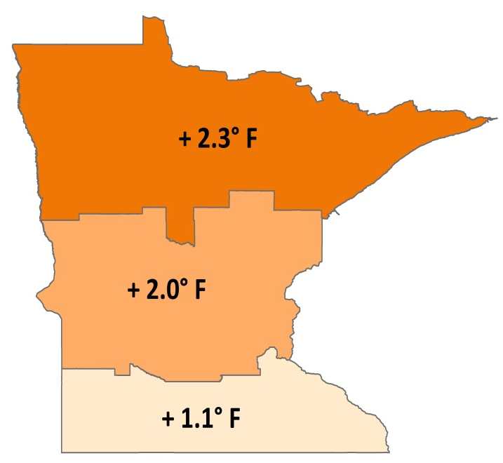
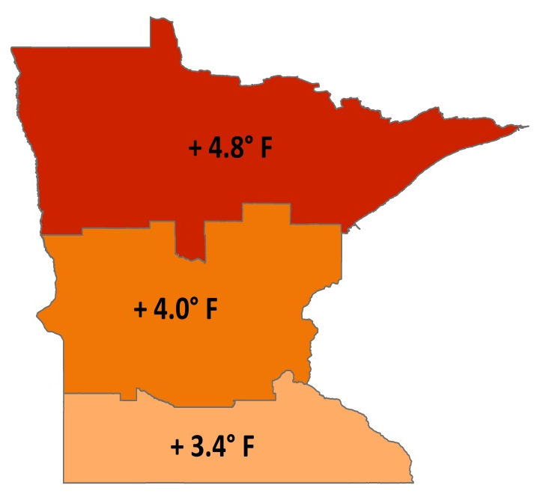
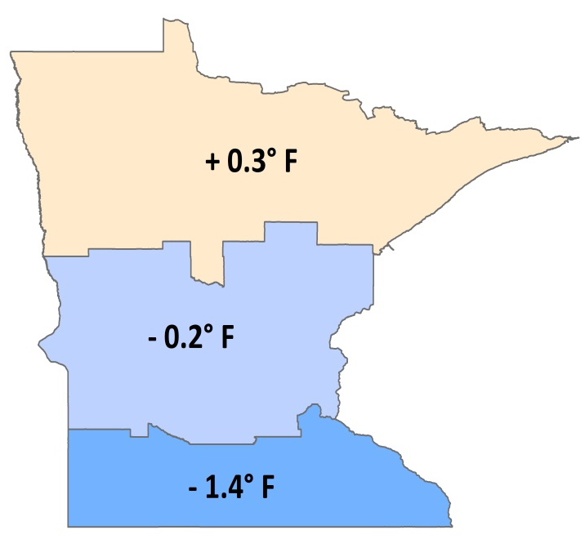
CHANGING TEMPERATURES BY GEOGRAPHY AND SEASON
Total Temperature Change, 1895-2015
Annual Average Winter Lows Summer Highs
Notes:
These maps show temperature changes since the beginning of the record for different parts of the state, and for annual average, winter low, and summer high temperatures.
As seen on the previous slide, annual average temperatures are increasing; however, winter low temperatures are rising much faster than the annual average temperatures. In fact, much of the observed warming we are experiencing in Minnesota can be explained by the warming of our winter low temperatures. In general, we are now having warmer winters, less snow and more winter rain.
Summer high temperatures have risen slightly in the north, but have fallen in the middle and southern part of the state.
And finally, the northern part of the state is warming faster than the southern part of the state. This is consistent with patterns seen across the Northern Hemisphere, where climate changes are occurring more rapidly at higher latitudes.
Source: Department of Natural Resources, 2017

Slide 9
ENVIRONMENTAL CHANGES
Changing Plant Hardiness Zones
After USDA Plant Hardiness Zone Map, USDA Miscellaneous Publication No. 1475, Issued January 1990.
Arbor Day Foundation Plant Hardness Zone Map published in 2015.
Notes:
Rising winter temperatures are already causing substantial shifts in the environment. Maps of the plant hardiness zones from the US Department of Agriculture show what types of plants will survive well and where. Zones are based on the average annual minimum winter temperature over a 30-year period and each zone represents a 10-degree Fahrenheit increment of minimum temperatures.
The maps on this slide compare two points in recent times. The map on the left is from 1990 and the map on the right is from 2015. Look closely at the changes in Minnesota over this 25-year period. In 1990, Minnesota was predominantly zone 3 in the northern half of the state and zone 4 in the southern half of the state. By 2015, these zones shifted north substantially, and in fact, zones historically associated with areas like southern Iowa have now arrived in southern Minnesota. Minnesota is now predominantly zone 4 across the majority of the state, AND zone 5 has now emerged in the far southern part of the state.
Source: USDA Agricultural Research Service, 2012
Image source: Plant Hardiness Zones – Arbor Day Foundation, 2015

Slide 10
PRECIPITATION INCREASES
Minnesota Average Annual Precipitation, 1895-2016
-0.2”/decade
+0.5”/decade
Notes:
With a warming atmosphere, more evaporation occurs. Warmer air can also hold more water vapor than cool air. The water holding capacity of air increases by about 7% per 1°C warming.
The graph on this slide shows Minnesota's average annual precipitation from 1895 to 2016. The graph on the left highlights the trend for the early part of the last century, 1895-1959, while the graph on the right highlights the trend for the most recent half century, 1960-2016. For most of the first half of the 20th century, the trend in precipitation was slightly downward, at a loss of 0.2 inches per decade or the equivalent of -2 inches per century. This downward trend was influenced by the Dust Bowl years of the 1930s. However, the rate of precipitation across the state has increased by nearly 0.5 inches per decade or the equivalent of 5 inches per century over the last 50+ years.
Source: Trenberth, 2011; National Oceanic and Atmospheric Administration (NOAA). 2017. NOAA National Centers for Environmental information, Climate at a Glance: U.S. Time Series, Precipitation, published February 2017, retrieved on February 9, 2017 from http://www.ncdc.noaa.gov/cag

Slide 11
PRECIPITATION – MORE EXTREME EVENTS
1860s
1870s
1880s
1900s
1910s
1920s
1930s
1940s
1950s
1960s
1970s
1980s
1990s
2000s
2010s
2020s
1890s
1
1
1
2
3
3
4
7 OF THE 15
MINNESOTA MEGA-RAIN EVENTS HAVE
OCCURRED SINCE 2002
Notes:
Overall our average annual precipitation is slightly increasing and this increase is being driven by heavy precipitation events. This timeline captures the historic mega-rain events in Minnesota that have occurred since 1858. These events constitute a six-inch rainfall that covers more than 1,000 square miles, with the core of the event topping eight inches. 15 mega-rain events have been identified in Minnesota since 1858 and 7 of these events have occurred since 2002.
A recent study of precipitation in Minnesota found that storms with 3+ inches of rainfall has increased 104% in last 50 years.
[Reference] These seven mega-rain events since 2002 include:
June 2002 – where rainfall topped 12 inches over 48 hours in Roseau and Lake of the Woods Counties of Northern MN
September 2004 – with more than 10 inches of rain in a 36-hour period in Faribault and Freeborn Counties of Southern MN
August 2007 – in South East Minnesota, after 15.1 inches of rain fell in 24 hours
September 2010 – in South Central Minnesota, after 9.5 inches of rain fell in one day
June 2012 – in North East Minnesota, after over 10 inches of rain fell over 2 days, causing severe flash flooding and river flooding; the St. Louis River crested at over 16 feet after rising 10 feet in 24 hours
July 2016 – in Central Minnesota, especially Pine County, with a two-day total of 9.3 inches
August 2016 – in Central and South East Minnesota, with rainfall rates of two-three inches per hour.
Source: MDNR, 2016

Slide 12
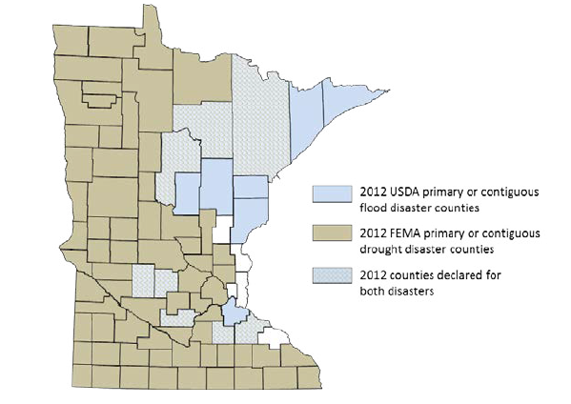
PRECIPITATION CHANGES
Blue counties were declared disaster areas due to flooding.
Brown counties were declared disaster areas due to drought.
Light blue, cross-hatched counties received both designations.
Notes:
However, more moisture in the atmosphere doesn’t necessarily mean a consistent rise in rain and snow. The character of precipitation in Minnesota is changing, increasing the potential for both extreme wet and dry spells. Minnesota is starting to experience increases in localized, heavy precipitation events. Observed trends have the potential to cause both increased flooding and drought, based on the localized nature of storms and their intensity, leaving some areas of the state drenched and other areas without any precipitation. For example, in 2012, 75 counties were declared primary or contiguous disaster areas for drought. However, in that same year 15 counties and three tribal reservations were declared disaster areas for flooding, with eight counties receiving disaster designation for both, underscoring the intensification of precipitation extremes in both directions.
Source: MDH, 2015

Slide 13
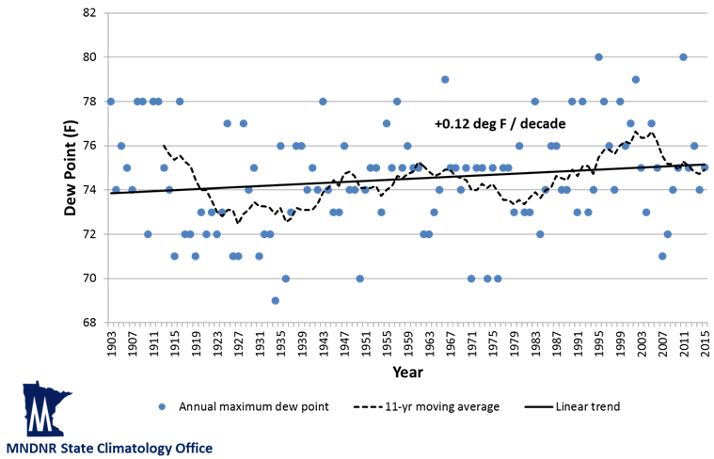
HUMIDITY CHANGES
Highest annual dew points at 6 p.m. CST
Minneapolis – St. Paul, 1903-2015
Notes:
Humidity levels are a function of both temperature and water levels in the atmosphere. Health professionals are particularly interested in humidity, since this affects the skin’s ability to evaporate moisture and cool the body. Dew point is a measure of water vapor in the air. Specifically, the dew point temperature is the temperature to which air must be cooled at constant pressure for it to become fully saturated with water. The higher the dew point is, the more uncomfortable and physically stressed a person feels. This is because people cool themselves by sweating, and if the dew point is high, it becomes more difficult for sweat to evaporate off the skin.
While many measures of dew point and humidity in Minnesota do not yet show evidence of increasing, the most extreme dew point values are becoming more frequent and more extreme over time. Based on historical data, annual maximum dew point temperatures (measured at 6pm CST) are increasing in Minnesota. This trend is modest but significant, about 0.12 degrees per decade. We are also experiencing an increase in the frequency of dew point readings at or above 75°F, a level that is extremely uncomfortable and oppressive. In fact, the frequency of these extreme dew point temperatures is 51% more common in the second half of Minnesota’s weather record (1960-2015) than in the first half (1903-1959).
Source: Trenberth, K.E., 2011; personal communication with Kenny Blumenfeld, Minnesota DNR State Climatology Office on August 9, 2016

Slide 14
OUTLINE
Climate change in Minnesota
The climate change and wellbeing connection
Meaningful action steps
Resources, data, and citations
Notes:
So how do these changes in temperature and precipitation impact our health, and in particular, our wellbeing?

Slide 15
CLIMATE AND HEALTH ARE LINKED
Notes:
As this graphic shows, the rise in greenhouse gases is leading to increases in temperature and changes in precipitation. These changes are causing changes in air quality, weather patterns, water quality and quantity, and ecosystems which, in turn, are leading to more air pollution, extreme heat, floods & drought, and ecosystem threats.
Source: EQB, 2015; MDH, 2015; NASA, 2016

Slide 16
CLIMATE AND HEALTH ARE LINKED
Notes:
While the physical health impacts of these climate hazards (air, weather, water, and ecosystems) will be felt everywhere — and by everyone — vulnerability to the psychological impacts of these climate hazards will vary across individuals and communities. That’s because a range of factors make individuals and communities more or less vulnerable to experiencing the negative impacts. The framework that we’ll walk through on this and subsequent slides, which was adapted from the 2014 and 2016 Climate Assessments, will help illustrate the factors that impact vulnerability as it specifically relates to wellbeing.
Source: MDH, 2014; Melillo, J., Richmond, T., & Yohe, G., 2014; Clayton, S., Manning, C. M. & Hodge, C., 2014; Dodgen, et. al, 2016

Slide 17
CLIMATE AND HEALTH ARE LINKED
Notes:
First, vulnerability to experiencing negative wellbeing effects from climate hazards may increase the more that individuals or communities are exposed. Exposure specifically encompasses the severity of the climate hazard, along with the frequency and length of exposure the individual or community experiences. For example, communities that are geographically located in disaster-prone areas, such as those that experience repeated instances of river flooding or drought, could be more vulnerable because they are exposed more often.
Second, the individual or community’s sensitivity to becoming disrupted by the climate hazard also plays a role in vulnerability. Like exposure, sensitivity is nuanced and encompasses a number of factors, including:
The ability to withstand exposure, such as having flood protection measures in place;
The environmental and institutional context that positively or negatively impact health outcomes, such as access to mental health services or the status of disaster planning as it relates to mental health; and
Lastly, social and behavioral factors, such as having a pre-existing mental health condition, socioeconomic status, family stability, and prior exposure to trauma.
Source: MDH, 2014; Melillo, J., Richmond, T., & Yohe, G., 2014; Clayton, S., Manning, C. M. & Hodge, C., 2014; Dodgen, et. al, 2016

Slide 18
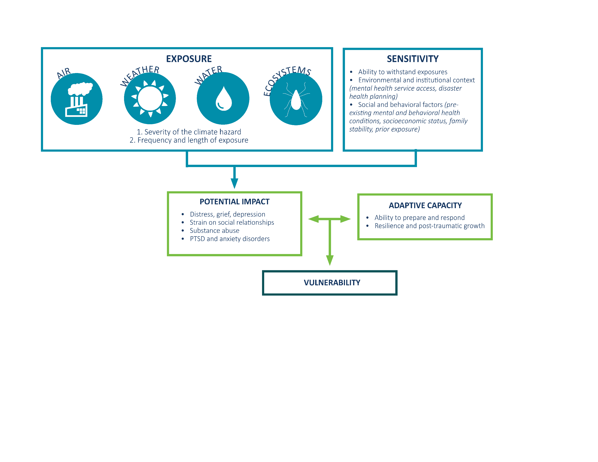
CLIMATE AND HEALTH ARE LINKED
Notes:
Following the diagram logic, you can see that the potential impact as it specifically relates to wellbeing (outlined in the green box at left), is jointly produced by the exposure and sensitivity factors we just discussed. In regards to wellbeing, potential health outcomes range from minimal stress and distress symptoms to clinical disorders, such as anxiety, depression, post-traumatic stress, and suicidal thoughts. Other negative wellbeing impacts include effects on everyday life, perceptions, and social network strains.
The good news here is that the potential health impacts just highlighted can be offset by increasing adaptive capacity, which is highlighted in the green box at right. Adaptive capacity refers to the social/behavioral, institutional, and technological responses and adjustments that are used to lessen the potential impact — in essence our ability to prepare, respond, and build resilience. Considering this full framework of vulnerability allows us to holistically strengthen our capacity to thrive.
Source: MDH, 2014; Melillo, J., Richmond, T., & Yohe, G., 2014; Clayton, S., Manning, C. M. & Hodge, C., 2014; Dodgen, et. al, 2016

Slide 19
HEALTH OUTCOMES: DISTRESS
Emotional reactions include: anxiety, depression, grief, helplessness, and resignation
Notes:
So what negative health outcomes are people vulnerable to when it comes to wellbeing and climate change? We’ll start by taking a look at the outcomes under the umbrella of distress. Each individual will react differently to climate change based on a variety of personal factors that may include where they live, where they work, the influences of their community and social networks, and any previous significant interactions with their environment (good or bad). Some of the emotional reactions to direct or gradual impacts of climate change can include:
Anxiety & Depression: High levels of distress and anxiety are often prevalent among people who have recently experienced an acute trauma and can include reactions like feeling overwhelmed, isolated, and worried about the future. This acute trauma impact is often replaced with a set of long-term psychological stressors, such as depression. Several studies have found that many victims of a flood disaster express psychological distress even years following the flood. High levels of distress and anxiety can be linked to negative health effects, such as lowered immune system response and greater risk of physical ailments.
Grief : Grief is a normal reaction to trauma or disaster, but in some cases, feelings of loss persist for so long, and so severely, that people have trouble resuming their normal lives. For example, a study of Hurricane Katrina victims found that 29% of respondents experienced a phenomenon known as complicated grief, which is a more intense and longer-lasting form of grief than is typically experienced.
Helplessness & Resignation: Watching the slow and largely irrevocable impacts of climate change unfold, and worrying about the future for later generations, can be an additional source of distress. Qualitative research has found evidence of some people being deeply affected by feelings of loss, helplessness, and frustration due to their inability to feel like they’re making a difference in stopping climate change.
Because some level of stress is normal during and after a disaster, it can be difficult for responders, friends, family, or coworkers to recognize when an individual is going through normal stress and is capable of coping or when that person is dealing with something much more serious. However, most people who experience disasters are resilient and basic support after an event will be sufficient to prevent negative mental health outcomes. Stress, anxiety, or fear that lasts for several weeks or impacts an individual’s daily activities and quality of life may indicate that that individual would benefit from additional mental health resources and support.
Source: Clayton, S., et. al, 2014; Dodgen, et. al, 2016
Image source: Pexels, https://www.pexels.com/photo/black-and-white-person-woman-girl-3351/

Slide 20
HEALTH OUTCOMES: DISTRESS
Solastalgia is characterized by a sense of distress or emotional pain felt when someone’s homeland is diminished or destroyed.
Notes:
As climate change irrevocably impacts traditional landscapes and places where people call home, larger numbers of people are likely to experience the type of stress and negative emotions from a psychological phenomenon called ‘Solastalgia.’ Solastalgia is a new concept developed to give greater meaning and clarity to environmentally-induced distress and is characterized by a sense of distress or emotional pain felt when someone’s homeland is diminished or destroyed.
Climate is fundamental to an individual’s understanding of place. Places with dramatically changing seasons provides a signal for certain recreation and economic activities, such as the beginning and end of the ice fishing season, planting and harvesting times, tourism to ski areas, and the availability of outdoor markets. Our attachment to place is what makes environmental changes and disasters particularly distressing. Our ties to places – and the environments, traditions, and customs of those places – are very deep and are part of our own identity. This is why we say “I’m a Minnesotan” or even “I’ve lived in Minnesota for 20 years, but I am a New Yorker at heart.” We achieve a sense of belonging within a place through familiarity and attachment to all of the characteristics of that place (i.e., We are “hardy Minnesotans” because each winter our ‘place’ gives us some challenging weather conditions).
The impacts of climate change will not have a uniform geographical distribution (some areas will be more severely and/or frequently impacted than others) and thus one’s place will be a key determinant of exposure to environmental changes or natural disasters. These impacts of climate change may change the look or feel of defining attributes of our place, including the inability for currently native plants and trees to continue to grow, invasive species able to thrive in areas they once could not, and the loss of habitat for birds and other wildlife. When the ecology of a place changes, it alters our connection to that place and what we know and understand about it.
Direct quote: ‘Solastalgia’ was created to describe the specific form of melancholia connected to lack of solace and sense of desolation in the everyday and lived experience of people within their ‘home’. (http://healthearth.blogspot.com/2008/01/solastalgia-history-and-definition.html)
Source: Albrecht, 2005; Clayton, S., et. al. 2014
Image source: Public Domain Pictures

Slide 21
HEALTH OUTCOMES: DISTRESS
The threat and perception of climate change can negatively impact a person’s level of distress and state of wellbeing.
Notes:
In addition to actual exposure to climate change events, the threat and perception of climate change can also adversely impact a person’s level of distress and state of wellbeing. The threat and perception of the negative impacts of climate change can be a key psychological and emotional stressor. The ongoing exposure to information regarding climate change and its impacts can also be a source of adverse wellbeing impacts. For example, mass media messages about climate change and its projected consequences can affect perceptions of physical and societal risks, and consequently affect mental health and wellbeing.
This stress can also manifest through repeated, cumulative exposure to natural disasters, such as annual floods or frequent wildfire. The ongoing uncertainty, anxiety, and dread experienced while anticipating a seasonal or frequent disaster (whether or not that disaster actually happens) is a significant source of background stress and anxiety.
Source: Clayton, S., et al, 2014; Dodgen, et. al, 2016
Image: Pexels, https://www.pexels.com/photo/field-agriculture-lawn-meadow-7500/

Slide 22
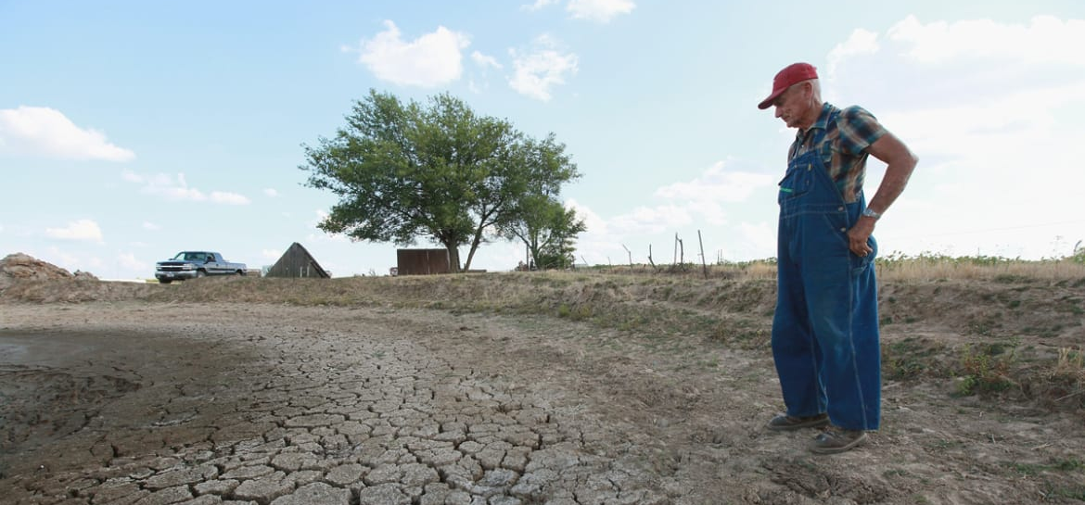
HEALTH OUTCOMES: DISTRESS
Drought conditions disrupt livelihoods and has been linked to an increase of suicide among male farmers.
Notes:
Of particular relevance to Minnesotans are the wellbeing impacts from drought conditions. Unlike other acute disasters, the onset of drought is difficult to determine (several dry years may or may not be the beginnings of a long and significant drought phase), and long-term drought conditions interact over time with multiple environmental, economic, and social stressors to disrupt livelihoods and the functioning of individuals and communities. Rural farming communities in particular are prone to the long-term effects of drought; and drought has been linked to increased incidence of suicide among male farmers.
Source: Clayton, S., et. al, 2014; Dodgen, et. al, 2016
Image: Scott Olson, Getty Images. Available online at: https://img.thedailybeast.com/image/upload/d_placeholder_euli9k/dpr_2.0/c_limit,w_585/fl_lossy,q_auto/v1/galleries/2012/07/17/photos-of-the-midwest-drought/midwest-drought-dried-ground_uoea9r

Slide 23
HEALTH OUTCOMES: RELATIONSHIP STRAIN
Climate change can strain relationships, impacting how individuals interact with each other and within their communities.
Notes:
In addition to influencing individual distress, climate change also has the potential to strain relationships – impacting how individuals interact with each other and within their communities. This can impact individual and community wellbeing in a number of ways, including:
Decreased community cohesion
Disrupted sense of continuity and belonging
Increased violence and crime
Increased social instability
Increased interpersonal aggression and domestic abuse
Source: Clayton, S., et. al, 2014; Dodgen, et. al, 2016
Image: Pexels, https://www.pexels.com/photo/adult-black-and-white-close-up-couple-347988/

Slide 24
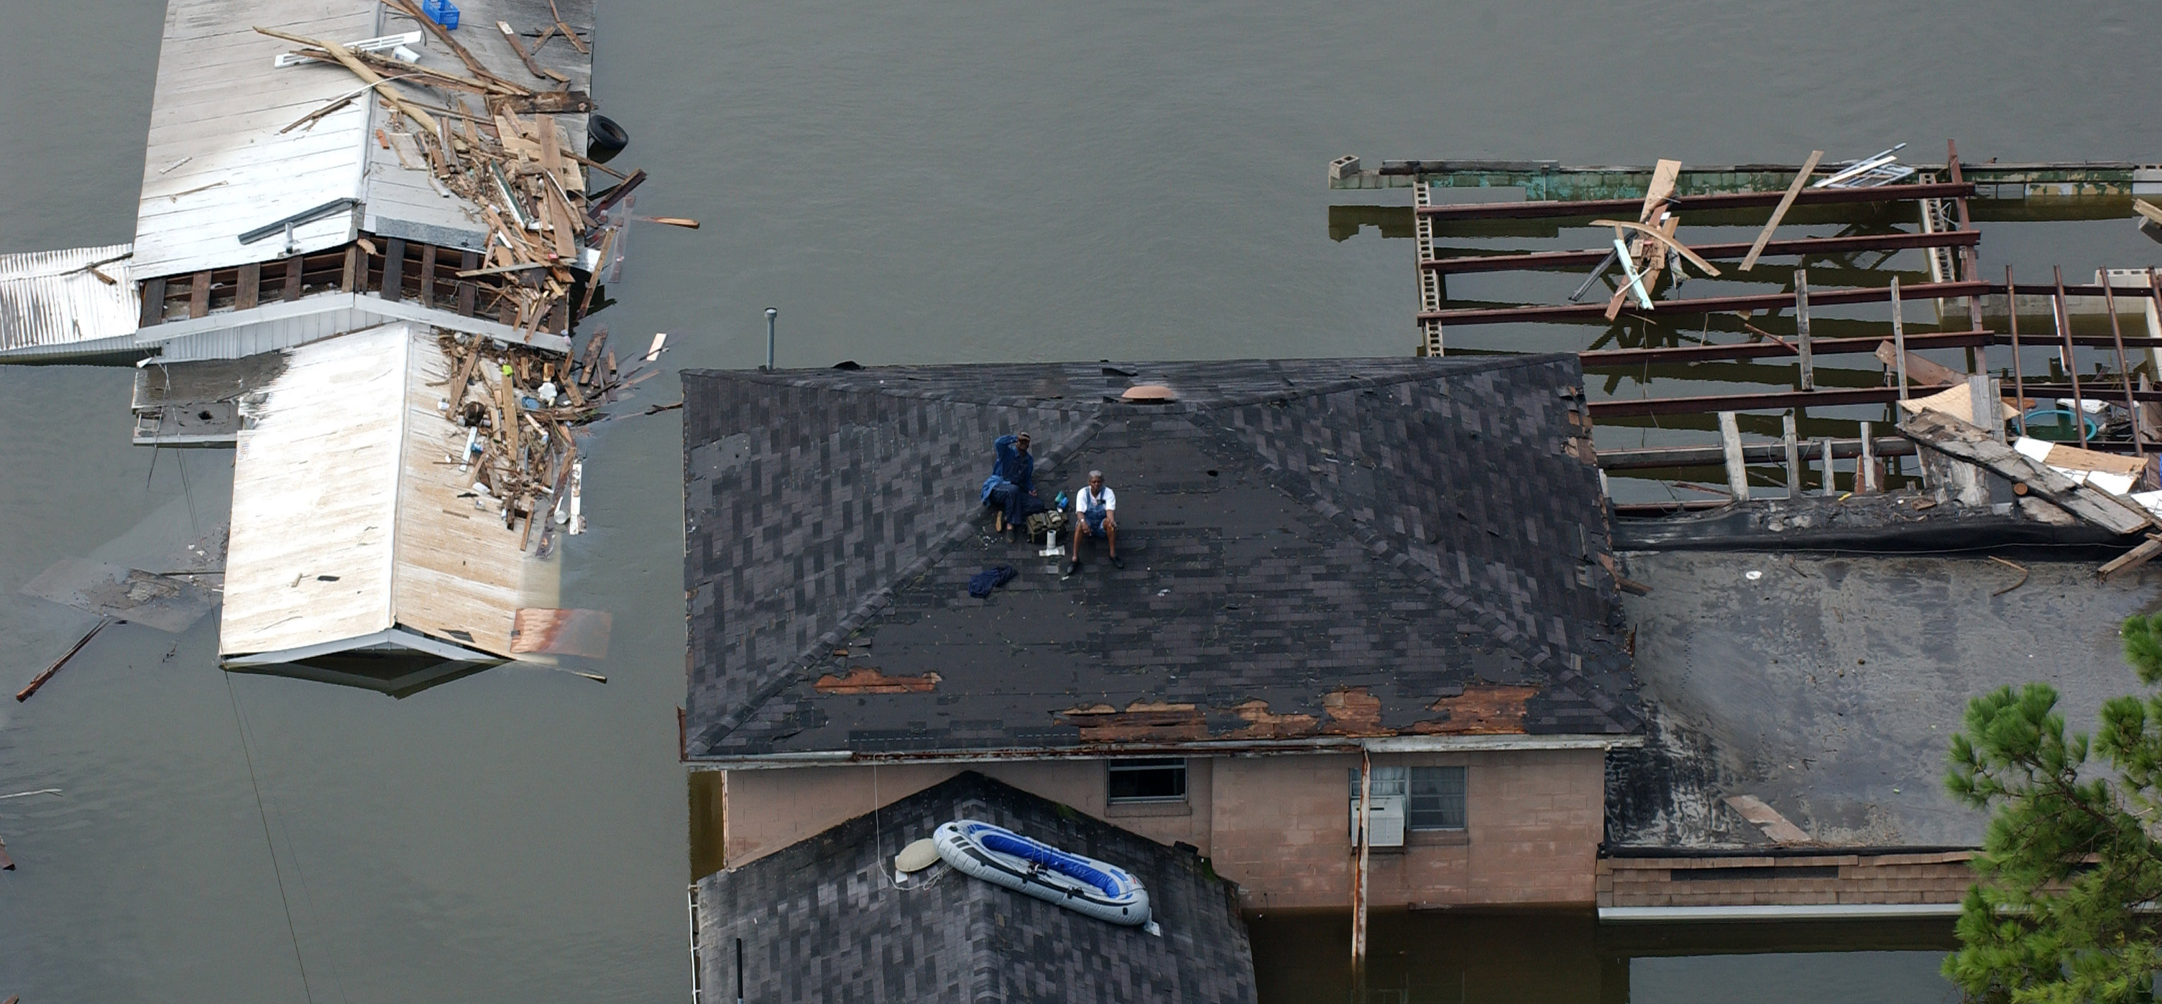
HEALTH OUTCOMES: RELATIONSHIP STRAIN
When the physical home is damaged, it changes the dynamics of the social relationships inside. This change is often negative.
Notes:
It’s important to note that relationship impacts from direct climate change events are not only attributable to exposure during the time of the initial event. Impacts are likely to accelerate the occurrence of additional stressors that can produce strains on relationships. For example, families whose homes are severely damaged or destroyed by a flood or wildfire must be relocated before settling permanently. They may have to be separated from their systems of social support. Parents may find themselves less able to be effective caregivers. Family relationships may suffer. This can have implications for interpersonal connections, as the home provides the context for social relationships. When the physical home is damaged, it changes the dynamic of the social relationships, often negatively.
Hurricane Katrina has served as a very thorough case study of the lasting mental health impacts of disaster. Six years after Katrina, many victims are still experiencing stress disorders, some as severe as post-traumatic stress disorder. Populations directly impacted by Hurricane Katrina also have rates of suicide attempt and suicide that are startling. Rates of suicide attempt are 78.6 times higher than pre-Katrina rates and suicide completion rates are 14.7 times higher. Victims of Katrina and their communities are still battling high rates of depression and an increase in domestic violence and child abuse.
While Hurricane Katrina serves as a “worst-case scenario” example, these types of outcomes are not specific to victims of Katrina alone. A 1999 study after the Grand Forks area flood of 1997 in Minnesota found a 24% increase in domestic violence among the affected population.
Image source: “Hurricane Katrina,” Good Free Photos, https://www.goodfreephotos.com/albums/united-states/louisiana/new-orleans/new-orleans-louisiana-after-the-flooding-of-hurricane-katrina.jpg

Slide 25
HEALTH OUTCOMES: RELATIONSHIP STRAIN
As temperature rises, so does the potential for increased violence
Notes:
While the linkages between climate change and aggression are complex and the evidence is still emerging, one of the consequences most frequently mentioned is the potential for increased violence. Both lab-based and quasi-experiments have demonstrated a relationship between heat and aggression. This could impact healthcare use, direct healthcare costs, and other indirect costs associated with disability, lost productivity, and decrease of quality of life.
Source: Clayton, S., et. al, 2014; Dodgen, et. al, 2016
Image: Pixabay, https://pixabay.com/en/weather-temperature-hot-summer-120-1216041/

Slide 26
HEALTH OUTCOMES: SUBSTANCE ABUSE
Climate change can lead to increases in high-risk coping behaviors
Notes:
Moving on to substance abuse, climate change can increase overall stress levels, which can lead to increases in high-risk coping behaviors, such as substance abuse, anxiety disorders, and depression. In general, individuals who use alcohol to cope with stress and those with preexisting alcohol use disorders are most at-risk to increased alcohol use following extreme weather events. Like many other facets of climate change and wellbeing, this is an emerging issue of concern that can benefit from additional, focused research activities.
Source: Clayton, S., et. al, 2014; Dodgen, et. al, 2016
Image: Pexels, https://www.pexels.com/photo/cold-alcohol-drink-glass-12591/

Slide 27
HEALTH OUTCOMES: PTSD
Well-being impacts of climate change, especially from extreme weather events, can lead to serious mental health consequences, such as Post-Traumatic Stress Disorder (PTSD)
Notes:
The wellbeing impacts of climate change can also include serious mental health consequences, including post-traumatic stress disorder (PTSD) and anxiety. This especially pertains to extreme weather events, such as floods, wildfires, or prolonged periods of drought, that involve loss of life, resources, or disruptions to social or economic networks.
PTSD is often linked to higher suicide levels and can increase the likelihood of substance abuse, depression and anxiety, violence and aggression, relationship strain, and job-related difficulties. Individuals who experience multiple acute events – such as more than one natural disaster or multiple years of drought – are likely to experience even more severe trauma and may be even more susceptible to PTSD.
Source: Clayton, S., et. al, 2014; Dodgen, et. al, 2016
Image: Pixabay, https://pixabay.com/en/anxiety-fear-stress-emotion-wooden-2019928/

Slide 28
HEALTH OUTCOMES: POST-TRAUMATIC GROWTH
Long-term trauma impacts are not inevitable
Notes:
The good news is that long-term psychological trauma due to direct or indirect climate change-related exposures is not inevitable. Studies show that a majority of individuals psychologically affected by a traumatic event will recover over time. These individuals likely possess a combination of personal qualities that make post-traumatic growth more likely, including good self-esteem, willingness to problem-solve, flexibility, and optimism. In fact, a study of low-income mothers who survived Hurricane Katrina found that optimism helped the mothers adjust and grow after the disaster.
Emerging evidence also suggests that individuals who are actively involved in climate change adaptation or mitigation activities experience a wellbeing benefit. Taking action and becoming involved in the issue both addresses the threat and helps manage the emotional responses as people come to terms with, and adjust their understandings and daily lives, to the context of climate change.
Source: Clayton, S., et. al, 2014; Dodgen, et. al, 2016
Image: Pexels, https://pixabay.com/en/kids-commerce-hair-salon-family-2810999/

Slide 29
AT-RISK POPULATIONS
We are only as resilient as our most vulnerable citizens
Notes:
In order to help promote effective action and support the ability of individuals and our communities to adapt, we need to understand the specific populations that might be more susceptible to negative impacts than others. The wellbeing impacts of climate change are compounded by risk factors at an individual and community scale.
The individual risk factors specific to wellbeing may include pre-existing mental illness, low socioeconomic status, and lack of resources to afford potential recovery costs (home repairs, replacing lost or damaged goods, loss of employment), low social connectedness, and proximity to the disaster (those directly affected are more vulnerable to poor mental health and wellbeing outcomes than those who are not directly affected). Community risk factors may include outdated emergency plans that do not address mental or behavioral health and a shortage of mental health and wellbeing resources available at the time of disaster for both victims and responders. Communities that are particularly vulnerable include disaster-prone areas (river flooding, high wildfire risk, repeated drought) and communities that are economically dependent on climate and the environment (forestry, fishing, agriculture). By understanding these risk factors, and by targeting our efforts to address those who are most vulnerable, we will bring lessons learned back to benefit greater society, inherently take care of everyone. We are only as resilient as our most vulnerable citizens.
Source: MDH, 2014
Image: Pexels, https://www.pexels.com/photo/adult-casual-collection-fashion-296881/

Slide 30
AT-RISK POPULATIONS: CHILDREN
Children are at particular risk for distress and anxiety in the aftermath of an extreme event
Notes:
So who are our most vulnerable citizens when it comes to the wellbeing impacts of climate change? Let’s start with children. Children have been shown to possess an innate resilience to adverse events, but despite this resilience, children are at particular risk for distress and anxiety following an extreme weather event. These symptoms depend on the developmental stage of the child, the level and type of exposure, the amount of destruction seen, and that particular child’s risk factors and protective factors.
The potential exists for an array for difficult emotional and behavioral responses in children shortly after a natural disaster, such as depression, anxiety, and social withdrawal, some of which is normal and will resolve over time with the proper support. However, children may also be at higher risk than adults of having symptoms that persist in the long-term. Significantly more children than adults have shown continued Post Traumatic Stress Disorder, or PTSD, symptoms more than two years post-disaster, and in general, studies have shown that children are more likely to be impaired by a disaster. The chronic stress from acute and ongoing impacts of climate change may alter biological stress response systems and make growing children more at-risk for developing mental health conditions later in life, such as anxiety and depression.
Source: Clayton, S., et. al, 2014; Dodgen, et. al, 2016
Image: Pexels, https://www.pexels.com/photo/bridge-child-children-fashion-191034/

Slide 31
AT-RISK POPULATIONS: WOMEN
Women have a higher prevalence of Post Traumatic Stress Disorder (PTSD) and other mental health disorders after disasters than men
Notes:
Women can also be more vulnerable, as post-disaster stress symptoms are often reported more frequently by women than men. Women have a higher prevalence of PTSD and other mental health disorders after disasters than men, and are prone to greater worry and feelings of vulnerability and anxiety disorders. Relatedly, increases in domestic violence towards women are also common after a disaster.
Also important to note is that while pregnant and postpartum women are often quite resilient, their resilience diminishes when social supports are reduced, when they have experienced injury, illness, or danger due to the disaster, or when they have lived through multiple disaster experiences. One study indicated that pregnant women with high hurricane exposure and severe hurricane experiences were at a significantly increased risk for PTSD and depression.
Source: Clayton, S., et. al, 2014; Dodgen, et. al, 2016
Image: Pexels, https://www.pexels.com/photo/adult-chair-concentration-furniture-299863/

Slide 32
AT-RISK POPULATIONS: ELDERLY
Elderly tend to have higher rates of untreated depression and physical ailments that contribute to their overall vulnerability
Notes:
The aging population is another population of concern. The elderly may have difficulty responding to the challenges of climate change, as they tend to have higher rates of untreated depression and physical ailments that contribute to overall vulnerability, such as increased susceptibility to heat and accompanying physical and wellbeing impacts. The wellbeing consequences experienced by the elderly in response to a natural disaster may ultimately be due to challenges they face with physical health, mobility, and difficulty managing trauma in response to the disaster.
Source: Dodgen, et. al, 2016
Image: Pexels, https://www.pexels.com/photo/woman-reading-book-in-grey-scale-photography-200390/

Slide 33
AT-RISK POPULATIONS: COMMUNITIES OF COLOR, IMMIGRANTS, LIMITED ENGLISH
Many live with factors that contribute to higher risk of poor wellbeing outcomes due to climate change
Notes:
In the United States, some communities of color, low-income groups, people with limited English proficiency, and certain immigrant groups live with many of the factors that contribute to their overall risk of experiencing negative effects from climate change. Socioeconomic and educational factors, limited transportation, limited access to health education, and social isolation related to language may impede their ability to prepare for, respond to, and cope with climate-related health risks. These populations also may have limited access to medical care and may not be able to afford medications or other treatments.
A number of health risks are also higher among Indigenous populations, such as poor mental health related to historical or personal trauma, alcohol abuse, and diabetes. Because of existing vulnerabilities, Indigenous people, especially those who are dependent on the environment for sustenance or who live in a geographically isolated or impoverished communities, are likely to experience greater exposure and lower resilience to climate-related health effects.
Source: Clayton, S., et. al, 2014; Dodgen, et. al, 2016; Gable, et. al 2016
Image: Pexels, https://www.pexels.com/photo/close-up-of-globe-335393/

Slide 34
AT-RISK POPULATIONS: HOMELESS
A combination of risk factors make people who are experiencing homelessness more at risk to the negative impacts of climate change
Notes:
People experiencing homelessness are another population of concern. About 30% of people who experience chronic homelessness suffer from some form of mental illness. The majority of people who are experiencing homeless live in urban and suburban areas, where they are more vulnerable to health risks from exposure to heat waves due to the urban heat island effect. The combination of risk factors, including high rates of mental illness and geographical location, contribute to a higher risk of experiencing negative impacts from climate change events like extreme heat.
Some extreme weather events are projected to become more frequent and severe, and those who become homeless due to these disasters are at increased risk for post-traumatic stress symptoms.
Source: Dodgen, et. al, 2016
Image: Pixabay, https://pixabay.com/en/homeless-beggar-sleeping-street-2182114/

Slide 35
AT-RISK POPULATIONS: LGBTQ+
LGBTQ+ youth make up 20-40% of youth experiencing homelessness
Notes:
The LGBTQ population faces amplified risks to the effects of climate change. For example, LGBTQ youth make up 20-40% of youth experiencing homelessness, it can be especially daunting to navigate often religious and gendered shelters to receive aid. Stigmatization, harassment, and abuse are added trauma that this population faces, all of which make coping with the effects of climate change more difficult.
Source: Youth.gov/youth-topics/runaway-and-homeless-youth/lgbt
Image: Flickr, https://www.flickr.com/photos/gazeronly/14350104167/in/photolist-nS5326-eNYgBb-WUcddy-bLW7xr-VK6TXR-T2tBCA-qXnHK5-nCtg1G-89WQAc-88QjAG-6AmdSS-ogXEUn-cNdbL-W3fRVR-6w8FPb-nECobn-2cWNX-TcvFJ9-6CQYKo-WdtpGc-o585ek-aZ2ARx-89aF9e-pqNixr-8ANxnj-snpd5y-TCeXqU-T3rWLy-mFeuRk-7LXcYr-nYPXFq-bYJpjb-dhUyp7-fWTjZ-UVHf7m-gufMQ-o8AWeM-t542-didgDi-6G2iXK-gj3hF9-7PznYR-fcy1pP-4W73Wk-o7JmyL-UhgJvH-a7Egia-kjwXmq-s5hPpK-dKRKsy

Slide 36
AT-RISK POPULATIONS: OCCUPATIONAL EXPOSURE
Outdoor occupational groups are among the first to be exposed to the effects of climate change
Notes:
Outdoor workers are often the first to be exposed to the effects of climate change. This includes farmers and other agricultural workers, fisherman, and those in construction, forestry, and mining. As mentioned previously, occupations impacted by drought are of concern because while some people may initially be resilient to the impacts, drought conditions over time can lead to significant psychological distress.
Emergency workers and first responders, including healthcare workers and public safety workers, are also at increased risk for mental health consequences from climate change, including substance use, both in the short and long term. The very nature of the work, which involves being exposed to a traumatic event and helping others in crisis, frequently working long hours in difficult environments, and being away from loved ones, increases the susceptibility of first responders and emergency workers to experiencing negative mental health consequences.
Source: Dodgen, et. al, 2016; Gable, et. al, 2016
Image: Pexels,. https://www.pexels.com/photo/construction-worker-safety-danger-8159/

Slide 37
OUTLINE
Climate change in Minnesota
The climate change and wellbeing connection
Meaningful action steps
Resources, data, and citations
Notes:
In general, some uncertainty remains about the degree to which future extreme weather and climate events will impact mental health and wellbeing. An increase in scope, frequency, and severity of these events will increase the number of people impacted and the degree to which they are affected. However, efforts that effectively increase preparation for both the physical and psychological consequences of extreme weather and climate-related events could decrease the impact on mental health and wellbeing. So where do we go from here? What can we do about it?
Source: Dodgen, et. al, 2016

Slide 38
Integrate mental health and wellbeing considerations
Notes:
Public health plays a critical role in protecting the health of Minnesotans; there are many steps we can take to prepare for and respond to the mental and behavioral health impacts of extreme weather events. First call to action is to examine planning processes and response activities to pinpoint feasible opportunities to integrate mental health and wellbeing supports. This could include incorporating mental and behavioral health considerations into local all hazards plans. Specific considerations to integrate could include:
identifying lead and supporting agencies that can help assess and provide mental and behavioral care;
documenting mental and behavioral resources; and
Identifying support processes and resources for those who are tasked with responding to disasters.
Beyond the local all hazards plan, it’s important that we help guide the rapid restoration of key support systems in times of natural disasters. Rapidly restoring key systems of support can help reduce the number of traumatic stress reactions. Successfully reinstating systems of safety and security, family reunification, foundations for returning to work, and institutions that provide meaning such as school, church, and civic organizations also allows the population to begin the recovery process with social support. One preparation that may appear small, but can make a big impact, is encouraging residents to incorporate mental health items into their disaster preparation kits. This could include comfort items like pictures, small toys for children, favorite treats, or recreational items like books and games.
Source: Clayton, S., et. al, 2014
Image: Pexels, https://www.pexels.com/photo/action-adult-affection-eldery-339620/

Slide 39
Learn more to help more
Notes:
The second call to action is to learn more to help more. Public health departments can increase their effectiveness in preventing long-term traumatic stress reactions by becoming more informed as professionals, in particular, getting trained in psychological and mental health first aid.
Psychological first aid can be used in any trauma setting and can be practiced by almost any person. It helps create and sustain an environment of safety, calm and comfort, connectedness, self-empowerment, and hope.
Mental health first aid training can help generate an understanding of mental illness and intervention strategies. Mental health first aid demystifies mental illness and builds the capacity to obtain, process, and understand the health information and services needed to make appropriate decisions and seek care.
Links to more information about these trainings will be provided on the PowerPoint version we share on our website after today’s webinar.
Source: MDH, Emergency Preparedness, Response, and Recovery, 2016
Image: Pexels, https://www.pexels.com/photo/writing-notes-idea-class-7103/

Slide 40
Strengthen networks and build community
Notes:
Public health professionals are an important piece of the puzzle when it comes to improving wellbeing outcomes in the face of climate change. At a systems level, public health professionals should be part of building community-level networks to create the resilience necessary for communities to successfully prepare for and cope with the potential psychological impacts of climate change. Scholars agree that climate preparedness planning is most likely to succeed if the community is involved, however, there is no one-size-fits all approach. Instead, professionals should work collectively to help communities prepare. For example, communities may want to strengthen pre-existing social and community support networks, develop plans to attend to the most vulnerable members of a community, or identify how organizations and individuals can work together to provide wellbeing assistance during and after extreme weather events.
At a tactical response level, public health departments are not expected to provide a full range of mental and behavioral health treatment, but they should be organized and equipped to serve as a bridge between residents in need and local mental and behavioral health treatment providers. Having a good understanding of the mental health resources available in your community will help provide follow-up and long-term care to those who need it. It’s important to discuss disaster behavioral health roles and responsibilities with specific providers or organizations BEFORE a disaster if you plan on referring trauma victims.
Source: Clayton, S., et. al, 2014
Image: Pexels, https://www.pexels.com/photo/group-of-people-enjoying-music-concert-325521/

Slide 41
Communicate with intention
Notes:
Many psychological stress symptoms stem from the early phases of a disaster. This brings us to our fourth call to action – communicate with intention. When people are in the throes of extreme distress and emotion, it is crucial that the services available to them be sensitive and interactional. Public health professionals can help limit the long-term negative psychological consequences and trauma of acute events by promoting a sense of safety, calm, collective efficacy, connectedness, and hope.
Outside of disasters, public health can reduce worry and anxiety by communicating about climate change strategically. Often, well-meaning attempts to create urgency about climate change and its health impacts rely on appeals to our fear of disasters or the certainty of dangerous health impacts. Unfortunately, this type of discussion around climate change can lead to denial, paralysis, or apathy – the opposite of the desired response. Focusing only on the terrible outcomes of climate change leaves people feeling overwhelmed and powerless. Instead, public health can share the anticipated health impacts of climate change and then follow with strategies for coping with those impacts. One strategy for effective climate communication that reduces the feelings of powerlessness is talking about climate change and climate action at a local level, which appeals to our sense of place. When talking about climate at the local level, audiences can recognize and relate to the changes being discussed. This removes some of the abstraction and fear associated with things we cannot understand and it allows us to discuss the actions that can be taken at the local level that will impact our immediate communities.
Source: Clayton, S., et. al, 2014; Leiserowitz, A., et. al, 2014; Maibach, E., et al, 2011
Image: Pexels, https://www.pexels.com/photo/idea-bulb-paper-sketch-8704/

Slide 42
Support recovery and resilience
Notes:
Outside of acute response and adaptation roles, public health can play an important role in helping advocate for a system of recovery and resilience in the face of climate change realities by promoting the positive mental health impacts of taking climate action. Emerging evidence shows that individuals who are actively involved in climate change adaptation or mitigation actions experience appreciable health and wellbeing benefit. While these psychological and environmental benefits don’t necessarily minimize distress, taking action to address the issue can buffer against distress.
In supporting a system of resilience, remember that health is not just the absence of disease, and wellbeing encompasses our ability to realize our potential, cope with normal stresses, work productively, and make community contributions. Public health can play two roles in supporting a system of resilience. The first role is to support climate mitigation efforts, which means taking on or supporting efforts that slow, stabilize or reverse climate change by reducing greenhouse gas emissions. The second is to support our communities with adapting to climate change — anticipating and preparing for the effects of climate change and reducing the risk of negative health outcomes. This presents a great opportunity for us to examine the role we can play in the systems that support our wellbeing, including social networks and physical infrastructure; and to allocate resources and model behavior in regards to mitigation. Encourage activities that provide a sense of personal meaning and satisfaction — promote the positive health benefits of climate action like biking as a mode of transportation or choosing clean energy to reduce air quality impacts, and support a sense of control or contribution towards finding a solution to the problem.
Source: Dodgen, et. al, 2016; WHO, 2014
Image source: Pexels, https://www.pexels.com/photo/green-green-terrace-terrace-garden-building-25431/

Slide 43
Focus on equity
Notes:
Last, but certainly not least, we should focus on equity in all that we do in the face of climate change and health. As discussed earlier, not everyone will experience climate change in the same way and this should be taken into account when developing programs and protocols that address climate and health impacts. Taking a health equity approach means matching resources and supports against need to facilitate the best outcome for all. This is not to be confused with equality, which treats everyone the same regardless of their starting point. To truly address health equity in the face of climate change and wellbeing, we cannot leave anyone behind. We need to actively shape our structures and systems of care, with the aim of granting fair and just access, by distributing resources according to areas and populations that may be more susceptible to negative impacts on wellbeing.
Source: Clayton, S., et. al, 2014, MDH 2014
Image: MDH, 2016

Slide 44
What can individuals do to address climate change?
Notes:
We as individuals can play many roles in mitigating and adapting to climate change. The next slides list actions each of us can take to make a difference.

Slide 45
Energy
1
Notes:
Energy production is one of the big three contributors to our changing climate because burning oil, coal, and natural gas to generate electric power puts a lot of GHGs into the air.
Image: Windmill – Pexels. Available online at: https://www.pexels.com/photo/road-street-desert-industry-477230/

Slide 46
ENERGY
Individual Action
Use less energy to heat or cool homes
Use energy-efficient appliances and lightbulbs
Reduce, reuse, recycle what we buy and use on a daily basis
Collective Action
Use more renewable energy (solar, wind, and biofuels)
Use less fossil fuel energy (oil, coal, natural gas)
Support policy change for renewable energy
Notes:
As individuals, we can each reduce the amount of GHG emissions we cause in a number of ways like using less energy to heat or cool homes (turning the temp up or down 2 degrees, adding insulation and weather stripping, planting trees for shade); using energy-efficient appliances and light bulbs; and reducing/reusing/recycling what we buy and use on a daily basis.
However, what is really going to make a difference is having all of us rely more on renewable energy sources like solar, wind, and biofuels and less on fossil fuel energy sources like oil, coal, and natural gas. As individuals, we can support public and private sector policy changes that lead to more renewable energy production. A policy example is Minnesota’s Next Generation Energy Act of 2007 that has achievable GHG reduction targets by 2025 and beyond.
Image: Windmill – Pexels. Available online at: https://www.pexels.com/photo/road-street-desert-industry-477230/

Slide 47
Transportation
2
Notes:
Transportation is the second biggest contributor to our changing climate because burning fuel to power vehicles emits a lot of GHGs into the air.
Image: Person biking – Pexels. Available online at: https://www.pexels.com/photo/person-wearing-black-and-gray-sleeveless-dress-riding-a-step-through-bicycle-521474/

Slide 48
Transportation
Individual Action
Burn less gasoline or diesel fuel
Walk, bike, use transit, carpool, and telecommute when possible
Drive an electric vehicle (powered by wind or solar energy)
Collective Action
Support public and private sector policies
To increase gas and diesel mileage standards
Incentivize the production of electric vehicles
Build more transit options
Notes:
As individuals, we can each reduce the amount of GHG emissions we cause by using transportation choices that burn less gasoline or diesel fuel like walking, biking, using transit, carpooling, and telecommuting when possible. Another option would be to drive an electric vehicle powered by wind or solar energy.
However, what is really going to make a difference is if we all have more transportation options that either burn less or don’t use any gasoline or diesel fuel. As individuals, we can support public and private sector policies like increasing gas and diesel mileage standards, incentivizing the production and purchase of electric vehicles, building more transit options where sufficient population density exists, and having policies that support telecommuting.
Image: Person biking – Pexels. Available online at: https://www.pexels.com/photo/person-wearing-black-and-gray-sleeveless-dress-riding-a-step-through-bicycle-521474/

Slide 49
Agriculture
3
Notes:
Agriculture is the third biggest contributor to GHG emissions because it takes a lot of energy to produce, process, and transport food.
Image: Food – Pexels. Available online at: https://www.pexels.com/photo/tomatoes-carrots-and-radish-on-the-top-of-the-table-196643/

Slide 50
Agriculture
Individual Action
Buy more locally grown foods
Eat fewer processed foods and less meat
Grow some of our own food
Collective Action
Support policies that incentivize:
Foods produced with fewer chemicals
Food that are less processed
Food that are transported shorter distances
Notes:
As individuals, we can each reduce the amount of GHG emissions we cause by buying more locally grown foods, eating fewer processed foods and less meat, and even growing some of our own food.
However, what is really going to make a difference is if we all have access to foods that are produced, processed, and transported using less energy. As individuals, we can support public and private sector policies that incentivize foods produced with fewer chemicals, foods that are less processed and closer to their natural state, and foods that are transported shorter distances.
Image: Food – Pexels. Available online at: https://www.pexels.com/photo/tomatoes-carrots-and-radish-on-the-top-of-the-table-196643/

Slide 51
MDH Mental Health Promotion Program
health.mn.gov/mentalhealth
Notes:
To learn more about mental health and wellbeing in Minnesota, the MDH Mental Health Promotion Program, offers information and resources to help guide investments in mental health promotion and illness prevention work. Specific to our discussion of climate change and wellbeing is the Program’s monthly Learning Community. The Mental Health Promotion Program leads a monthly Learning Community opportunity for anyone interested in building resilience and promoting mental wellbeing. The learning community is held the last Tuesday of each month from 10am to Noon and emphasizes community-based initiatives.
To find out more about the Learning Community or the MDH Mental Health Promotion Program, you can visit the link shown at the bottom of this slide or search for “mental health” through the MDH agency website.

Slide 52
GENERAL CLIMATE AND HEALTH RESOURCES
The Impacts of Climate Change on Human Health in the U.S.: A Scientific Assessment
U.S. Global Change Research Program
This scientific assessment examines how climate change is already affecting human health and the changes that may occur in the future. This includes a chapter dedicated to mental health and wellbeing.
https://health2016.globalchange.gov/
Ambit Network at the University of Minnesota is a leader in helping communities use research-based prevention and intervention techniques to increase children’s ability to deal with trauma.
www.cehd.umn.edu/fsos/projects/ambit/default.asp
“A Public Health Approach to Prevention of Behavioral Health Conditions”
A Presentation from the Substance Abuse and Mental Health Services Administration (SAMHSA)
http://store.samhsa.gov/product/A-Public-Health-Approach-to-Prevention-of-Behavioral-Health-Conditions/SMA12-PHYDE051512
This presentation discusses the public health model to prevent substance abuse and mental health disorders. Additionally, it reviews some of the challenges in preventing behavioral health problems and potential solutions, with an emphasis on early intervention.

Slide 53
DISASTER BEHAVIORAL HEALTH RESOURCES
Behavioral Health and Emergency Preparedness
Minnesota Department of Health, Office of Emergency Preparedness
This website provides expanded information on Psychological First Aid, continuity of operations, resources for responders, disaster planning, and suicide prevention.
www.health.state.mn.us/oep/responsesystems/behavioral.html
Disaster Behavioral Health Resources
Substance Abuse and Mental Health Services Administration (SAMHSA)
A collection of resources, presentations, and toolkits pertinent to disaster behavioral health. Resources target specific populations or relate to specific types of disaster.
www.samhsa.gov/dtac/disaster-behavioral-health-resources
Psychological First Aid Mobile App
National Child Traumatic Stress Network
PFA Mobile™ lets responders review PFA guidelines and assess their readiness to deliver PFA in the field. The app provides additional support for successful interactions with different survival groups.
www.nctsnet.org/content/pfa-mobile

Slide 54
CLIMATE & HEALTH RESILIENCE RESOURCES
Minnesota Climate Change Vulnerability Assessment 2014
Minnesota Department of Health, Climate & Health Program
This report assesses population vulnerabilities by county based on retrospective data for Minnesota climate hazards.
www.health.state.mn.us/divs/climatechange/docs/mnclimvulnreport.pdf
Assessing Health Vulnerability to Climate Change: A Guide for Health Departments
Centers for Disease Control and Prevention (CDC)
This technical report provides a suggested sequence of steps that health departments can undertake to assess health vulnerabilities associated with climate change.
www.cdc.gov/climateandhealth/pubs/AssessingHealthVulnerabilitytoClimateChange.pdf
Lets Talk Health & Climate: Communication Guidance for Health Professionals
ecoAmerica and Climate for Health
This guide synthesizes the latest academic research and message testing on climate communications into a guide to support meaningful discussions of climate and health.
http://climateforhealth.org/lets-talk

Slide 55
ACKNOWLEDGEMENTS
This work was supported by cooperative agreement 5UE1EH000738 from the Centers for Disease Control and Prevention
Special thanks to the following people for their contributions to the creation of this training module: Nancy Carlson – Minnesota Department of Health, Office of Emergency Preparedness
Domonique Jones – Minnesota Department of Human Services, Adult Mental Health
Anna Lynn – Minnesota Department of Health, Community/Family Health
Christie Manning – Macalester College, Department of Environmental Studies and Department of Psychology
Larraine Pierce – Minnesota Department of Human Services, Adult Mental Health
Nelly Torori – Minnesota Department of Human Services, Children’s Mental Health
Catherine Zimmer – Zimmer Environmental Improvement, LLC

Slide 56
Questions?
Contact Minnesota Climate and Health Program
health.climatechange@state.mn.us
651-201-4898

Slide 57
REFERENCES: 1 of 4
Albrecht, G., 2005. ‘Solastalgia’: A New Concept in Health and Identity. Philosophy Activism Nature (PAN) No 3 2005.
Arbor Day Foundation. 2017. Everyone Can Plant a Tree & Help Fight Climate Change. Available online: www.arborday.org/trees/climatechange/plantatree.cfm
Blumenfeld, K. 2016. Minnesota Department of Natural Resources, State Climatology Office; personal communication on August 9, 2016.
Clayton, S., Manning, C.M. & Hodge, C., 2014. Beyond Storms & Droughts: The Psychological Impacts of Climate Change. Washington, DC: American Psychological Association and ecoAmerica. Available online: https://ecoamerica.org/research
Dodgen, D., Donato, D., Kelly, N., La Greca, A., Morganstein, J., Reser, J., Ruzek, J., Schweitzer, S., Shimamoto, M.M., Thigpen Tart, K., and Ursano, R., 2016: Chapter 8: Mental Health and Well-Being. The Impacts of Climate Change on Human Health in the United States: A Scientific Assessment. U.S. Global Change Research Program, Washington, DC, 217–246. http://dx.doi.org/10.7930/J0TX3C9H
Do It Green Minnesota. 2017a. Eating Low: Back to Basics. Available online: https://doitgreen.org/topics/food/eating-low-back-basics
Do It Green Minnesota. 2017b. The Connection Between Recycling and Global Warming. Available online: https://doitgreen.org/topics/climate-change/connection-between-recycling-and-global-warming
Do It Green Minnesota, 2017c. Save the Rainwater! Available online: https://doitgreen.org/topics/gardening/save-rainwater

Slide 58
REFERENCES: 2 of 4
Do It Green Minnesota. 2017d. Achieving a Sustainable Lawn. Available online: https://doitgreen.org/topics/gardening/achieving-sustainable-lawn
Environmental Quality Board. 2015. Minnesota and climate change: our tomorrow starts today. Available online: https://www.eqb.state.mn.us/content/climate-change
Gable, J.L., Balbus, M., Berger, K., Bouye, V., Campbell, K., Chief, K., Conlon, A., Crimmins, B., Flanagan, C., Gonzalez-Maddux, E., Hallisey, S., Hutchins, L., Jantarasami, S., Khoury, M., Kiefer, J., Kolling, K., Lynn, A., Manangan, M., McDonald, R., Morello-Frosch, M.H., Redsteer, P., Sheffield, K., Thigpen Tart, J., Watson, K.P., Whyte, and Wolkin, A.F., 2016. Chapter. 9: Populations of Concern. The Impacts of Climate Change on Human Health in the United States: A Scientific Assessment. U.S. Global Change Research Program, Washington, DC, 247-286. http://dx.doi.org/10.7930/J0Q81B0T
Leiserowitz, A., Maibach E., Roser-Renouf, C., Feinberg, G., Rosenthal, S., & Marlon, J. (2014) Public Perceptions of the Health Consequences of Global Warming: October 2014. Yale University and George Mason University. New Haven, CT: Yale Project on Climate Change Communication. Available online: http://climatecommunication.yale.edu/publications/public-perceptions-of-the-health-consequences-of-global-warming
Maibach E, Nisbet M, Weather M. 2011. Conveying the Human Implications of Climate Change: A Climate Change Communication Primer for Public Health Professionals. Fairfax, VA: George Mason University Center for Climate Change Communication.
Melillo, J., Richmond, T., & Yohe, G., Eds., 2014: Highlights of Climate Change Impacts in the United States: The Third National Climate Assessment. U.S. Global Change Research Program, 148 pp.

Slide 59
REFERENCES: 3 of 4
Minnesota Department of Health (MDH). 2014. Climate Change Vulnerability Assessment. http://www.health.state.mn.us/divs/climatechange/docs/mnclimvulnreport.pdf
Minnesota Department of Health (MDH). 2015. Minnesota Climate and Health Profile Report. Available online: http://www.health.state.mn.us/divs/climatechange/docs/mnprofile2015.pdf
Minnesota Department of Health (MDH). 2016. Emergency Preparedness and Response, Behavioral Health and Emergency Preparedness. Available online: http://www.health.state.mn.us/oep/responsesystems/behavioral.html
Minnesota Department of Natural Resources (MDNR), 2016. Historic Mega-Rain Events in Minnesota. Available online: http://www.dnr.state.mn.us/climate/summaries_and_publications/mega_rain_events.html
Minnesota Public Radio (MPR) News. 2012. Is cooling the house heating up the planet? August 27, 2012. Available online: www.mprnews.org/story/2012/08/25/regional/air-conditioning-global-warming
National Aeronautics and Space Administration (NASA). 2005. What’s the Difference Between Weather and Climate? Available online: https://www.nasa.gov/mission_pages/noaa-n/climate/climate_weather.html
National Aeronautics and Space Administration (NASA). 2016. Global Climate Change: Vital Signs of the Planet. Available online: http://climate.nasa.gov/causes

Slide 60
REFERENCES: 4 of 4
National Oceanic and Atmospheric Administration (NOAA). 2017. National Centers for Environmental Information, Climate at a Glance: U.S. Time Series, Average Temperature, February 2017. Available online: http://www.ncdc.noaa.gov/cag
Trenberth, K.E. 2011. Changes in precipitation with climate change. Available online: http://www.int-res.com/articles/cr_oa/c047p123.pdf
United States Department of Agriculture (USDA) Agricultural Research Service. 2012. USDA Plant Hardiness Zone Map. Available online: http://planthardiness.ars.usda.gov
United States Environmental Protection Agency (U.S. EPA) 2016. Climate Change, What You Can Do: At Home. Available online: www.epa.gov/climatechange/what-you-can-do-home
What’s Your Impact. 2017. Available online: http://whatsyourimpact.org/fight-climate-change/drive-less
World Health Organization (WHO), 2014. Mental Health: a state of wellbeing. Available online: http://www.who.int/features/factfiles/mental_health/en
Xcel Energy. 2017. Renewable Energy Options – Residential. Available online: www.xcelenergy.com/programs_and_rebates/residential_programs_and_rebates/renewable_energy_options_residential
Zandlo, J. 2008. Observing the climate. Minnesota State Climatology Office. Available online: http://climate.umn.edu/climateChange/climateChangeObservedNu.htm

Slide 61
PHOTO AND IMAGE CREDITS
Slide 4: Lightening bold and sun – Microsoft Clip Art
Slide 5: Leaves – Microsoft Clip Art
Slide 6: Climate change graphic – MDH, 2017
Slide 8: Temperature map – MNDNR State Climatology Office
Slide 9: Plant Hardiness Zones – Arbor Day Foundation, 2015
Slide 11: Mega-rain events graphic – MDH, 2017
Slide 12: Minnesota flood and drought map – MDH, 2015
Slide 14: Highest annual dew point chart – MNDNR State Climatology Office
Slide 15: Climate and health graphic – MDH, 2016
Slide 16: Climate and health graphic – MDH, 2017
Slide 17: Climate and health graphic – MDH, 2017
Slide 18: Climate and health graphic – MDH, 2017
Slide 19: Black and white woman with head down – Pexels. Available online at: https://www.pexels.com/photo/black-and-white-person-woman-girl-3351/
Slide 21: Home sweet home sign – Public Domain Pictures
Slide 22: Male farmer – Scott Olson, Getty Images. Available online at: https://img.thedailybeast.com/image/upload/d_placeholder_euli9k/dpr_2.0/c_limit,w_585/fl_lossy,q_auto/v1/galleries/2012/07/17/photos-of-the-midwest-drought/midwest-drought-dried-ground_uoea9r
Slide 23: Happy couple – Pexels. Available online at: https://www.pexels.com/photo/adult-black-and-white-close-up-couple-347988/
Slide 24: Hurricane Katrina, Good Free Photos. Available online at: https://www.goodfreephotos.com/albums/united-states/louisiana/new-orleans/new-orleans-louisiana-after-the-flooding-of-hurricane-katrina.jpg
Slide 25: Thermometer – Pixabay. Available online at: https://pixabay.com/en/weather-temperature-hot-summer-120-1216041/
Slide 26: Drink – Pexels. Available online at: https://www.pexels.com/photo/cold-alcohol-drink-glass-12591/
Slide 27: Anxiety – Pixabay. Available online at: https://pixabay.com/en/anxiety-fear-stress-emotion-wooden-2019928/
Slide 29: Happy family – Pexels. Available online at: https://pixabay.com/en/kids-commerce-hair-salon-family-2810999/

Slide 62
PHOTO AND IMAGE CREDITS
Slide 29: People standing next to each other – Pexels. Available online at: https://www.pexels.com/photo/adult-casual-collection-fashion-296881/
Slide 30: Children holding hands – Pexels. Available online at: https://www.pexels.com/photo/bridge-child-children-fashion-191034/
Slide 31: Woman at table – Pexels. Available online at: https://www.pexels.com/photo/adult-chair-concentration-furniture-299863/
Slide 32: Older woman reading a book – Pexels. Available online at: https://www.pexels.com/photo/woman-reading-book-in-grey-scale-photography-200390/
Slide 33: Globe – Pexels. Available online at: https://www.pexels.com/photo/close-up-of-globe-335393/
Slide 34: Homeless person sleeping – Pexels. Available online at: https://pixabay.com/en/homeless-beggar-sleeping-street-2182114/
Slide 35: Rainbow flag – Flickr. Available online at: https://www.flickr.com/photos/gazeronly/14350104167/in/photolist-nS5326-eNYgBb-WUcddy-bLW7xr-VK6TXR-T2tBCA-qXnHK5-nCtg1G-89WQAc-88QjAG-6AmdSS-ogXEUn-cNdbL-W3fRVR-6w8FPb-nECobn-2cWNX-TcvFJ9-6CQYKo-WdtpGc-o585ek-aZ2ARx-89aF9e-pqNixr-8ANxnj-snpd5y-TCeXqU-T3rWLy-mFeuRk-7LXcYr-nYPXFq-bYJpjb-dhUyp7-fWTjZ-UVHf7m-gufMQ-o8AWeM-t542-didgDi-6G2iXK-gj3hF9-7PznYR-fcy1pP-4W73Wk-o7JmyL-UhgJvH-a7Egia-kjwXmq-s5hPpK-dKRKsy
Slide 36: Construction worker – Pexels. Available online at: https://www.pexels.com/photo/construction-worker-safety-danger-8159/
Slide 38: Older adult – Pexels. Available online at: https://www.pexels.com/photo/action-adult-affection-eldery-339620/
Slide 39: Person writing notes – Pexels. Available online at: https://www.pexels.com/photo/writing-notes-idea-class-7103/
Slide 40: People sitting on grass – Pexels. Available online at: https://www.pexels.com/photo/group-of-people-enjoying-music-concert-325521/
Slide 41: Sketch on paper – Pexels. Availabe online at: https://www.pexels.com/photo/idea-bulb-paper-sketch-8704/
Slide 42: Biking – Pexels. Available online at: https://www.pexels.com/photo/green-green-terrace-terrace-garden-building-25431/
Slide 43: Equity – MDH, 2016
Slide 45: Windmill – Pexels, Available online: https://www.pexels.com/photo/road-street-desert-industry-932/
Slide 47: Person biking – Pexels. Available online: https://www.pexels.com/photo/person-wearing-black-and-gray-sleeveless-dress-riding-a-step-through-bicycle-112588/
Slide 49: Food – Pexels. Available online: https://www.pexels.com/photo/tomatoes-carrots-and-radish-on-the-top-of-the-table-196643/

